Slide 1
Unit 2 I’m Healthy
WWW.PPT818.COM

Slide 2
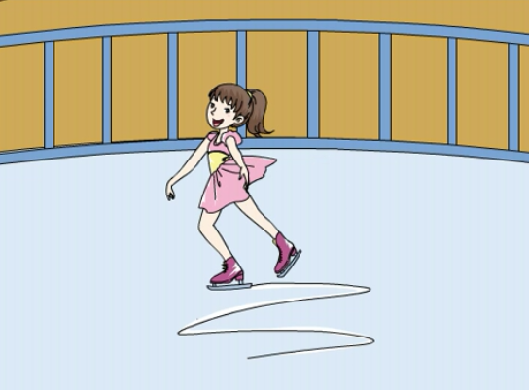
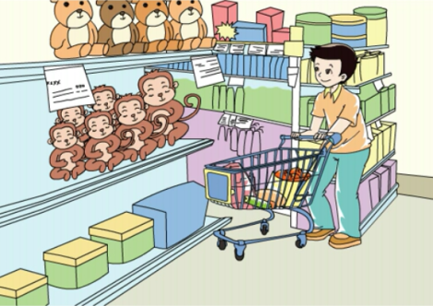
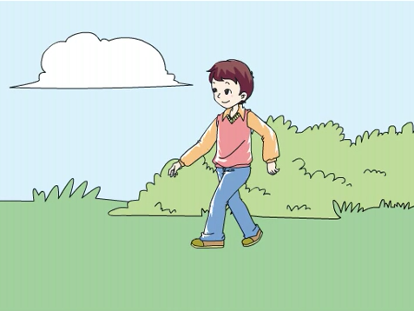
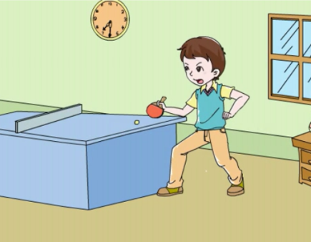
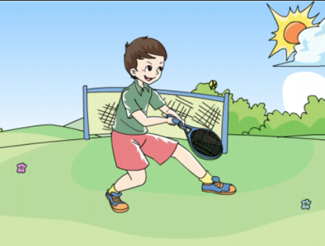
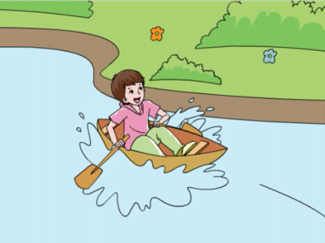
>>Warming-up
Quick response

Slide 3
>>Warming-up
Free talk
Do you often play sports?
What do you like to play?
How often do you play?

Slide 4
>>Presentation
Read and answer
The first reading!
Does the tiger often play sports?
No, He doesn’t.
Does the tiger eat fruits and vegetables every day?
No, He doesn’t.

Slide 5
>>Presentation
Read and answer
The first reading!
Does the tiger go to bed early every night?
No, He doesn’t.
Does the tiger look healthy?
Yes, he does.

Slide 6
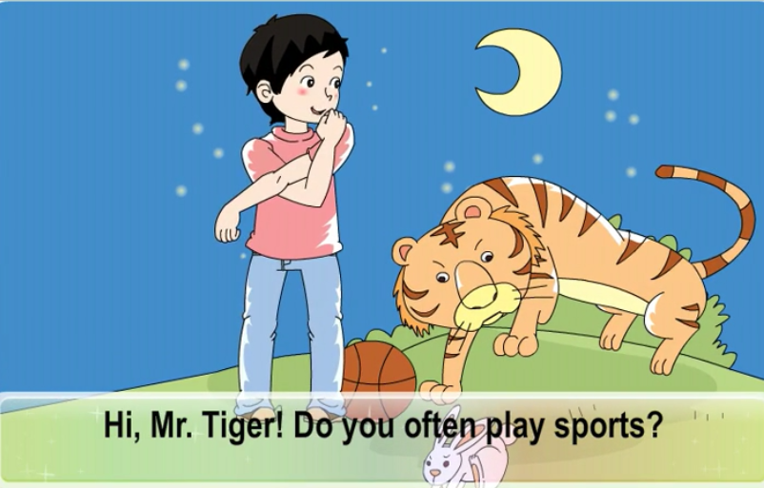
>>Presentation
Let’s watch

Slide 7
>>Presentation
Read and answer
The second reading!
What does the tiger often do?
He often run after small animals.
What does the tiger eat every day?
He eats meat every day.

Slide 8
>>Presentation
Read and answer
The second reading!
When does the tiger go to bed and get up?
He sleeps in the day and get up at night.
What does the boy’s mom say to him?
His mom says he should play sports, eat vegetables and go to bed early to keep
healthy.

Slide 9
>>Practice
Show time
小组合作，练习对话并表演，其他同学评价。
Pronunciation (语音) |  | Fluency (流利) | Cooperation (合作)
OK!
Great!
Super!

Slide 10
>>Practice
Read and tick
1. I like sports and I eat (good/well), so I am healthy.
2. —How often (do/does) your father go to work by car?
—Every day.
3. Peter eats a lot of ( health/healthy) food.
4. Kitty plays ping-pong with her father (two/twice) a
week.
5. We go (boat/boating) in the park once a month.

Slide 11
>>Practice
Read and talk
A: How often do you/does Colin play computer games?
B: I play/He plays it …
 | Play computer games | Go boating | Take a walk | Play ping-pong
You | once a week | twice a year | three times a month | every day
Colin | twice a week | once a year | every day | once a month

Slide 12
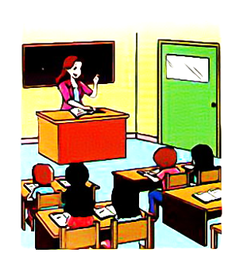
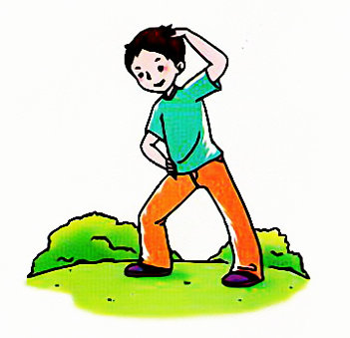
>>Practice
Look and write
I do exercise every
day.
I have English classes three times a week.
________________________________

Slide 13
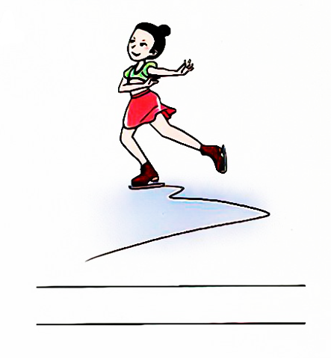
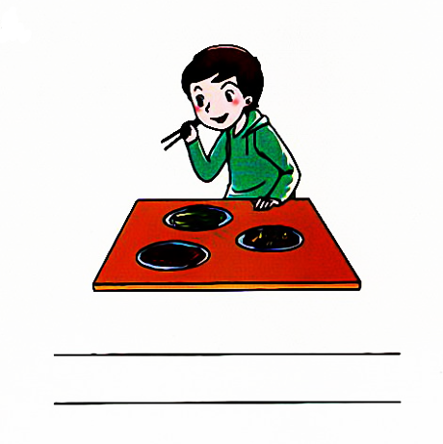
>>Practice
Look and write
I skate / go skating twice a week.
________________________________
________________________________
I eat vegetables every day.

Slide 14
>>Consolidation
Practice Activities
How Can I Keep Healthy?
Do you often eat fruits and vegetables?
How often do you drink milk?
How many hours do you sleep every night?
What sports do you like?
How often do you play sports?
Do you look healthy?

Slide 15
>>Homework
1.观看课文动 画，按照正确的语音、语调朗读课文对话。
2.根据本单元所学加上自己的见解，以“How
Can I keep healthy?” 为题写一篇。
3.预习“Unit3 Let’s learn”。
close

