Slide 1
Unit 1 Teachers’ Day
Were they active in class?
WWW.PPT818.COM

Slide 2
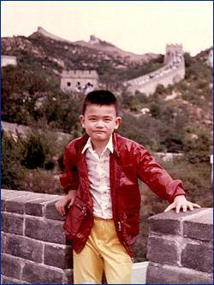
YaoMing
He was short then.
He was thin.

Slide 3
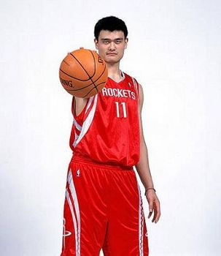
now
He is tall.
He is strong.

Slide 4
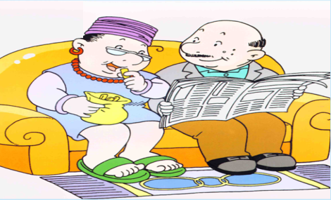
Now they are old.

Slide 5
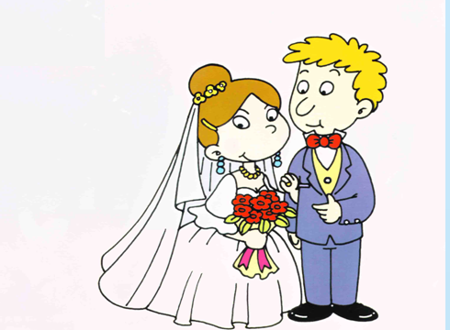
Then
They were young then.
were（are 的过去式）

Slide 6
Then Now
They were young then.
Now they are old.

Slide 7
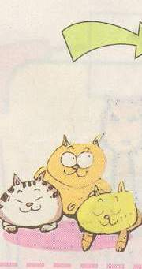
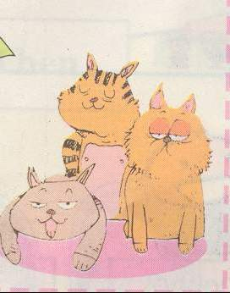
They were small then.
Now they are big.

Slide 8
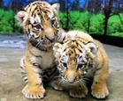
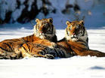
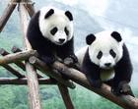
用were/ are说句子。
young
old
were
young then.
are
old.
They
Now they
small
big
were
are
They
small then.
Now they
big.

Slide 9
Let’s learn: 让我们学
were
pupil
ago
but
active 活跃的
naughty 淘气的
smart 聪明的

Slide 10
1. Who is back at school?
2. Were the boys active in class?
3. What do Mr Wang’s pupils say?
They are Mr Wang’s pupils.
Yes, they were.
Happy Teachers’ Day.

Slide 11
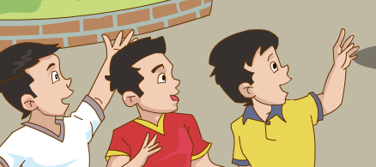
pupil
s

Slide 12
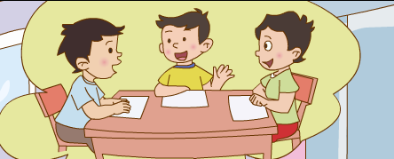
They were in his class
ten years ago.

Slide 13
Thank You

