Slide 1
Unit 3 We should obey the rules.
人教精通版英语五年级下册
WWW.PPT818.COM

Slide 2
>>Warm-up
Let’s chant

Slide 3
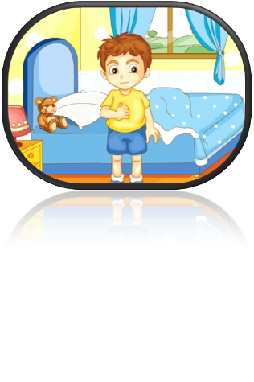
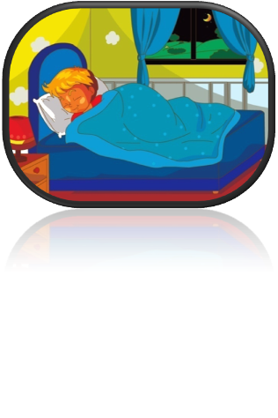
>>Lead-in
Review
do housework
get up
go to bed

Slide 4
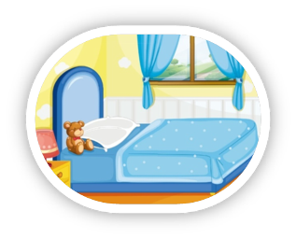
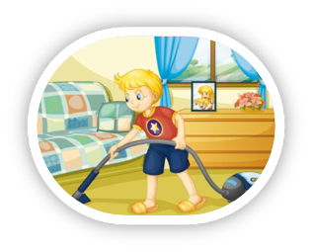
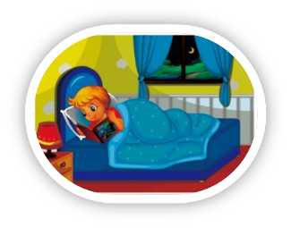
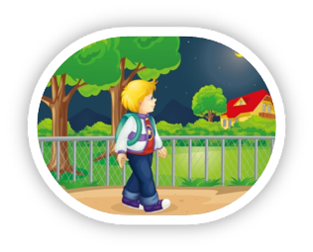
>>Lead-in
Review
keep your room clean
do housework
read in bed
go home late

Slide 5
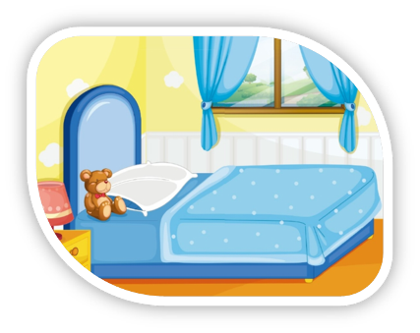
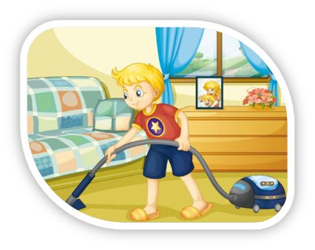
>>Practice
Just practice
You should…/You shouldn’t…

Slide 6
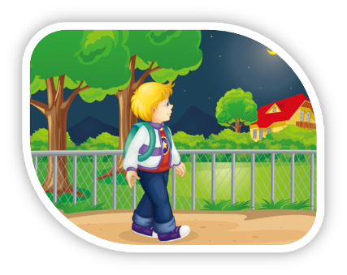
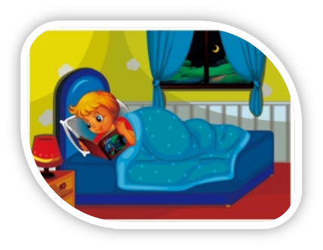
>>Practice
Just practice
You should…/You shouldn’t…

Slide 7
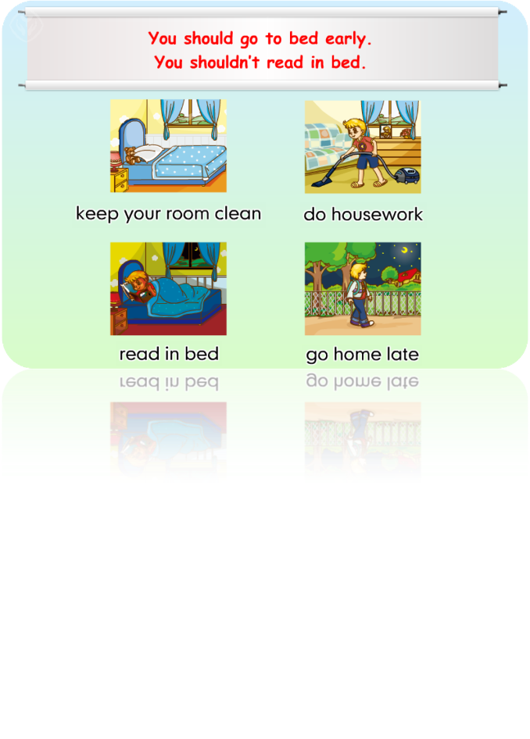
>>Practice
Just practice

Slide 8
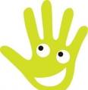
>>Practice
Just write
Can you write them?
go home
do housework
get up
go to bed

Slide 9
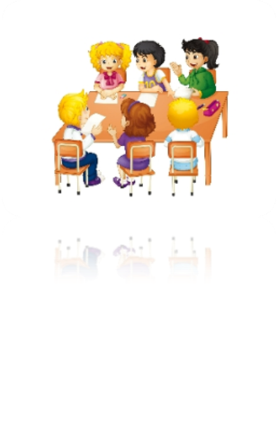
>>Practice
Let’s talk
We shouldn’t go home late.
We should keep our classroom clean.
We should…
We shouldn’t…

Slide 10
>>Practice
We should:
1. ____________________
2. ____________________
3. ____________________
We shouldn’t:
1. ____________________
2. ____________________
3. ____________________

Slide 11
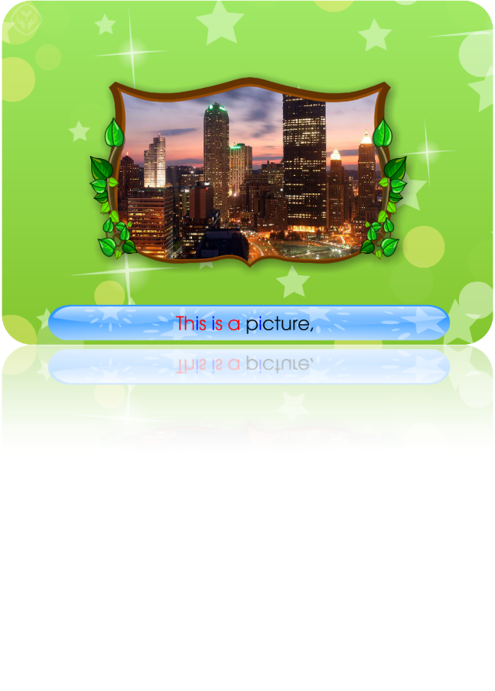
>>Presentation
Let’s chant

Slide 12
>>Summary
四会短语：
go home
do housework
get up
go to bed
如何表达应该和不应该做某事？
You should…
You shouldn’t…

Slide 13
>>Homework
1. 观看课文动画，按照正确的语音、语调朗读课文。
2 . 分别在两张卡片上写上在学校和在家应该和不应该做的事情，下节课分享。
3 . 预习Lesson17。
close

