Slide 1
Unit 6
When was it invented?
Section A (第2课时)
WWW.PPT818.COM

Slide 2
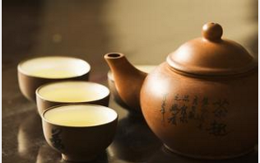
Warming up
Look at the pictures. Answer the questions.
1.Do you like drinking tea?
2.How was tea invented?

Slide 6
Read the passage quickly and match each paragraph with its main idea.
3a
Paragraph 1 Lu Yu and his book Cha Jing
Paragraph 2 How tea spread to other countries
Paragraph 3 How tea was invented by accident
An Accidental Invention
Did you know that tea, the most popular drink in the world (after water), was invented by accident? Many people believe that tea was first drunk about 5,000 years ago. It is said that a Chinese ruler called Shen Nong was the first to discover tea as a drink. One day Shen Nong was boiling drinking water over an open fire. Some leaves from a tea plant fell into the water and remained there for some time. It produced a nice smell so he tasted the brown water. It was quite delicious, and so, one of the world’s
favorite drinks was invented.

Slide 7
A few thousand years later, Lu Yu, “the saint of tea”, mentioned Shen Nong in his book Cha Jing. The book describes how tea plants were grown and used to make tea. It also discusses where the finest tea leaves were produced and what kinds of water were used.
It is believed that tea was brought to Korea and Japan during the 6th and 7th centuries. In England, tea didn’t appear until around 1660, but in less than 100 years, it had become the national drink. The tea trade from
China to Western countries took place in the 19th century. This helped to spread the popularity of tea and the tea plant to more places around the world. Even though many people now know about tea culture, the Chinese are without doubt the ones who best understand the nature of tea.

Slide 8
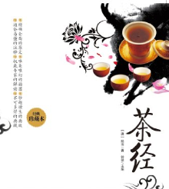
3b
Read the passage again and answer the questions.
1. When was tea first drunk?
2. How was tea invented?
3. Who is called “the saint of tea”?
4. What is Cha Jing about?
5. When was tea brought to other countries?
It was first drunk about 5,000 years ago.
While Shen Nong was boiling drinking water over an open fire,some leaves fell into the water,so tea was invented.
Lu Yu.
It's a book about tea.
During the 6th and 7th centuries.

Slide 9
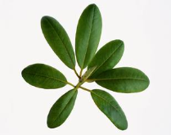
Complete the sentences with the correct forms of the verbs in the box.
3c
1. One of the world's favorite drinks was _______
by accident.
2. Tea was first ______ by Shen Nong 5, 000
years ago.
3. A nice smell was ________ when the tea leaves
dropped into the hot water.
4. Tea was ________ to Korea and Japan during
the 6th and 7th centuries.
5. Tea is now _______ between many different
countries.
invent
drink
bring
produce
trade
invented
drunk
produced
brought
traded

Slide 10
Language Points
1.by accident 偶然地，意外地
e.g.:The scientist died by accident suddenly.
2.smell 和 taste的用法
（1）n. smell味道（闻到的）；taste 味道，品味（尝起来的）
（2）vt. smell闻……；taste 品尝……
（3）连系动词 ：smell 闻起来；taste尝起来
e.g.:He smelt the fish.He felt the smell was bad,so he didn't taste it.

Slide 11
3.辨析happen和take place
(1)happen 发生（指突然发生）
e.g.:The earthquake happened suddenly.
（2）take place发生（指按计划发生）
e.g.:Big change took place in our town.
4.in the 19th century 在19世纪
in the +序数词+century表示“……世纪”
【拓展】in the 1980s 在20世纪80年代
5.without doubt毫无疑问
e.g.:He knows the truth without doubt.

Slide 12
Exercise
一、根据首字母提示补全单词填空。
1.He is b_____ water to make tea now.
2.Look! A few apples still r______ on the tree.Let's pick them now.
3.The chicken produces a nice s______.I want to eat it soon.
4.The old man is n______ 90 years old,but he is very strong.
oiling
emain
mell
early

Slide 13
二、单项选择。
( )1.Australian Open Tennis Championship（澳网公开赛）______ in January,2014.
A.happened B.took place
C.held D.was helding
( )2.It’s said that tea was invented _____.
A.by accident B.sudden C.at last D.for Chinese
( )3.A rabbit______ the hole and couldn't come out.
A.fell into B.fell off C.fell down D.fell
( )4.He won't come back_____ midnight.
A.at B.from C.until D.since
B
A
A
C

Slide 14
Homework
1.Learn and remember the new words and useful phrases by heart.
2.Retell the text according to the key words.

Slide 15
Thank you!

