Slide 1
Unit 7
Seasons
Grammar 2
WWW.PPT818.COM

Slide 2
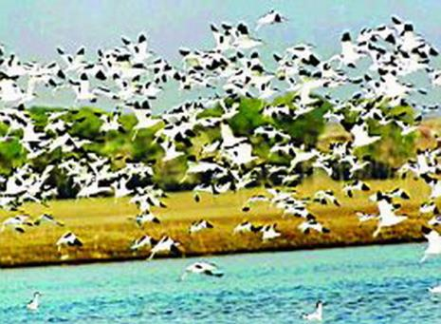
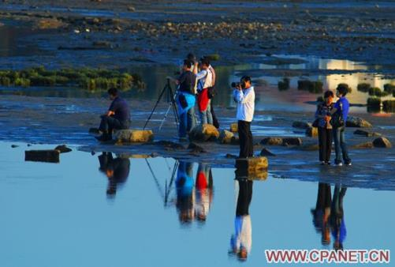
Birdwatching
1.
Zhalong looks beautiful.
We can see many birds.
Some people are watching birds.
They are birdwatchers.
Birdwatching is interesting.
S
V
P
2.
S
V
O
3.
S
V
O
4.
S
V
P
5.
S
V
P

Slide 3
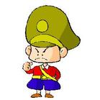
a keeper
A logical subject-predicate relations
逻辑上的主谓关系
We call the man ‘keeper’.
S
V
DO
OC(宾补)
Object Complement
I make him angry.
V
OC
S
DO
He tells us to protect the birds
S
V
DO
OC

Slide 4
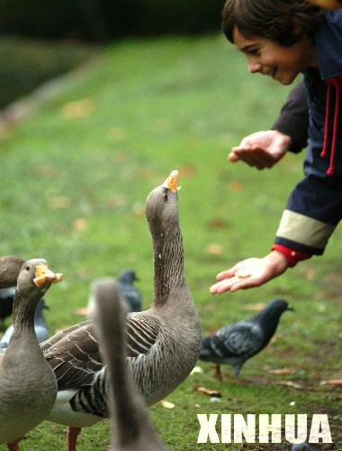
show buy pass send bring make teach …
sb.
Sth.
we shouldn’t give any food.
the birds
S
V
IO(间接宾语)
DO
Indirect Object
He tells me some rules.
S
V
IO
DO

Slide 5
Zhalong gives
birds
an ideal home
to
IO
DO
I pass
him
a book
to
IO
DO
He bought
his son
for
a present.
IO
DO

Slide 6
Play a game
eg:
He gave me a book.
+
IO
DO
He calls me Tom.
+
DO
OC
1.Lily brings me a present.
+
IO
DO
2. People call Zhalong Birds’ Home.
+
DO
OC
+
3.I found it important.
DO
OC
4.Zhalong brings the wildlife an ideal home.
+
IO
DO
5. We call the panda XiWang.
+
DO
OC
6.She thought the swan beautiful.
+
DO
OC

Slide 7
S
+
V
Sentence structures
1.
S
+
V
+
O
2.
S
+
V
+
P
3.
S
+
V
+
+
DO
4.
IO
S
+
V
+
DO
OC
5.
+

Slide 8
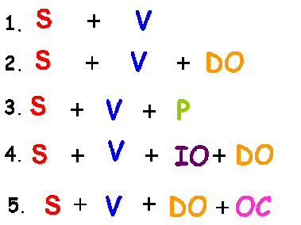
They are watching TV.
Many boys are running.
He gave Tom a present.
I find it interesting.
eg:
Music sounds beautiful.
I feel excited.
I am a student.
She bought a pen for me.
I saw her dance.

Slide 9
A weather diary
The clouds became dark. They covered the sun.
Luckily, it didn’t rain.
Mum and Dad gave me nice presents, but I was
not happy. I hate rainy days.
The sun was shining. I saw some kids
kicking the ball in the park.
S
V
P
S
V
O
S
V
V
DO
IO
S
V
S
P
S
V
O
S
V
S
V
DO
OC

Slide 10
Thank you!

