Slide 1
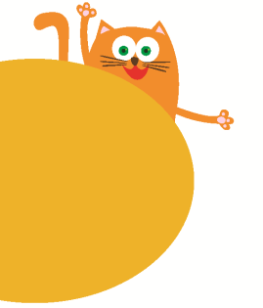
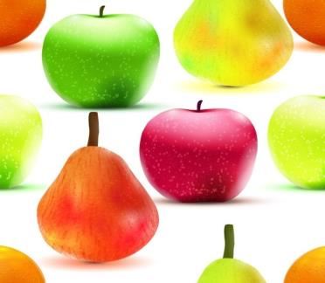
Tastes
2
第三课时
WWW.PPT818.COM

Slide 2
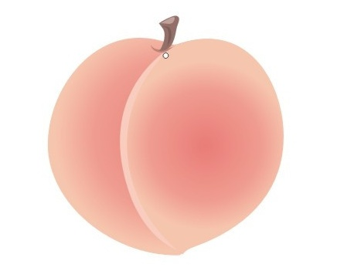
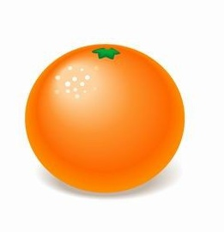
Look and spell

Slide 3
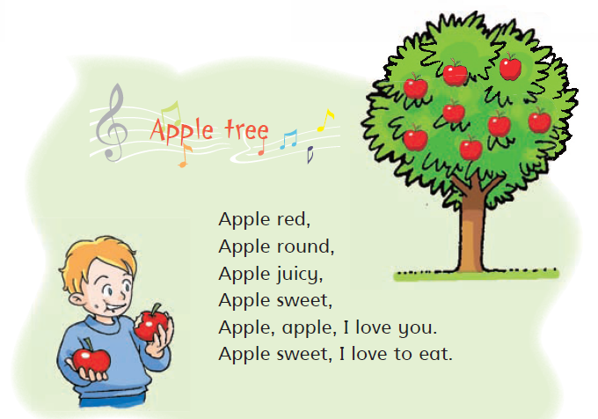

Slide 4
Ask and answer
What is it?
It is an apple.
How is the apple?
It is red.
It is round.
It is sweet.
It is juicy.

Slide 5
Ask and answer
What is it?
How is …?

Slide 7
Read and guess

Slide 8
Read and guess

Slide 9
Read and guess

Slide 10
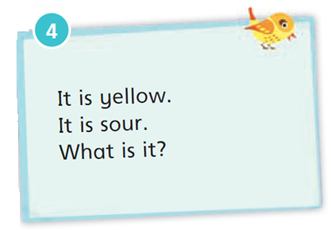
Read and guess

Slide 11
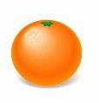
Read aloud

Slide 12
Read aloud

Slide 13
Read aloud

Slide 14
Read aloud

Slide 15
Read aloud

Slide 16
Read aloud

Slide 17
Read and guess
1
2
3

Slide 18
Read and guess
1
It is green.
It is big and round.
It is sweet.
What is it?

Slide 19
Read and guess
2
It is brown.
It is sweet.
It is not cold.
It is not hot.
It is not a fruit.

Slide 20
Read and guess
3
It is long.
It is sweet.
It is cold.
We eat it in summer.

Slide 21
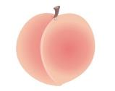
Make a riddle
It is …
It is …
It is …
What is it?

Slide 22
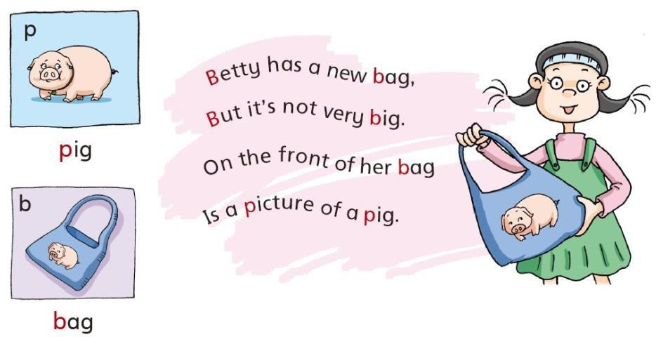
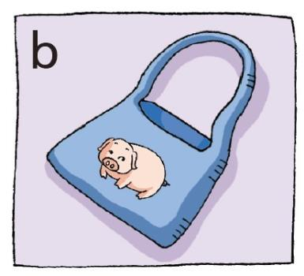
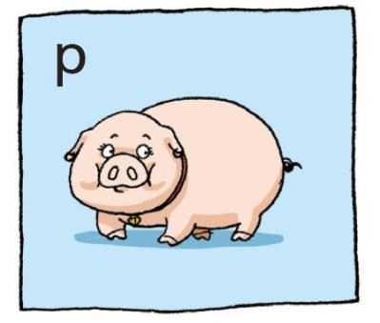

Slide 23
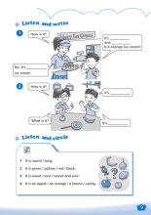
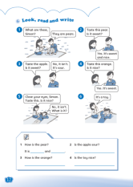
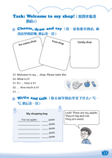
Homework
Read and act Look and read.
Recite Listen and say.
Complete Workbook pages 9, 12 and 13.
4 Make a riddle about food.

