Slide 1
Unit1 It' s so beautiful!
WWW.PPT818.COM

Slide 2


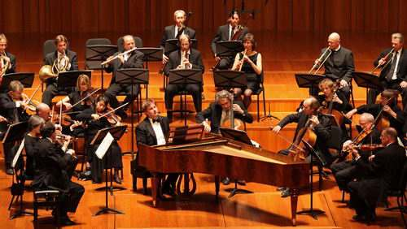
What music do you like?
traditional Western music
传统西方音乐
I like traditional Western music.

Slide 3
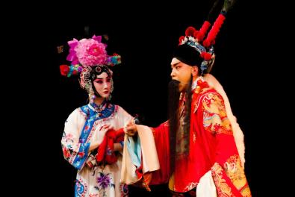
What music do you like?
Beijing Opera
京剧
I like Beijing Opera.

Slide 4
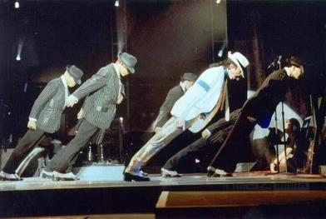
What music do you like?
pop music
流行音乐
I like pop music.

Slide 5
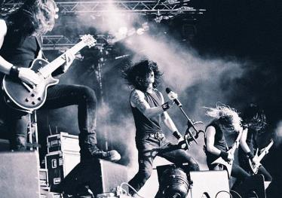
What music do you like?
rock music
摇滚乐
I like rock music.

Slide 6

1
Listen and number the words as you hear them.
adj.活泼的，轻快的
1
2
adj. 现代的
adj. 吵闹的
4
lively modern music noisy pop
rock sound violin Western
7
5
1
9
8
6
6
3
4
2
n. 声音
n. 小提琴

Slide 7

Match the music with the people.
Tony
rock music
Tony’s dad
pop music
traditional Western music
Tony’s mum

Slide 8
2
Work in pairs. Answer the questions about the conversation in Activity 1.
1. Which modern music does Tony like?
He likes pop and rock music.
2. What does Tony’s mum think about rock music?
It’s lively.

Slide 9
3. Why doesn’t Tony like traditional Western music?
It’s too slow.
4. Which music does Tony’s dad think is too noisy?
He thinks pop music is too noisy.
Now listen again and check.

Slide 10
3
Listen and read.
(The blue Danube)
Daming: Hmm, this is Western music, isn’t it? Can you hear the violin and the piano? It’s so beautiful! Is this by Strauss or Mozart?
Lingling : I’m not sure…
Betty : It’s by Strauss. L love his music! Do you know anything about him, Tony?
Tony: Was he German?

Slide 11
Betty: No, he was born in Vienna, the capital of Austria. What a beautiful city! This is called The Blue Danube. The Danube is a river in Europe. It goes through Vienna.
Lingling : Do you like traditional Western music or pop music, Betty?
Betty : Well, I like both. You listen to pop music, Lingling, don't you?
Lingling: Yes, I do. I also like Bejing Opera. Listen to this fantastic voice.
n. 声音

Slide 12
Tony: Hmm, the sound is very...different, isn’t it? I’m a fan of rock music. Listen to this?
Daming: Hey! Give us a break!
Lingling: Rock music? Listen to those drums!
Daming: It’s so noisy! And much too fast!
Tony: You don’t like rock music? I don’t believe it!
n. 鼓
v. 相信

Slide 13
Now check (√) the true sentences.
1
2
1. They’re listening to Western music.
2. Tony knows little about Strauss.
3. Strauss was born in the capital of Australia.
4. The Blue Danube is pop music.
5. Lingling enjoys Beijing opera very much.
√
4
√
6
√

Slide 14
4
Check (√) the types of music the students like.
Name
 | Tony | Lingling | Betty | Daming
Traditional Western music
Beijing Opera
pop
rock
Music
√
√
√
√
√
√

Slide 15
Now work in pairs. Ask and answer the questions.
1. Where was Strauss born?
He was born in Vienna, the capital of Austria.
2. Does Betty like pop music?
Yes, she does.
3. Does Daming like rock music?
No, he doesn’t.

Slide 16
[观察1] Hmm, the sound is very…different, isn't it?
嗯，这声音非常……不同，不是吗？
Sound travels at 340 metres per second in air.
声音以每秒340米的速度在空气中传播。
[探究] sound作名词时，泛指听到的“声音”。

Slide 17
[辨析] sound, voice与noise
sound | 泛指人们听到的“声音”，可以指人或动物的声音，也可指物体碰撞发出的声音或大自然的任何声音。例如： Light goes faster than sound. 光比声音传播得快。
voice | 指人的嗓音、人说话、唱歌时发出的声音或鸟叫声。例如：They talked in a loud voice. 他们高声谈话。
noise | 通常指不悦耳、不和谐的嘈杂声。例如： Don't make any noise here. 不要在这里制造任何噪声。

Slide 18
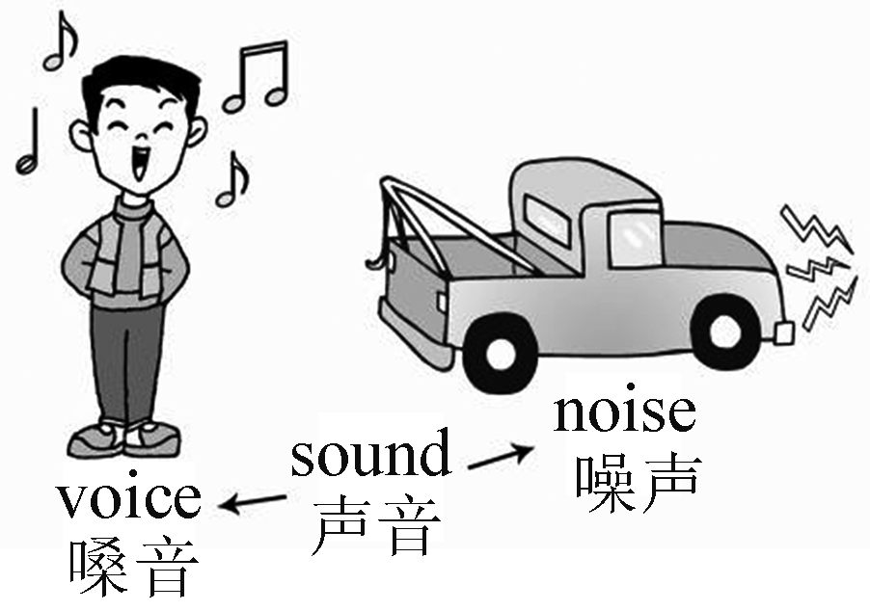
[图解助记]

Slide 19
活学活用
1．用voice, sound或noise填空
(1)The woman spoke in a very loud________.
(2)At midnight the girl heard a strange________.
(3)Don’t make any________！It's time for class!
voice
sound
noise

Slide 20
[观察2] The Danube goes through Vienna. 多瑙河流经维也纳。
The sunlight shines in through the glass. 阳光透过玻璃照进来。
[探究] through常与________，walk等动词连用，表示“穿过”。
go

Slide 21
[辨析] through, across, over与past
through | 意为“穿过，通过”，强调从内部空间穿过。例如： There is a river running through the city. 有一条河流经这座城市。
across | 意为“穿过”， 强调从某个平面的一边到另一边。例如： Walk across the street, and you'll see it. 穿过这条街，你就会看到它。
over | 意为“越过，跨越”，强调从某物的正上方跨越。例如： The cat jumps over the wall to play every day. 这只猫每天跳过墙去玩。
past | 意为“经过，超过”，强调从某人或某物的旁边经过。例如：He is walking past the post office. 他正从邮局旁边走过。

Slide 22
[图解助记]

Slide 23
活学活用
2．(1)2019·凉山—Look，there is a cute bird, Mum.
—It flew into our kitchen(厨房) ________ the window just now, Alex.
A．across B．through C．above D．under
B

Slide 24
(2)—Excuse me. Where is the bookstore?
—Go ________ the bridge, and you'll see it on your left.
A．on B．cross C．across D．through
C

Slide 25
[观察3] Well, I like both. 哦，两者我都喜欢。
Both of them are my good friends.
他们两个都是我的好朋友。
Both of the boys are asleep.
这两个男孩都睡着了。

Slide 26
[探究] both作代词，表示“两个；两者”，常与介词________连用，后接名词或代词的________形式，名词前加the或形容词性物主代词。例如：
Both of his daughters are doctors.
他的两个女儿都是医生。
复数
of

Slide 27
[拓展] (1)both也可作形容词，直接修饰名词，其后不加of。例如：
Both children won prizes. 两个孩子都得了奖。
(2)both 还可以作连词，常用词组为both…and…， 意为“……和……都……”，连接两个并列主语时，谓语动词用复数形式。 例如：
Both my friend and I like playing basketball.
我和我的朋友都喜欢打篮球。

Slide 28
(3)both 是具有肯定意义的词，与not连用时表示部分否定，意为“两者不都……”。neither…nor…表示完全否定，连接两个并列主语时，谓语动词的形式遵循“就近原则”，即谓语动词与离它最近的主语在数上保持一致。例如：
Daming and Tony don’t both like skiing.
大明和托尼不都喜欢滑雪。(有一人不喜欢)
Neither Daming nor Tony likes skiing.
大明和托尼都不喜欢滑雪。

Slide 29
(4)both和all的区别：both 意为“(两者)都”； all 意为“(三者或三者以上人或物)都”。

Slide 30
活学活用
3．(1)单项填空
2018·长春 Dumplings are very delicious.________ of my parents like them.
A．All B．Both
C．None D．Neither
B

Slide 31
(2)同义句转换
Lily and Lucy both live in New York.
________ Lily ________ Lucy live in New York.
(3)用所给单词的适当形式填空
①Both Mary and Tom________ (be) clever.
②Neither Mary nor Tom ________ (be) clever.
③Either my brother or my parents ________ (be) leaving for Beijing.
Both
and
are
is
are

Slide 32
[观察4] …this is Western music, isn’t it?
……这是西方音乐，不是吗？
[探究]本句是反意疑问句，由陈述句加简短的疑问句构成。反意疑问句遵循“前肯后否，前否后肯”的原则。例如：
Becky can play the violin, can’t she?
贝姬会拉小提琴， 不是吗？
He doesn’t like music, does he?
他不喜欢音乐，是吗？

Slide 33
活学活用
2018·黔南 He has few friends in his new school, ________？
A．hasn’t he B．does he
C．is he D．doesn’t he
B

Slide 34
5
Complete the sentences with the correct form of the words from the box.
believe, both, drum, German, noisy, voice
Strauss wasn’t _________. He came from Austria.
Daming thinks the _______ in rock music are too ________.
3. Tony can’t _________ that Daming doesn’t like rock music.
4. Betty likes ______ traditional Western music and pop music.
5. Tony thinks the sound of the ________ in Beijing opera is very different.
German
drums
noisy
believe
both
voice

Slide 35

6
Complete the sentences about yourself.
1. My favorite music is ...
2. I like it because ...
3. My parents like ...

Slide 36
7
Listen and read.
1. What a beautiful city!
2. It’s so beautiful!
3. I love his music!
4. Listen to this!

Slide 37
8
Work in pairs. Ask and answer questions about the music you like or don’t like.
— What music do you like?
— I like pop. It’s lively and good to dance to, but I don’t like rock. It’s too noisy. What about you?

Slide 38
Exercise
根据句意及首字母提示补全单词
1.My father and my mother are b________ teachers. But they don't teach in the same school.
2.Many young people like W________ food like KFC very much.
oth
estern

Slide 39
3.Shanghai is a m________ city, and there are many tall buildings and cars.
4.Don't speak in a loud v________ in the reading room.
5.Basketball is very p________ in the US.
odern
oice
oplar

