Slide 1
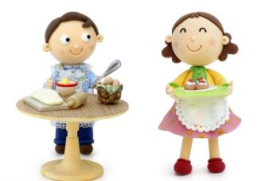
Unit 7 Topic 2
I’m not sure whether
I can cook it well.
Section B
WWW.PPT818.COM

Slide 2
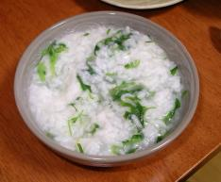
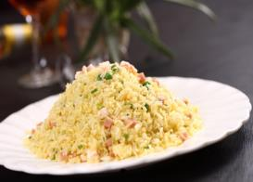
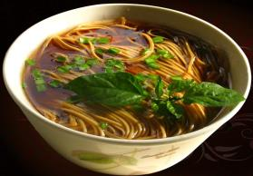
Who can tell me how to cook
porridge/fried rice/noodles ?
I can tell you how to cook ...
First, …
Next, …
Then, …
After that, ...
Finally, …

Slide 3
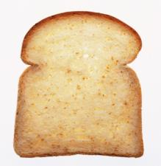
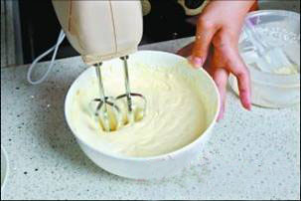
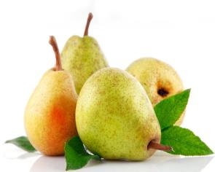
a piece of bread
n.一块（片、张、件......）
butter
n. 黄油
pear
n. 梨

Slide 4
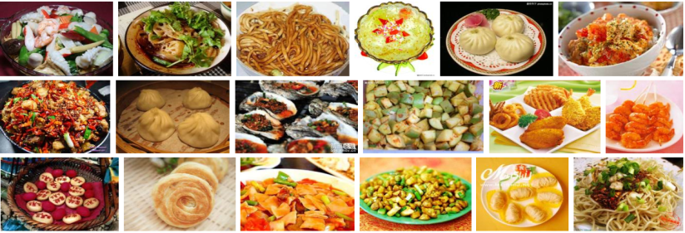
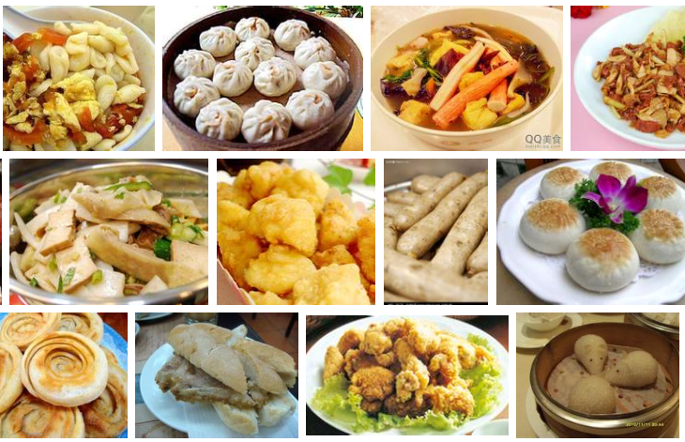
snack
n.小吃

Slide 5
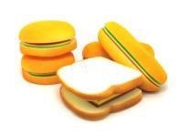
Do you know how to make a sandwich
with some bread and a pear?
First, take two pieces of bread and spread butter on them.
Next, cut a pear into small pieces carefully.
Then put them on the bread lightly.
After that, put some honey over the pear slowly.
Finally, put the pieces of bread together.

Slide 6
Key points of 1a
1.Would you mind if we learn to make it from you ?
我们向你学习做它（三明治）好吗？
（1）Would you mind if...请求允许或客气地请某人做某事。
E.g:我打开窗户好吗？
Would you mind if I open the window?
（2）learn to do sth.from sb. 向某人学习做某事
E.g:他向他父亲学习下棋。
He learns to play chess from his father.
2. ...,you did quite well.你做得非常好。
But I think you did better than I.但是我认为你做得比我更好。
Michael did best of all.迈克尔是所有人中做得最好的。
这三个句子中的well,better,best都是副词，作动词did的状语。
better,best分别是well的比较级和最高级形式。
3.Practice makes perfect.
熟能生巧。

Slide 7
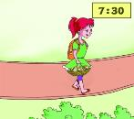
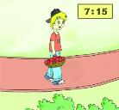
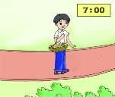
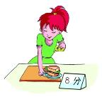
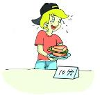
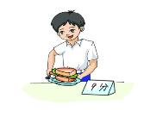
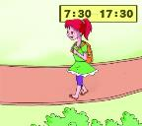
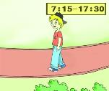
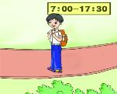
Look at the pictures and match the parts of the sentences.
2
Michael arrives early.
Kangkang arrives earlier.
Jane arrives earliest.
Michael cooks well.
Kangkang cooks better.
Jane cooks best.
Michael stays long.
Kangkang stays longer.
Jane stays longest.

Slide 8
1b
Listen to 1a and fill in the blanks.
Favorite snack:_____________
Ingredients:1.bread 2._________ 3. pear 4.__________
Process: ______,take two pieces of bread and put some butter on them.
Next, cut a pear into small pieces __________.
______, put them on the bread __________.
After that, put some honey over pear __________.
______,put the pieces of bread together.
a sandwich
butter
honey
First
carefully
Then
lightly
slowly
Finally

Slide 9
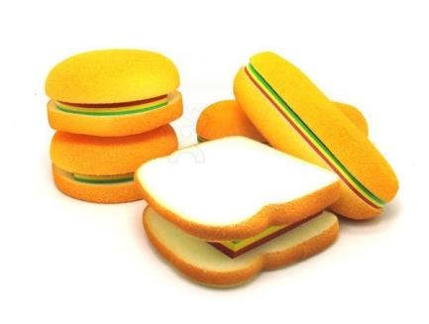
1c
Read 1a and retell the process of making a sandwich, using first, next, then...based on 1b.

Slide 10
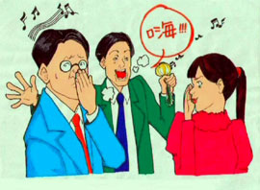
polite
adj.有礼貌的，有教养的
impolite
adj. 不礼貌的， 粗鲁的

Slide 11
noisily
adv. 喧闹地
E.g.：In Japan, it's polite to eat soup noisily.
在日本，大声地喝汤是礼貌的。

Slide 12
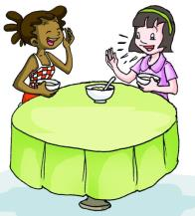
3
Listen and number the sentences to form a conversation.Then practice with your partner.
7
( ) OK,let me try.(Slurp!)
( ) Well,in Cuba,it's impolite to eat so noisily.I don't know if it is
polite in Japan.
( ) OK. Mm, it's delicious. (Slurp!)
( ) Not bad,Maria.
( ) Kumiko,is it too hot?
( ) Come on,Kumiko!Help yourself to some soup.
( ) No.Why?
( ) Oh.In Japan,it's polite to do that.It means you like the food
very much.
5
2
8
3
1
4
6

Slide 13
If/whether引导的宾语从句
◆I don't know if it is polite in Japan.
我不知道在日本这样是否礼貌。
这是由if引导的宾语从句，if意为“是否”，不能省略。
if和whether 都可以引导宾语从句，意为“是否”，两者通常能互换，但不可省略。从句表一般疑问的意义。
E.g:我不能确定是否有不明飞行物。
I'm not sure if there are UFOs.
◆Understand the following sentences：
1. I don’t know if/whether I need to obey all the rules while I’m having dinner with my friends.
2. Could you tell me if/whether it’s polite to speak loudly at the table?
3. I don’t know if/whether you are right.

Slide 14
Project
Compare the following things with your friends, then make a report after the example.
go to school/do one's homework/play basketball/run/cook/... (early/well/fast...)
Example:
Wang Gang and I are good friends.I go to school earlier than he.But he does his homework better than I. ...

Slide 15
4a
Read the pairs of words aloud,paying attention to the sounds of the underlined letters.Then listen and try to imitate.
cheap——jeep chain——Jane
cheer——jeer choose——juice

Slide 16
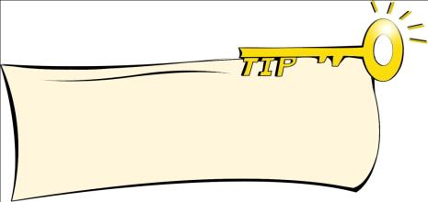
4b
Listen and read the conversation,paying attention to the intonation and pause.Then practice with your partner.
When you describe more than one step,you often use rising tone for such words as first,second before you come to the end.
A:Would you like to tell me how to cook the meal?
B:Sure.What do you want to learn?
A:Could you teach me how to make fried rice?
B:Yes,it's easy.First,cut some cooked meat very finely.Next,put some oil in the pan.Then fry the meat lightly.After that,add the rice slowly and fry it for a few minutes.Finally,add some salt.
A:Yeah! Cooking is fun!

Slide 17
Exercises in class
单项选择。
( ) 1. I don’t know ____ he is right .
A. that B. what C. if
( ) 2. Which one goes ____, the car, the train or the plane?
A. fast B. faster C. fastest
( ) 3. I would like a sandwich_______ honey.
A. for B. with C. of
( ) 4. It's polite______ up your hand before answering the questions.
A. put B. putting C. to put
( ) 5. ---Would you mind if I learn English from you?
---__________. I am very glad to teach you.
A. Of course not. B. You’d better not. C. Sounds great.
C
C
B
C
A

Slide 18
Summary
We learn:
1. Some new words:
snack,butter,pear,piece,slurp,impolite,noisily,polite
2.The comparative and superlative degrees of
monosyllabic adverbs:
You did quite well.
But I think you did better than I.
Michael did best of all.
3.Object clauses with if/whether:
I don't know if it is polite in Japan.
We can:
1.Ask for permission:
Would you mind if we learn to make it from you?
2.Make sandwich step by step.

Slide 19
Homework
1.Make a sandwich or a hamburger.
2.Read 1a and try to retell it.
3.Finish Section B in your workbook.
4.Preview Section C.

