Slide 1
Unit4 Natural Disasters
Section Ⅱ Reading and Thinking(1)
WWW.PPT818.COM

Slide 2
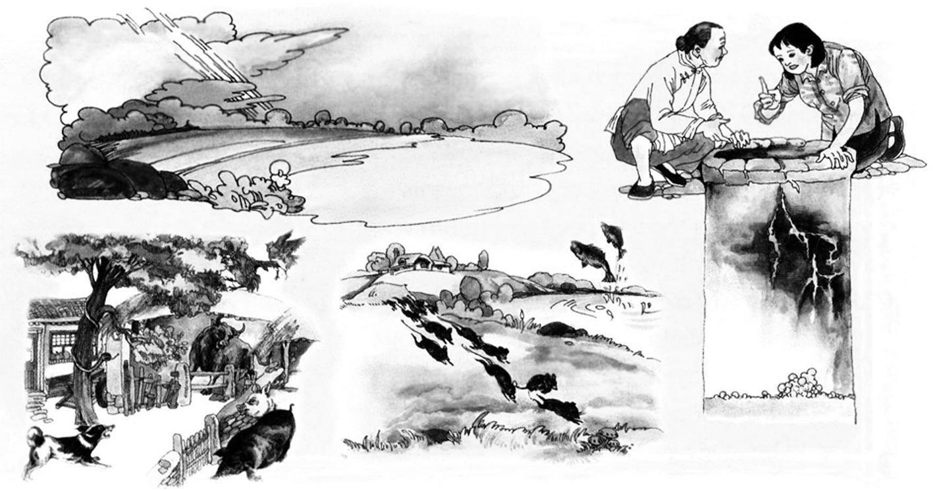
1.Discussing—What do you think may happen before an earthquake?

Slide 3
Bright lights in the sky may appear.
Animals may be too nervous to eat.
Mice may run out of holes looking for places to hide.
Fish may jump out of their pools and ponds.
Well walls may have deep cracks.
________________________________________________________________________
________________________________________________________________________
________________________________________________________________________
________________________________________________________________________
________________________________________________________________________
2.Predicting—Look at the title and the picture and predict what the text is probably about.
A terrible earthquake is likely to happen.
________________________________________________________________________

Slide 4
1.First reading—Match the main idea with each paragraph.
Para.1 A.The earthquake caused unbelievable destruction to Tangshan.
Para.2 B.The earthquake happened and caused deaths and injuries in Tangshan.
Para.3 C.Help came soon after the quakes.
Para.4 D.Strange things happened，but no one paid attention to them.
Para.5 E.Tangshan came back to life again.
答案 Para.1 D Para.2 B Para.3 A Para.4 C Para.5 E

Slide 5
2.Second reading—Choose the best answer according to the text.
(1)When did the earthquake happen?
A.At night on July 28，1976. B.On the morning of July 28，1976.
C.On the afternoon of July 28，1976. D.The writer didn’t tell us.
(2)How many people who lived there were dead or injured?
A.A half. B.Two thirds.
C.One third. D.The text didn’t tell us.

Slide 6
(3)What does the sentence “Slowly，the city began to breathe again.” mean?
A.The city will not die; it has hope and it can recover from the pain.
B.The army sent 150，000 soldiers to Tangshan to help people.
C.Hundreds of thousands of people were helped.
D.Most of the 10，000 miners were rescued.
答案 (1)B (2)B (3)A

Slide 7
3.Third reading—Fill in the blanks according to the text.
Tangshan Earthquake
Before the earthquake | ·The water in the village wells ①____________ and fell again and again. ·Animals in the farmyards became too ②__________ to eat.
During the earthquake | At 3：42 am everything began to ③____________. And hard hills of rock became rivers of ④____________.
Damages of the earthquake | Over 400，000 people were killed or ⑤____________ in the earthquake. And nearly everything was ⑥____________.
rose
nervous
shake
dirt
injured
destroyed

Slide 8
The help from the whole nation | Soldiers dug out those who were ⑦____________ and buried the dead. Medical workers came to provide medical ⑧____________. Workers built ⑨____________ for survivors.
The great success people have achieved | The new city has taken on a new look, with great ⑩____________ in transportation, industry, and environment.
trapped
care
shelters
improvements

Slide 9
1.Compared with Wenchuan Earthquake，why did Tangshan Earthquake cause such great losses?
__________________________________________________________________________
__________________________________________________________________________
__________________________________________________________________________
2.Imagine the room begins to shake and you must leave it right away.You have time to take only one thing.What will you take? Why?
________________________________________________________________________
3.Group work：Make a poster about earthquakes in groups.
________________________________________________________________________
People took no notice of the signs before the earthquake./People thought little of the earthquake./People didn’t make good preparations for the earthquake./They lack knowledge about how to survive the earthquake./The buildings were not strong enough to resist...
The answer is open.
The answer is open.

Slide 10
阅读技巧点拨
怎样理清文章的篇章结构？
阅读一篇文章，首先要知道这篇文章是围绕什么而展开的、是怎样展开的，这就是文章的篇章结构问题。理清文章和段落的组织结构有助于我们更加清晰地把握文章的脉络，理解作者的观点在文章中是如何提出、展开的。理清了文章结构不但可以帮助我们理解和记忆文章的主要信息，还可以帮助我们极大地提高阅读效率。学会有选择地阅读，哪些语句可以跳读、粗读，哪些语句需要精读、细读。
本篇文章结构：____________结构；文章是以____________组织的。
分总
时间顺序

Slide 11
语言现象感知
Ⅰ.单词理解
体会句中加黑单词的词性和含义
1.He was bleeding from the head and suffering from shock.____________
2.His glasses were buried under a pile of papers. ____________
n.休克
vt.掩埋

Slide 12
Ⅱ.词块积累
写出下列词块的含义
1.tens of thousands of____________
2.bury the dead____________
3.the rest of the world ____________
4.in the well walls____________
5.as usual____________
6.look for places to hide ____________
7.get up on one’s feet____________
8.become a home to_______________
成千上万的
埋葬死者
世界其他地方
在井壁上
和往常一样
寻找藏身之处
站起来
成为……的家园

Slide 13
Ⅲ.句式欣赏
1.同词重复表强调
For several days the water in the village wells rose and fell，rose and fell.
2.everywhere用作连词，引导状语从句。
Everywhere survivors looked，there was nothing but ruins.
3.把无生命的事物当作有生命的事物来描写，这种方法叫做拟人。
Slowly，the city began to breathe again.
[思考] 请你在文中找出类似的拟人句：
_______________________________________________________________________
The city began to revive itself and get up on its feet again.

