Slide 1
Unit6 I like hamburgers.
人教精通版三年级上册
WWW.PPT818.COM

Slide 2
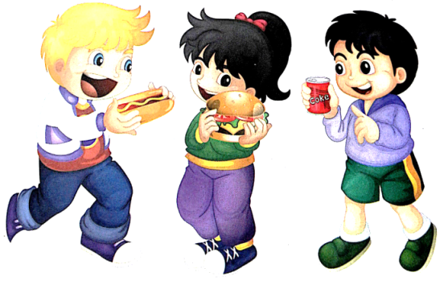
Review
Let’s chant
I like hot dogs. Yummy, yummy, yummy!
I like hamburgers. Yummy, yummy, yummy!
I like Coke. Yummy, yummy, yummy!

Slide 3
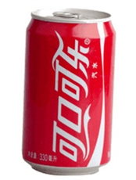
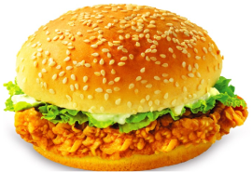
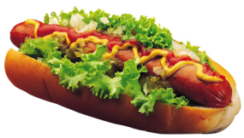
Review
Match and say
I like …
Coke
hamburger
hot dog

Slide 4
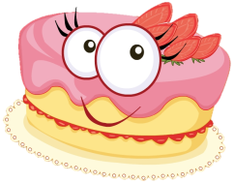
Presentation
Just learn
a
cake
cakes

Slide 5
Presentation
Just learn
an
egg
eggs

Slide 6
Presentation
Just learn
an
orange
oranges

Slide 7
Practice
Game 1
大小声
hamburger
hot dog
Coke
cake
egg
orange

Slide 8
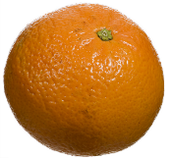
Practice
Game 2
What’s missing?

Slide 9
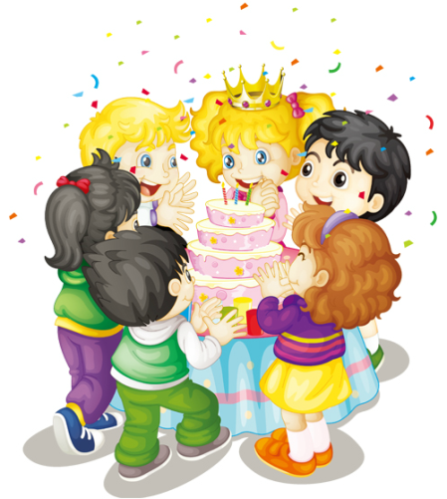
Presentation
Listen and say
Listen! What are they talking about?

Slide 10
Presentation
Look and say
Here’s a letter for you.
Thank you!

Slide 11
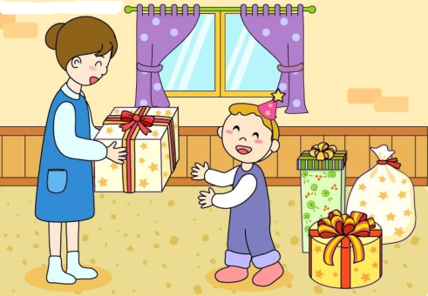
Presentation
Look and say
Here’s a present for you.
Thank you!

Slide 12
Presentation
Look and say
Here’s a book for you.
Thank you!

Slide 13
Presentation
Listen and imitate
Hi, Kate! Here’s a cake for you!
Oh, thank you!
Happy birthday!
Happy birthday!

Slide 14
Practice
Let’s read
1
2
3
Read together.
(齐读)
Read in roles.
（分角色读）
Read in groups.
(分组读）

Slide 15
Show time
四人一组试着练习对话并表演，其他同学评价。
 | 模仿录音中的语音语调，有感情地朗读。
 | 可以脱离课本，适当改动其中部分，语音地道。
 | 适当添加内容，意思完整，有创新，表演生动。
Good
Great
Excellent

Slide 16
Practice
Let’s sing

Slide 17
Summary
本课学习的食物类的单词有:
cake
egg
orange

Slide 18
Summary
送别人礼物时，应说：
Here’s … for you.
祝福别人生日快乐时，应说：
Happy birthday!

Slide 19
Homework
1.观看或跟读Just talk部分的课文动画或录音，并注意语音、语调。
2.学唱本课Let’s sing部分的英文歌曲，并唱给你的父母听。
3. 预习Lesson33。
Close

