Slide 1
Unit2 There are forty students in our class.
人教精通版四年级下册
WWW.PPT818.COM

Slide 2
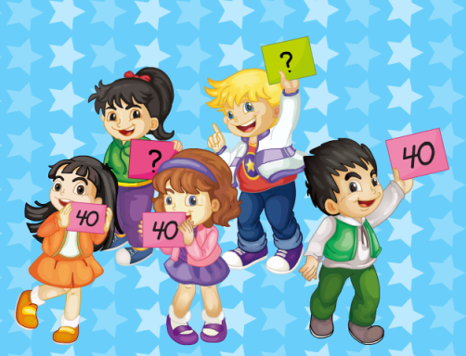
Warm-up
Let’s chant
（单击图片可播放动画）

Slide 3
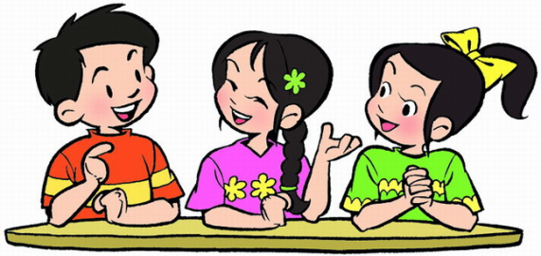
Lead-in
Free talk
How many teachers are there in our
school?

Slide 4
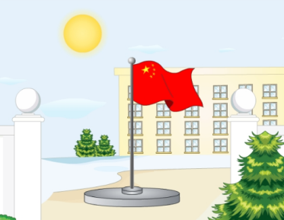
Presentation
Let’s learn
teacher
school

Slide 5
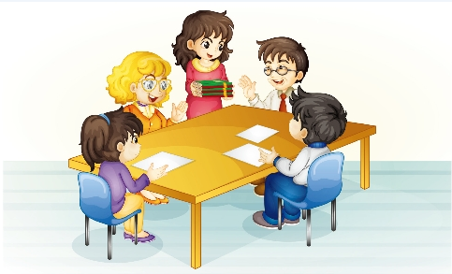
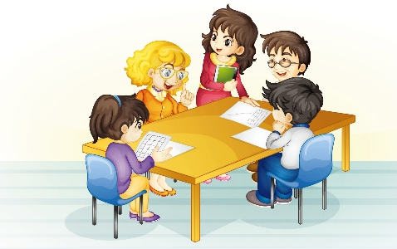
Presentation
Look and Think
Who are they?
Where are they?
What are they talking about?

Slide 6
Presentation
Listen and say
How many teachers are there in the man’s school?
There are fifty teachers in his
school.

Slide 7
Presentation
Listen and say
How many teachers are there in Miss White’s school?
There are sixty teachers in her
school.

Slide 8
Practice
Follow to read
录音 | 课文句子
Hello, Miss White! Welcome to our school!
Thank you! How many teachers are there
in your school?
There are fifty.
How about your school?
There are sixty teachers in our school.

Slide 9
Practice
Role play
...
...
...

Slide 10
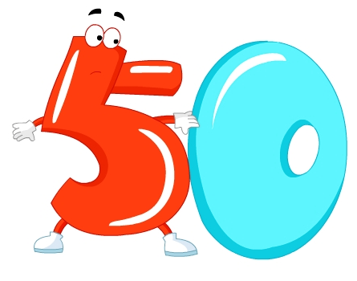
Presentation
Let’s learn
fifty

Slide 11
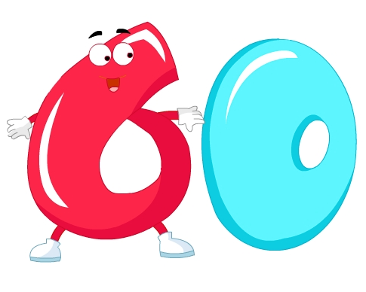
Presentation
Let’s learn
sixty

Slide 12
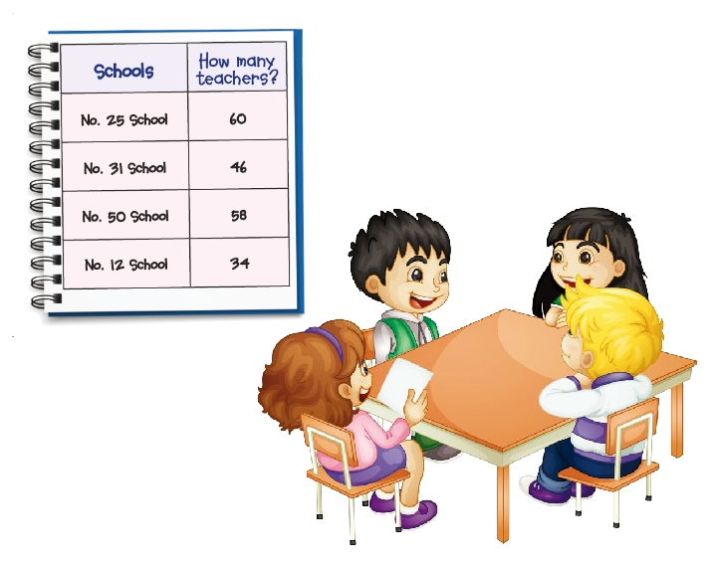
Practice
Let’s do a survey
How many teachers are there in your school?
There are sixty.

Slide 13
Practice
Make a new conversation
how many there are
students class teacher school
fifty sixty

Slide 14
Summary
1. 本课重点学习的单词是什么？
teacher
school
fifty
sixty
2. 本课的重点句型是什么？
How many teachers are there in your school?
There are fifty.

Slide 15
Homework
1. 跟读课文Just talk部分的录音，注意语音、语调。
2. 调查自己学校的教师和学生人数，并仿照本课对话，编写一段新的对话。
3. 预习Lesson10。
Close

