Slide 1
Unit3 Topic3
What would you like to drink?
Section D
WWW.PPT818.COM

Slide 2
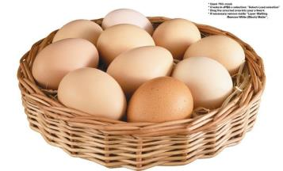
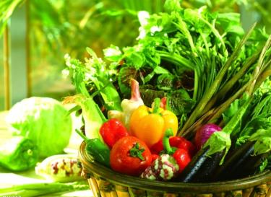
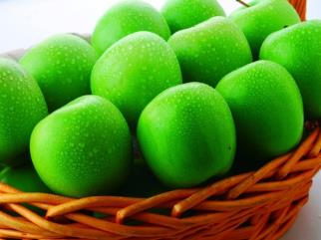
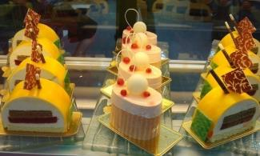
Group A: Countable nouns
some eggs
some cakes
some apples
some hamburgers
some vegetables

Slide 3
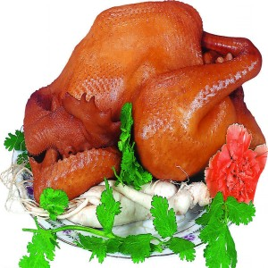
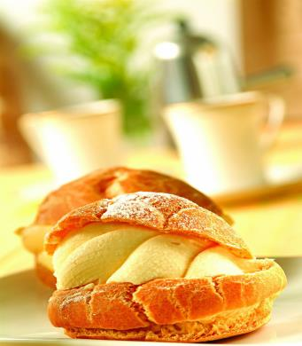
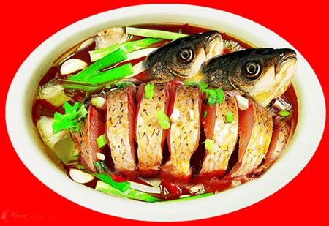
Group B: Uncountable nouns
some fish
some rice
some bread
some milk
some chicken
some juice

Slide 4
可数名词
Sum Up
名词
不可数名词
可数名词： cake egg apple banana
vegetable noodle pencil car
(some+可数名词) some cakes
eggs
vegetables
不可数名词： fish meat rice chicken
milk water tea
(some+不可数名词) some fish
meat
milk

Slide 5
Read the latter from Jane .Then answer the following question.
① Who writes the letter?
② Who does she write to?
③ Does she have many friends here?
④ Do they often have dinner together?
⑤ Does she like Fujian food?
Jane.
Jack.
Yes, she does.
Yes, they do.
No, she doesn’t.

Slide 6
Exercise
Jane
kind
nice
China

Slide 7
英文书信的基本格式：
（1）称呼：常用Dear…开头，顶格起写,
后用逗号。
（2）正文：主体部分。
（3）结束语：结尾客套话，末尾用逗号，
常用Yours/Sincerely yours/Love。
（4）签名：在结束语下面。

Slide 8
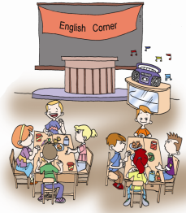
Project
Sharing Favorite Food
Survey the students about their favorite food, and then have a party. One student acts as the host, and the others act as the guests.

Slide 9
Project
Make up a conversation.
1) Would you like something to…?
2) What would you like to…?
3) Why not…?
4) What do you usually have for…?
5) Help yourself/yourselves to…?

Slide 10
Sum Up
这个单元，你学到了什么？
1. 词汇：
2. 语法：
3. 重点句子：

Slide 11
1. 复习并牢记本单元的单词。 2. 预习Unit 4, Topic 1, Section A, 1a 和2a。
Homework

