Slide 1
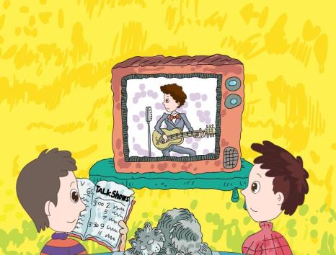
人教版八年级上册
Unit5
Do you want to watch a game show?
Section A（第1课时）
WWW.PPT818.COM
0

Slide 2
1.掌握以下单词和短语sitcom/news/talk show/soap opera/game show等。 2.通过完成句子配对来识记并运用电视节目及其正确形容的表达： I don’t mind them./ I can’t stand it./It’s relaxing. 3.通过口语小组操练来正确运用询问和讨论各类电视节目。 4.学会询问他人喜好的句型，能正确的和他人用此话题进行交流。
学习目标

Slide 3
自学互研
新词自查
根据句意及汉语提示完成句子
1. My father often reads the newspaper to learn more
news (新闻).
2. We all think the story is very educational (有教育意义的).
3. The students are having a discussion (讨论) about the
TV show.
4. My mother told me the story happened (发生) many
years ago.
5. My sister expects (期望) to get more news about the
talent show.

Slide 4
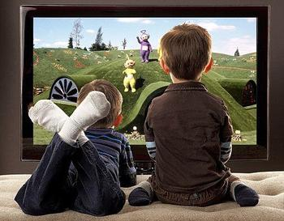
情景导入
Ask and answer
Do you like to watch TV?
What’s your favorite programme?

Slide 5
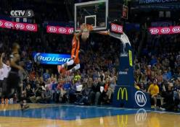
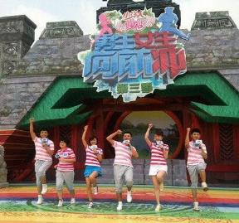
New words
talent show
talk show
sports show
news
soap opera
game show
sitcom

Slide 6
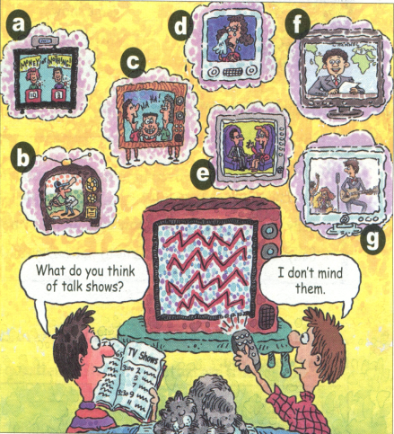
1a Match the TV shows with the pictures [a-g].
1.talk show____
2.soap opera____
3.sports show____
4. sitcom _______
5.game show_____
6.talent show_____
7.news ________
e
d
b
c
a
g
f

Slide 7
1c Practice the conversation. Then make your
own conversations.
love
like
don’t mind
don’t like
can’t stand
A: What do you want to watch?
B: What do you think of talk
shows?
A: They’re OK. I don’t mind them.
B: Then let’s watch a talk show.

Slide 8
Pair work
—What do you think of talk shows?
—I like them.
—What do you think of sitcoms?
—I can’t stand them.

Slide 9
1b Listen and number the shows [1-4] in the order you hear them.
____talent show ____talk show
____soccer game ____ news
3
1
4
2

Slide 10
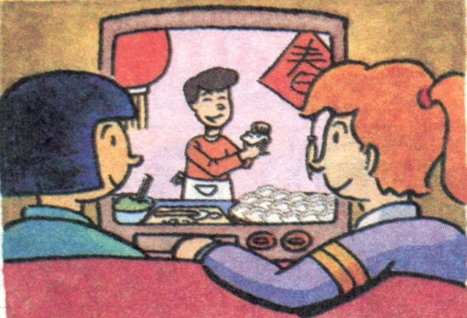
2a Listen to Lin Hui and Sally’s conversation.
Number the TV shows [1-5] in the order you
hear them.
______ sitcoms
______ news
______ game shows
______ talk shows
______ soap opera
1
2
4
3
5

Slide 11
2b Listen again. Complete the sentences.
1. Sally likes to watch ________________.
2. Lin Hui thinks she can learn ____________ from sitcoms.
3. Sally thinks __________ are more educational than sitcoms.
4. Sally loves _________. She plans to watch Days of Our Past _______.
the news or talk shows
some great jokes
game shows
soap operas
tonight

Slide 12
2c Ask and answer questions about the TV shows
in 2a. Use information that is true for you.
A: Do you plan to watch the news tonight?
B: Yes, I like watching the news. I watch it
every night.
A: Why?
B: Because I hope to find out what’s going on
around the world.

Slide 13
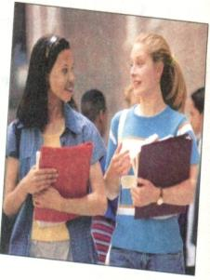
Role-play
2d Role-play the conversation.
Grace: What did you do in class today, Sarah?
Sarah: We had a discussion about TV shows.
My classmates like game shows and
sports shows.
Grace: Oh, I can’t stand them. I
love soap operas. I like to
follow the story and see
what happens next.

Slide 14
Sarah: Well, I don’t mind soap operas. But
my favorite TV shows are the news
and talk shows.
Grace: They’re boring!
Sarah: Well, they may not be very exciting, but
you can expect to learn a lot from them.
I hope to be a TV reporter one day.

Slide 15
Pair work
1.Role-play the conversation in 2d.
2.Make conversations about talking about TV shows.

Slide 16
Group work
1. Use the sentences we have learned to design a passage about your favorite TV shows.
2. Show your passage to the class.

Slide 17
问题探究
▲ Let’s watch a talk show.让我们看谈话节目吧
让某人做某事：let sb. do sth.
导练（C）Let’s_____ for a walk, shall we?
A to go B going C go
▲ stand
作不及物动词时，意为“站立”，构成stand up, 反义词为 sit down。
作及物动词时，意为“忍受，忍耐”，一般多用于否定句中，构成短语can’t stand (doing) sth. 不能忍受做某事。如：I can’t stand soap operas.我无法忍受肥皂剧。
导练：My brother can’t stand writing (write) diaries

Slide 18
课堂评价
补全对话。
Grace：_1____, Sarah?
Sarah: We had a discussion about TV shows. My classmates like game shows and sports shows.
Grace: Oh, I can’t stand them .______. I like to follow the story and see what happens next.
Sarah: Well, _____. But my favorite TV shows are the news and talk shows.
Grace:______!
Sarah: Well, _____, but you can expect to learn a lot from them. I hope to be a TV reporter one day.
A
C
B
D
E

Slide 19
What did you do in class today
I don’t mind soap operas.
I love soap operas.
They’re boring.
They may not be very exciting.

Slide 20
Summary
Please make your own conversations with the following structure:
A: What do you want to watch?
B: I want to watch a talk show.
A. What do you think of talk shows?
A: They’re OK. I don’t mind them.
B: Then let’s watch a talk show.

Slide 21
Homework
Review the language points that we have learned in this class.

