Slide 1
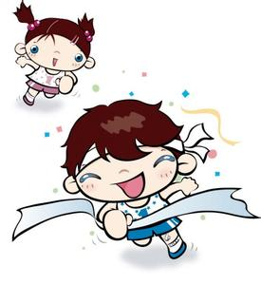
Unit 10 I am very fast
WWW.PPT818.COM

Slide 2
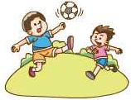
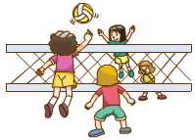
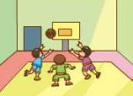
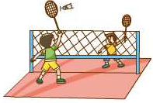
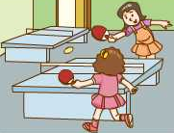
Let’s play a game
Which one is missing?

Slide 3
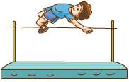
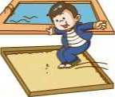
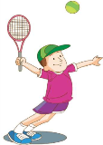
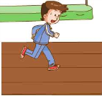
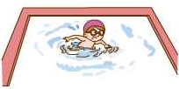
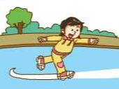
Let’s play a game
Which one is missing?

Slide 4
Let’s Talk
badminton
play badminton
1/17/2023

Slide 5
volleyball
play volleyball

Slide 6
I like...
Sports:
playing
doing
football
basketball
volleyball
baseball
tennis
table tennis
golf
chess
running
swimming
skating
skiing
kung fu
the long jump
the high jump
the athletics

Slide 7
Let’s Talk
My favourite sport is volleyball.
My favourite sport is playing volleyball.
volleyball
1/17/2023

Slide 8
Group work
My favourite sport is volleyball.
My favourite sport is playing volleyball.

Slide 9
Let’s Talk
What’s your favourite sport?
My favourite sport is ….
My favourite sport is sth./doing sth.
I like … best.
playing basketball
football
doing the long jump
the high jump
running
kung fu
…
…

Slide 10
Let’s Talk
What’s your favourite sport?
I like … best.
I like sth. / doing sth. best.
playing badminton
tennis
swimming
table tennis
skating
volleyball
…
…

Slide 11
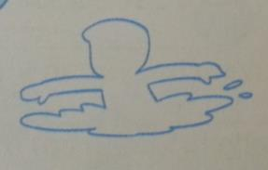
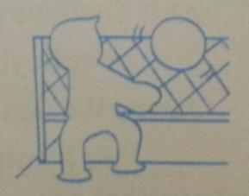
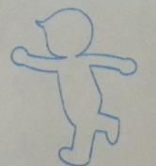
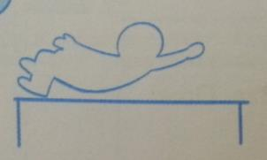
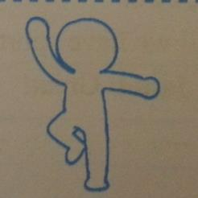
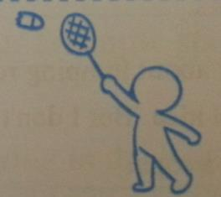
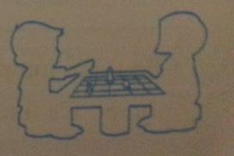
Guessing game
What do you like doing?
I like ….
1/17/2023

Slide 12
Listen to Daniel and Sheila, answer.
1. What’s Ben’s favourite sport?
Running.
2. What’s Janet’s favourite sport?
Volleyball.
1/17/2023

Slide 13
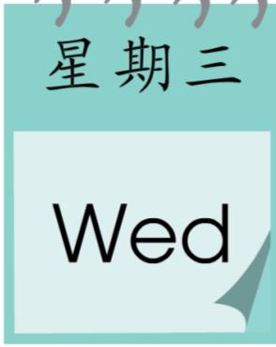
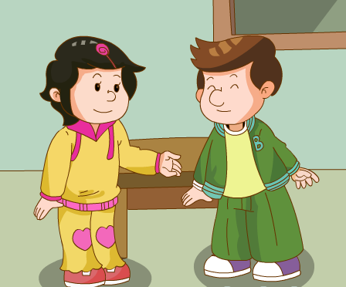
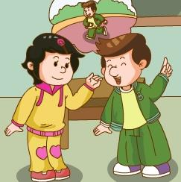
Question:
What day is Ben’s favourite day?

Slide 14
Let’s review
Why?
clever
On Wednesday they have two
PE lessons. Ben loves sport.

Slide 15
Let’s read and answer
1. What’s Ben’s favourite sport?
Why?
Running.
He is fast.
2. What’s Janet’s favourite sport?
Why?
Volleyball.
She is tall and she has long arms.
3. Does Jiamin like sport?
What does he like doing?
No, he doesn’t. He likes taking a bath.
1/17/2023

Slide 16
Let’s finish the dialogue
Ms White：What’s your ____________ _________?
Janet: I am ______ and I have ________ _________,
so I like _____________ ______________.
Ben: My favourite _________ is _____________.
I am very _________.
Ms White: And what do you like _________, Jiamin?
Jiamin: I like __________ ___________.
Ms White: So do you like ___________ __________?
Jiamin: No, I like __________ _______ ________.
favourite
sport
tall
long
arms
playing
volleyball
sport
running
fast
doing
the
water
swimming
best
taking
a
bath
1/17/2023

Slide 17
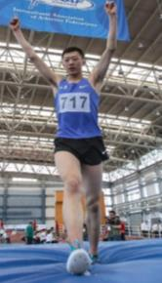
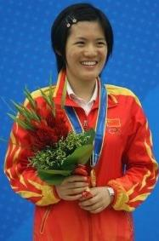
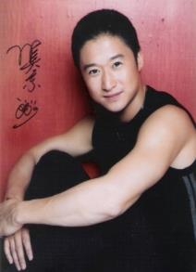
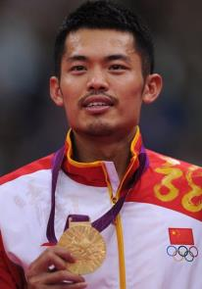
Let’s match
clever
strong
long arms
long legs

Slide 18
Let’s Talk
A: What do you like doing?
B: I am …. I have ….
I like ….
1
2
3
4
1/17/2023

Slide 19
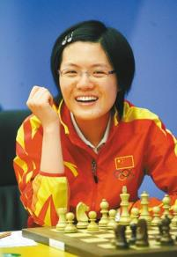
Let’s Talk
A: What do you like doing?
B: I am clever. I like playing chess.
B: I am …. I have ….
I like ….
1/17/2023

Slide 20
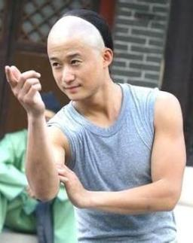
Let’s Talk
A: What do you like doing?
B: I am strong. I like kung fu.
B: I am …. I have ….
I like ….
3
1/17/2023

Slide 21
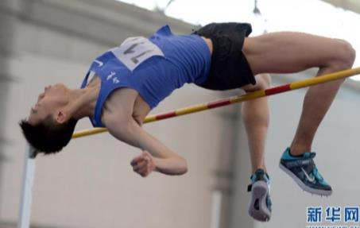
Let’s Talk
A: What do you like doing?
B: I am tall. I have long legs.
I like the high jump.
B: I am …. I have ….
I like ….
1
1/17/2023

Slide 22
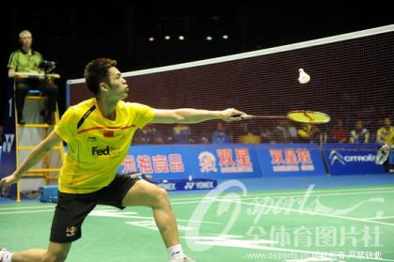
B: I am …. I have ….
I like ….
Let’s Talk
A: What do you like doing?
B: I am tall and strong.
I have long arms.
I like playing badminton.
4

Slide 23
Homework:
1. 打卡书；
2. 背诵第十单元的单词。

