Slide 1
Unit 8 Fashion
Comic strip and Welcome to the unit
WWW.PPT818.COM

Slide 2
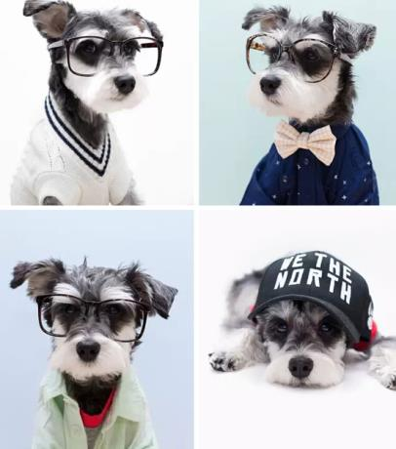
Free talk
Do dogs like a
fashion show?
2. Do you think
dogs need clothes?
Notes:
2

Slide 3
Listen and answer
1.What is Eddie doing?
He is thinking about what to wear.
2.How much more time can Eddie spend in bed?
He can spend 10 more minutes in bed.
3.Is Eddie lazy?
Yes, he is.
Notes:
3

Slide 4
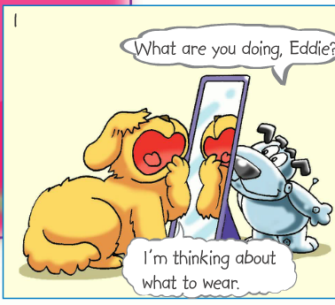
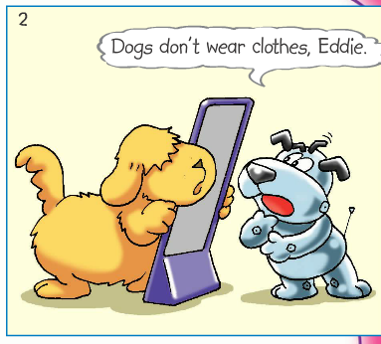
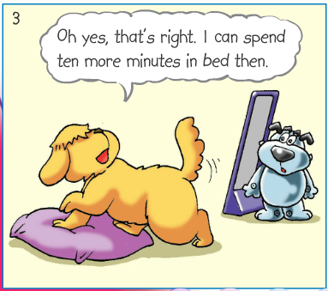
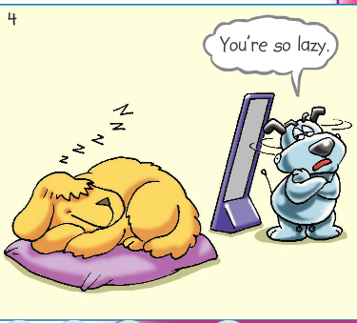
Read and act out
Notes:
4

Slide 5
Read and complete
Eddie is ____________ what to wear. But Hobo tells him dogs ________________. So Eddie wants to __________________ in bed. He is a ______ dog.
thinking about
don’t wear clothes
spend ten more minutes
lazy
Notes:
5

Slide 6
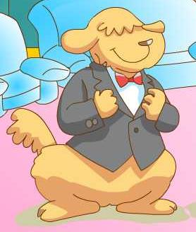
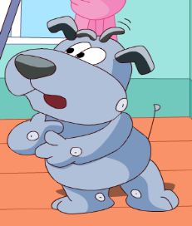
A dog fashion show
The 1st International Dog Fashion Show
2015. 10.30 1 p.m.—4 p.m.
China Art Centre, Beijing
Notes:
6

Slide 7
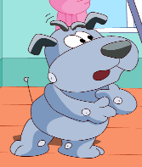
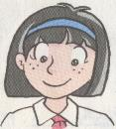
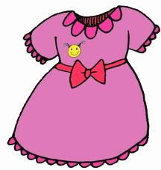
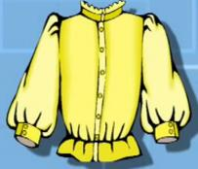
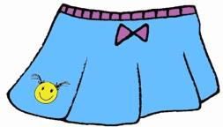
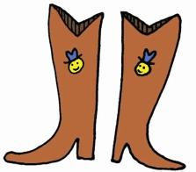
Clothes and shoes
dress
es
blouse
skirt
a pair of boots
Notes:
7

Slide 8
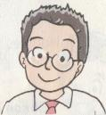
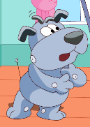
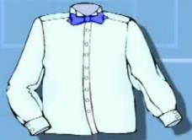
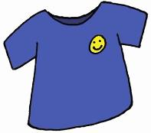
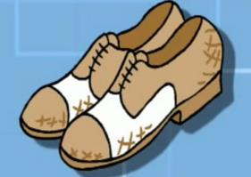
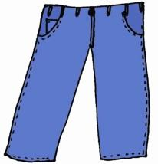
Clothes and shoes
shirt
tie
T-shirt
a pair of trousers
a pair of shoes

Slide 9
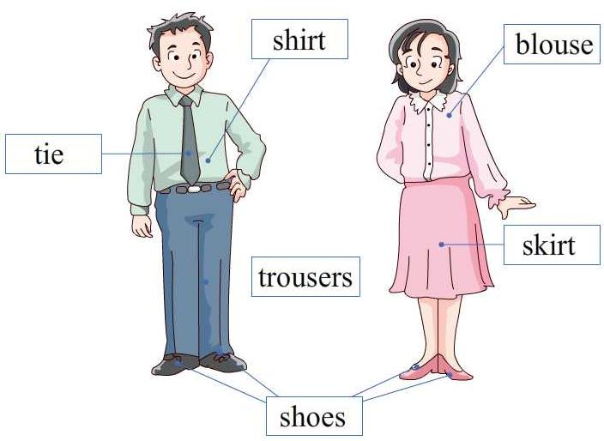
Learn to say
blouse shirt shoes skirt tie trousers
Notes:
9

Slide 10
Listen and answer
1.What does Millie want to borrow from
her mother?
She wants to borrow a red blouse
from her mother.
2.What’s her mother’s size?
It’s size 4.
Notes:
10

Slide 11
Make a conversation
A: What will you wear at the fashion show?
B: I am thinking about it. Can you lend me
your … for our fashion show?
A: Of course.
B: What size/colour is your …?
A: Size …. / The colour is ….
B: Oh, it’s too large/small for me, but … can
wear it. She’s ….. / I don’t like this colour,
but ….
A: OK, then.
B: Thank you, ….
Notes:
11

Slide 12
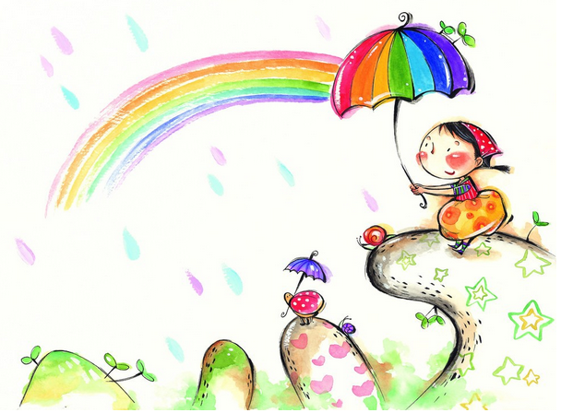
Conclusion
Colourful clothes
Colourful days
Notes:
12

Slide 13
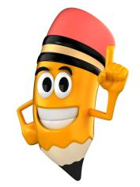
Homework
Write down what Hobo may wear for the dog fashion show.
Recite the comic strip.
3. Preview Reading.
Notes:
13

