Slide 1
Lesson 35
Future Transportation
WWW.PPT818.COM

Slide 2
Learning aims:
1.学习和掌握以下单词和短语:
hoverboard , smooth, float, transporter, form, allow sb. to do sth.
at the speed of light ，all the time
2. 能够模仿本课中对飞翔器的介绍，自己组织语言，尝试用英语介绍自己喜欢的未来交通工具。
3.鼓励大家发挥想象力，用英语表达自己的想法，展现自己的风采。

Slide 3
Words
hoverboard
n. 飞翔器

Slide 4
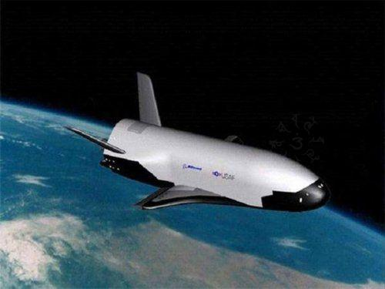
This is a type of hoverboard. It is made in
America. It can float in the space
smoothly. It can travel at the speed of light

Slide 5
Words
hoverboard
transporter
n. 飞翔器
n. 输送器,运输车

Slide 6
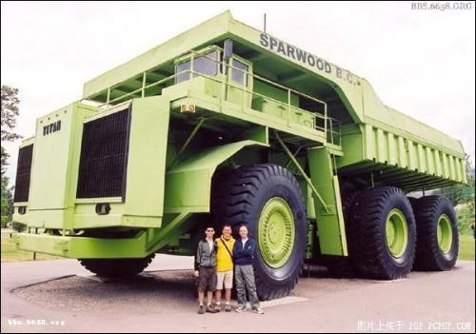
This is one of the biggest transporters in the world. It is used in Australia now. It can carry 200 tons things from one place to another place very quickly.幻灯片 5
It’s a transporter.
运输车，输送器

Slide 7
Words
hoverboard
transporter
smooth
float
allow
form
n. 飞翔器
n. 输送器,运输车
adj. 平稳的
v. 漂浮
v.允许
n.形式 , 相当于 type

Slide 8
词语运用：Fill in the blanks with right words.
– Is the lift __________(平稳的) enough?
– Of course.
2. It would take a few seconds from Canada to China with a _____________(运输车).
3. A ___________ (飞翔器) would be like a skateboard, but it wouldn’t have any wheels.
4. The new _______ (形式) of transporters would send you from one place to another place very quickly.
5. Some clouds are f________ in the sky.
smooth
transporter
hoverboard
forms
loating

Slide 9
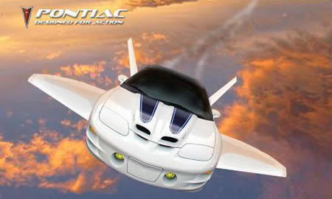
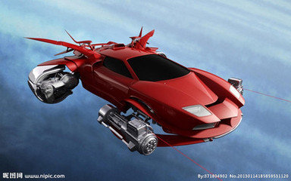
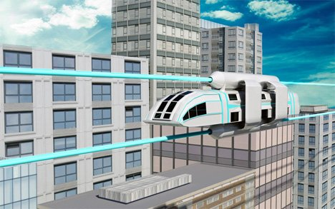
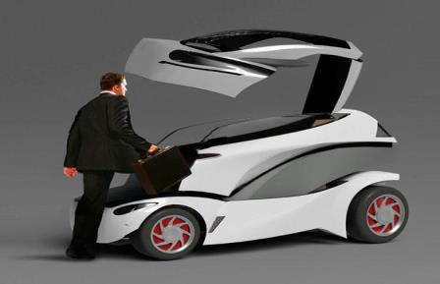
Talk about What type of transportation would you like to see in the future ?

Slide 10
Listen to the tape and
find out the phrases.
1.allow sb. to do sth.
2.at the speed of light
3.all the time
Pay attention to the new words

Slide 11
Language points:
1.A transporter would allow you to travel at the speed of light.
allow sb. to do sth. 允许某人做某事
at the speed of light 以光的速度
The doctor allowed him to eat three apples
我们不允许他去游泳。
We don’t allow him to swim .
Maybe you can travel ___ the speed of light in the future.
A. on B. at C. for D. with
B

Slide 12
Language points:
2. People use new forms of transportation all the time .
all the time 总是， 一直
He teaches us English all the time.
他一直教我们英语

Slide 13
Fast reading

Slide 14
Read the lesson and write true (T) or false (F).
1. A hoverboard would be like a skateboard with wheels. ( )
2. A hoverboard would float in the air. ( )
3. Riding the train from Canada to China takes eleven hours. ( )
4. TV shows about space and spaceships are about the future. ( )
F
T
F
T

Slide 15
Reading
Carefully

Slide 16
Read the text carefully and fill in the chart.
a. like a skateboard
no
b. ____ wheels
hoverboard
fast
c. go ____
d. Ride would be _____
Future transportation
. smooth
e. send people from one place to another very ________
quickly
transporter
f. make you travel
_______
at the speed of light

Slide 17
速读大PK
Attention, please!
Read quickly and loudly

Slide 18
Hello everyone! My name is Sam.
What type of transportation would I like to see in the future? I would like to see a hoverboard . It would be like a skateboard. It would go really fast. I hope someone will invent one in the future.
Maybe I will invent a transporter . It would allow you to travel at the speed of light.
I like to watch TV shows about new forms of transportation all the time.

Slide 19
Hello everyone! My name is Sam.
What type of transportation would I like to see in the future? I would like to see a
hoverboard . It would be like a skateboard. It would go really fast. I hope someone will invent one in the future.
Maybe I will invent a transporter . It would allow you to travel at the speed of light.
I like to watch TV shows about new forms of transportation all the time.

Slide 20
Use your imagination to draw a new kind of transportation. Then write a passage according to the following questions.
1.What does it look like?
2. Is it fast, smooth and safe?
3. How does it travel?
4.Is it good for us/ the environment(环境)?
draw and write

Slide 21
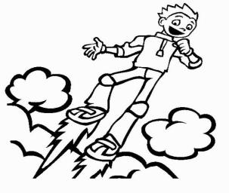
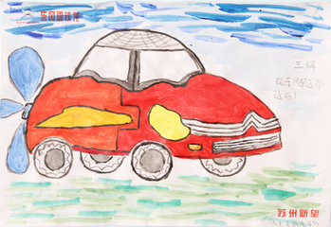
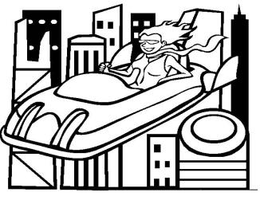
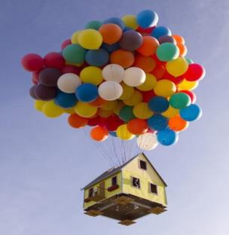
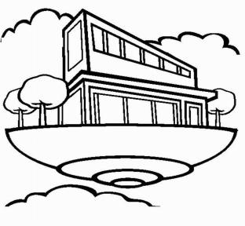
Draw your transportation (These pictures may help you!)

Slide 22
Describe your transportation
My Future Transportation
I would like to see my transportation in the future. It looks like_____. It has_______. It is fast /safe/smooth,it is very useful/helpful/great . With my transportation , you don’t need _____. It’s good for us .I think it will be popular in the future. ( Or use your own words )
Example

Slide 23
Homework
1. Learn words and useful expressions of this lesson by heart.
2. Preview Lesson 36.
3.Go on finishing your passage .

