Slide 1
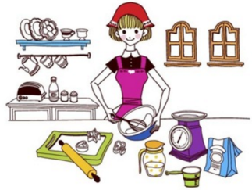
Unit2 I’m Cooking in the Kitchen
陕旅版
四年级下册
第三课时
WWW.PPT818.COM

Slide 2
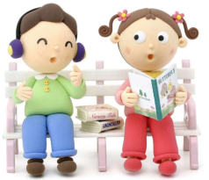
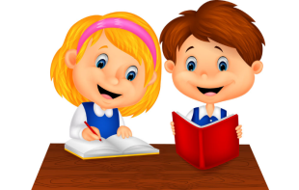
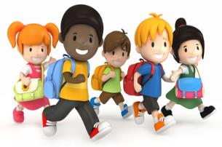
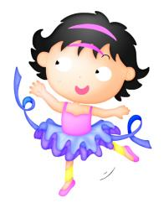
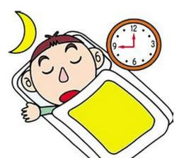
>>Review
Look and say
—What … doing?
—… doing ….

Slide 3
>>Review
Magic fingers
read write sleep eat
listen cook stand sit

Slide 4
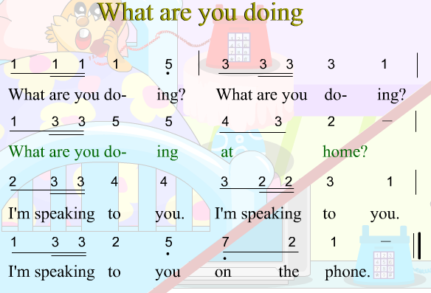
>>Warm-up
Let’s sing

Slide 5
>>Presentation
Listen and answer
What is the baby doing?
The baby is sleeping.
What is Alice doing?
She is singing.
What are the boys doing?
They are drawing pictures.
What are the girls doing?
They are listening to music.

Slide 6
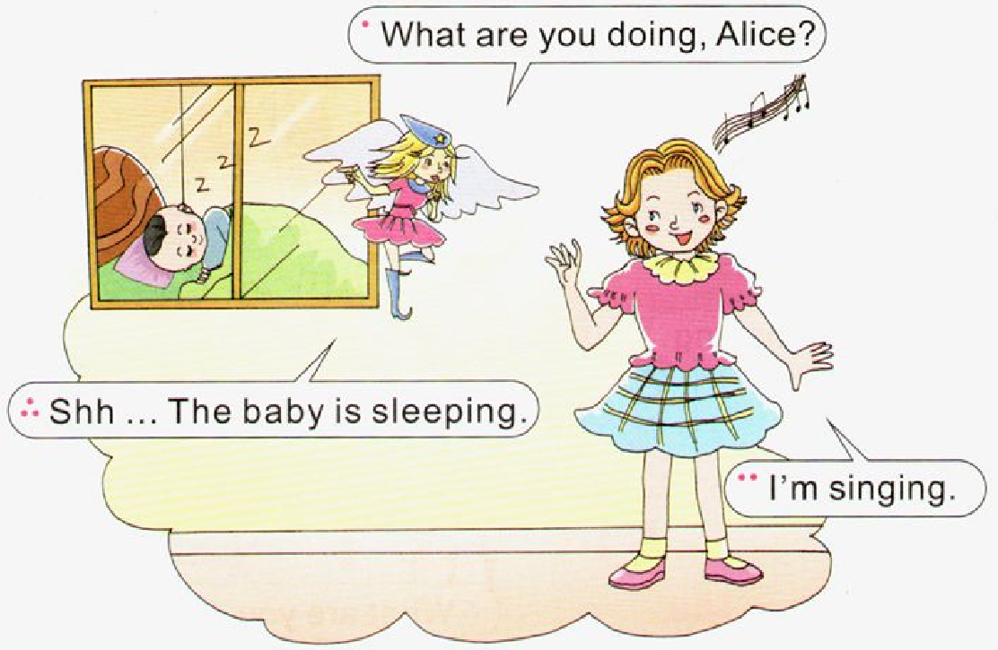
>>Presentation
Let’s learn more

Slide 7
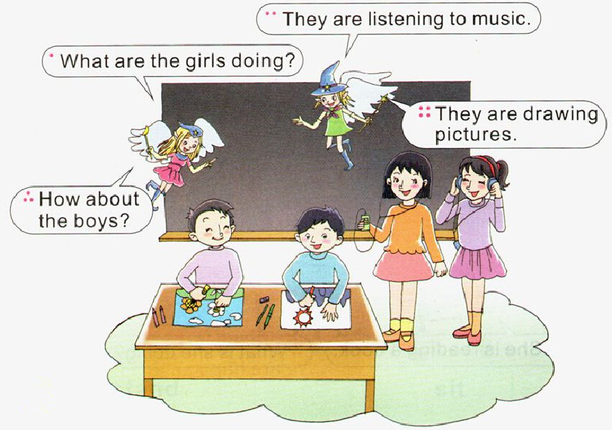
>>Presentation
Let’s learn more

Slide 8
>>Practice
Let’s learn more
Read and imitate
Aggie: What are you doing, Alice?
Alice: I'm singing.
Aggie: Shh … The baby is sleeping.
Aggie: What are the girls doing?
Toby: They are listening to music.
Aggie: How about the boys?
Toby: They are drawing pictures.

Slide 9
>>Practice
Read it by yourselves for one minute .
自读课文一分钟。
一分钟倒计时
60
Learning tip :
10
50
当你自己朗读时，遇到不会读或不明白意思的单词或句子，可以把它圈起来，请教同学或老师！
20
40
30
开始

Slide 10
>>Practice
Super Mary:表演我最棒！
小组合作：
1.三人一小组
2.根据剧本分角色练习
3.适当加上一些动作辅助表演
4.课文基础上进行新对话创编
Make a new dialogue 创编新对话

Slide 11
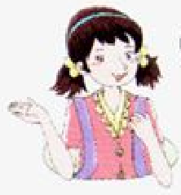
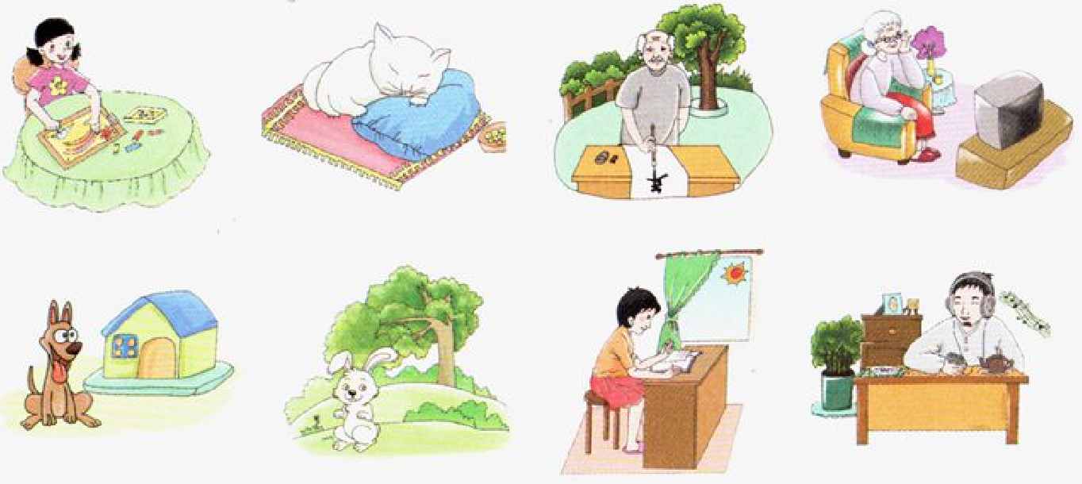
>>Practice
Look and say
What are they doing?
Wu Chen is drawing a picture.

Slide 12
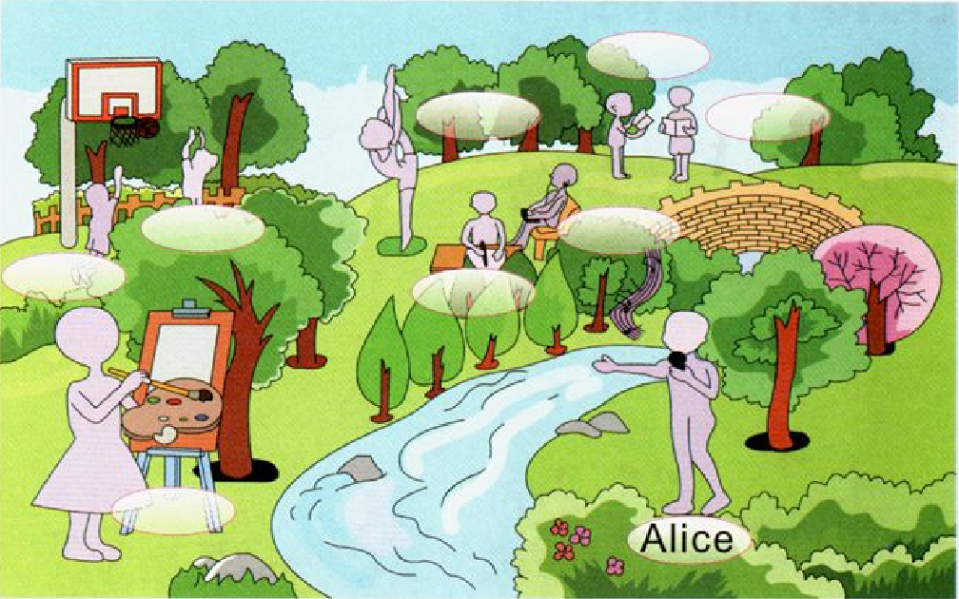
>>Practice
Look and say

Slide 13
>>Practice
Read and name
There are many people in the park. Look! Alice is singing. Li Shan is dancing. Wu Chen and Su Nan are reading books. Liu Zhaoyang and Kevin are playing basketball on the playground. Kitty is listening to music. Colin is writing. Miss White is drawing a picture.

Slide 14
>>Practice
Ask and answer
1. What is Alice doing?
She is singing.
2. What are Wu Chen and Su Nan doing?
They are reading books.
3. What is Colin doing?
He is writing.
4. What is Miss White doing?
She is drawing a picture.

Slide 15
>>Summary
如何用现在进行时询问他人正在
做什么及其答语？
-What are you doing?
-I’m + v-ing.
-What are you doing?
-I’m reading a book.

Slide 16
>>Summary
-What is he/she doing?
-He /She is ...
-What are they doing?
-They are ...
The baby is sleeping.

Slide 17
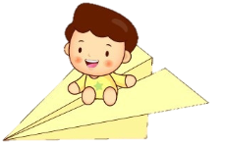
>>Homework
1.听课文录音并跟读，按照正确的语音、语调朗读并表演课文对话。 2.同桌之间2人一组，用不同的人称询问对话并回答（注意学生不同人称的使用）。
3.预习B Read a story。
close

