Slide 1
Module 5 Museums
Unit 2 If you ever go to London, make sure you visit the Science Museum.
WWW.PPT818.COM

Slide 2
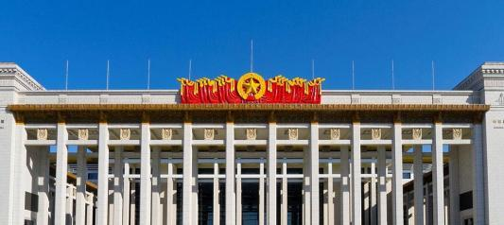
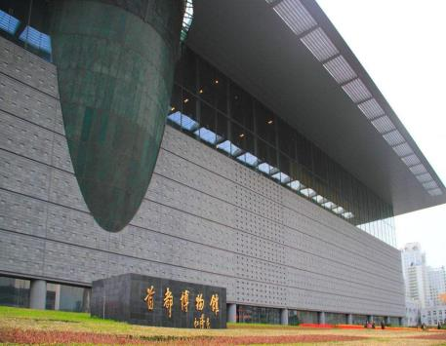
What museums have you ever been to?
The National Museum
of China
Beijing Capital Museum

Slide 3
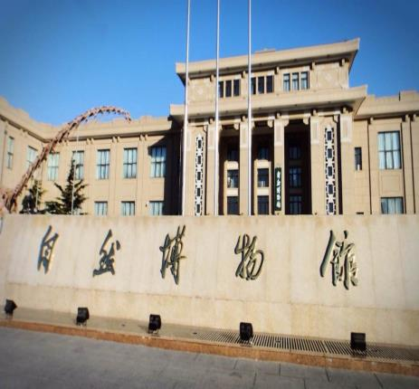
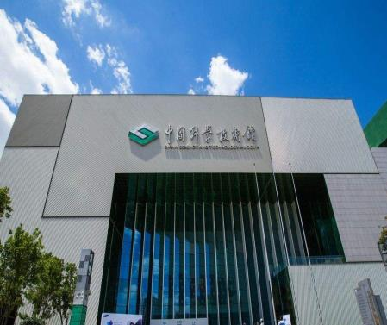
What museums have you ever been to?
Beijing Museum of Natural History
China Science and Technology Museum

Slide 4
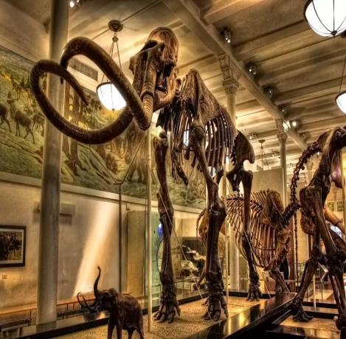
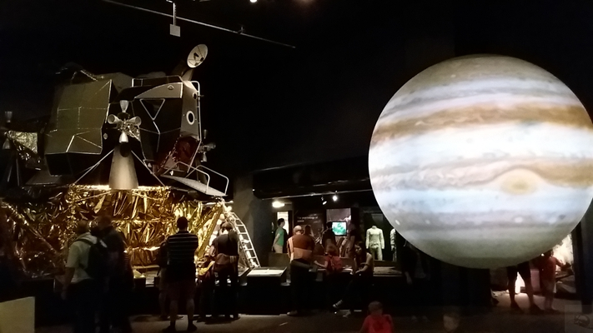
What museums are they?

Slide 5
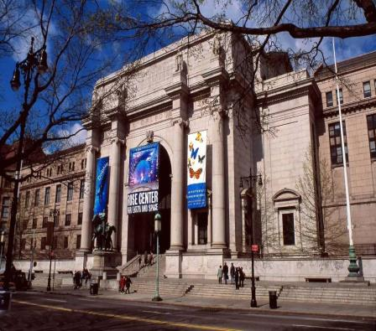
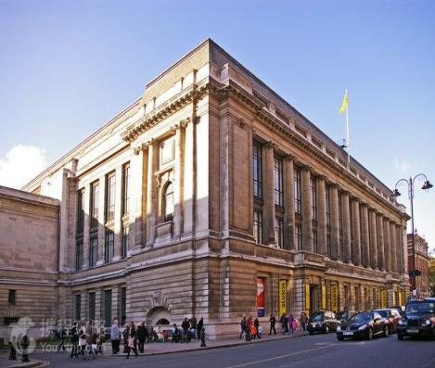
What museums are they?
American Museum of Natural History
The Science Museum in London
The first science museum in the world

Slide 6
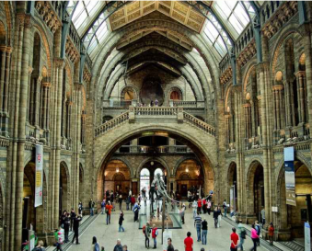
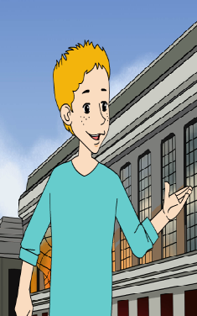
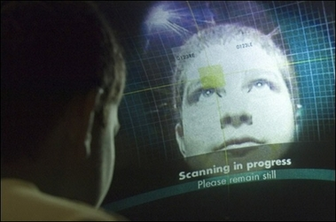
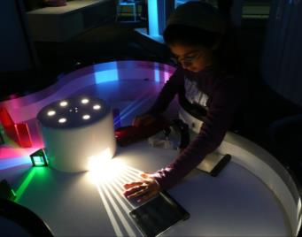
What do you want to learn about it?
Welcome to…

Slide 7
Let’s pay a visit to the Science Museum!
Read Para1 and answer:
1.What does Tony think of the museum?
It is the most friendly and different.
2.Why does he think so?
People can talk about what they can see and do here and it is noisy.

Slide 8
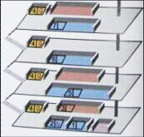
Let’s pay a visit to the Science Museum!
Read Para2-4 and answer:
1.How does Tony introduce exhibitions
in the museum?
He introduces it on the different
floors.
2.How does he make us know what
experiments we can do there?
He gives us many examples.

Slide 9
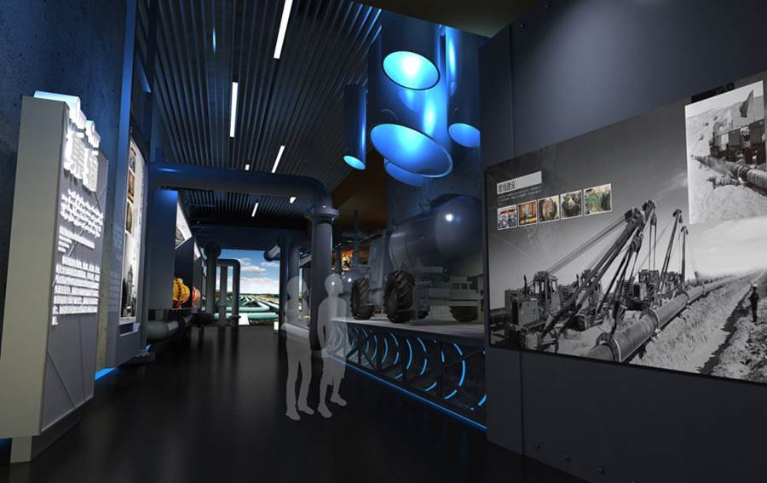
On the second and third floors
What can we learn about?
n. 通信
communications
environment
maths
physics
chemistry
examples

Slide 10
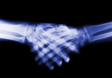
On the second and third floors
What experiments can we do here?
communications
environment
创造能源
maths
create energy
physics
dig coal
chemistry

Slide 11
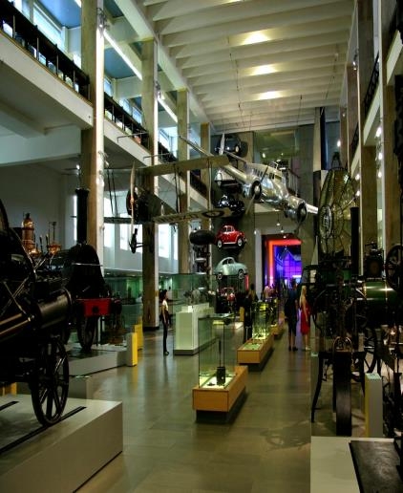
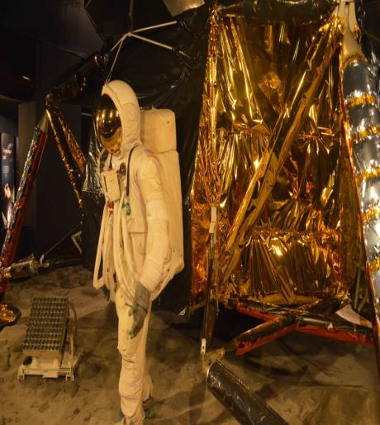
Which floor is the most popular room? Why?
What experiments can we do here?

Slide 12
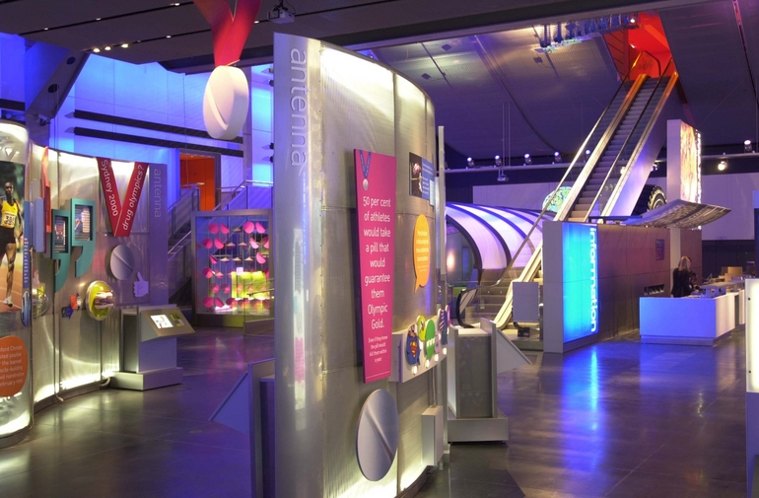
On the fourth and fifth floors
What can we learn about?

Slide 13
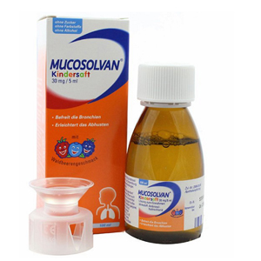
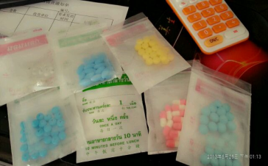
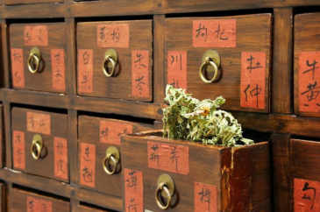
On the fourth and fifth floors
What can we do there?
VS
compare…with

Slide 14
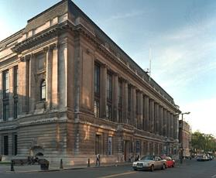
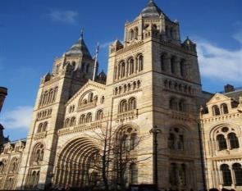
More information
Free
Price:
Opening time:
Tony’s opinion:
10 am---6 pm daily
His favourite museum in the whole world

Slide 16
Think about …
What is the writer’s purpose in writing
this passage? （ ）
A. To tell the differences between museums.
B. To introduce his favorite museum--- the
Science Museum.
C. To just describe the exhibits in the museum.
D. To tell people to visit the Science Museum.
B

Slide 17
Do you like the Science Museum?
After reading the passage,
which floor do you like best?And why?
Please talk with your partners!

Slide 18
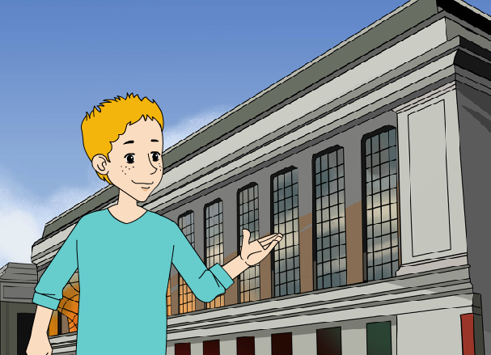
Introduce the Science Museum to others.
If you were Tony, would you like to introduce it to your friend?

Slide 19
Introduce to your partners!
…is my favorite museum, …

Slide 20
The Science Museum in London
Thanks for your listening!

