Slide 1
Unit 9
Can you come to my party?
Section B 2 3a-Self check
WWW.PPT818.COM

Slide 2
1) bring … to …把…带来
2) take a trip去旅行
3) think of 认为
4) without doing sth. 没有做某事
5) so that 以便于；目的是
6) look forward to doing sth.期待做某事
7)be surprised at sth. 对…感到惊奇
8) hear from 收到某人的来信
9) be glad to do sth.乐意做某事

Slide 3
the day after tomorrow
1. 后天 _______________________
2. 前天 _______________________
3. 照看；照顾 __________
4. 去旅行 ______________
the day before yesterday
look after
take a trip

Slide 4
bring … to …
5. 带……去…… ________________
6. 乐意做某事 ________________
7. 以便于；以至于 _____________
8. 盼望；期待 _________________
be glad to do sth.
so that
look forward to …

Slide 5
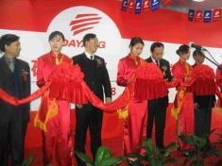
New words
1. opening n. 开幕式；落成典礼
动词 open + ing → opening
e.g. My father has to go to the
opening of a new theater
tomorrow.
我爸爸明天必须去参加一个
剧院的落成典礼。

Slide 6
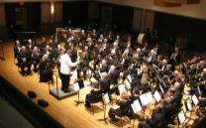
2. concert n. 音乐会；演奏会
e.g. Peter gave me two tickets for
the concert.
彼得给了我两张音乐会的票。
3. daytime n. 白天；日间
e.g. Bats sleep in the daytime.
蝙蝠白天睡觉。

Slide 7
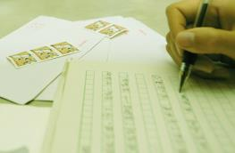
4. headmaster n. 校长
e.g. He went to see the
headmaster yesterday.
他昨天去看望校长了。
5. event n. 大事；公开活动；比赛项目
e.g. sporting event
体育赛事

Slide 8
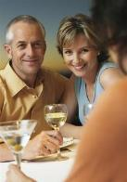
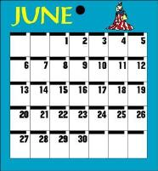
6. guest n. 客人；宾客
e.g. We must prepare a room for
the guest.
我们必须为客人准备一个房间。
7. calendar n. 日历；日程表
e.g. Is there a calendar here?
这里有日历吗？

Slide 9
3a
Read the invitation and answer the questions.
1.Who is making the invitation?
________________________________________
2. What is the invitation for?
________________________________________
3. When will the event happen?
________________________________________
4. What will happen after this?
________________________________________
Larry Smith.
It is for the opening of the new library.
On Wednesday, January 8th at 9:00.
They can enjoy the school concert and have lunch.

Slide 10
5. Do parents have to bring anything?
________________________________________
________________________________________
6. How should people reply to this invitation, and when?
________________________________________
________________________________________
Yes. They should bring one book as a gift for the new library.
They should reply to this invitation in writing by Friday, December 20th.

Slide 11
Write an invitation to a party or any other event. Reply to your partner’s invitation. If you turn down the invitation, give a good reason.
3b
Include the following information:
Kind of party or event(事件)
When and where it will be
How guests should dress
If guests(客人) should bring anything
If the guests should reply to the
invitation
When and how the guests should reply
Use the following
words and phrases:
would like to
will be
after this
please
reply

Slide 12
范文赏析
Hi Mike,
Thanks for asking me to your home, but I’m sorry I can’t visit you next Saturday. I’ll be busy that day. In the morning, I have to do my
homework. In the afternoon, I am having piano
lesson. In the evening, I’m going to the movies with my friends. There is a new movie. I can’t miss it. Can you watch it with us next Saturday evening?
Write soon.
Henry

Slide 13
Slef Check
1
Fill in the blanks in the conversation.
A: Hi, Peter. _______ you come to my party
_______ the weekend?
B: Sure, _________ love to.
A: How about ________, Jenny?
C: I’m afraid I ________. I _______ to look after
my little cousin.
A: ________ you come, Jeff?
D: I ________ be able to, but I’m not sure.
________ let you know tomorrow.
Can
on
I’d
you
can’t
have
Can
might
I’ll

Slide 14
Useful phrases
study for a test
come to the party
the whole day
another time
soccer practice
try to do sth.
write soon
have a piano lesson
have to do sth.
on the weekend
a birthday party
the day after tomorrow
join sb.
go to the concert
the day before yesterday

