Slide 1
Unit 3 Where is my car?
WWW.PPT818.COM

Slide 2
on

Slide 3
in

Slide 4
under

Slide 5
near

Slide 6
on 在...上面
in 在...里面
under 在...下面
near 在...附近

Slide 7
Let's do !
Put your hands ...

Slide 8
Let’s play a guessing game .
猜猜游戏
OK!

Slide 9
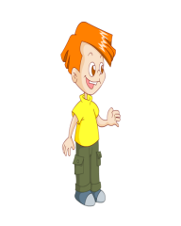
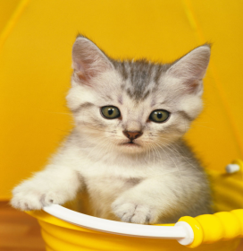
What’s this?
It’s a cat.
Where is the cat?
It’s ___ the box.
in

Slide 10
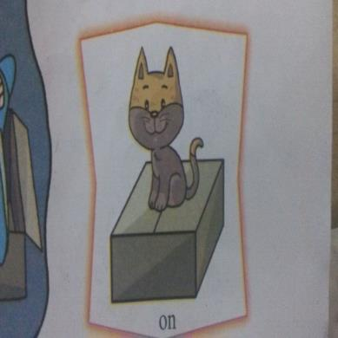
Where is the cat?
It’s ___ the box.
on

Slide 11
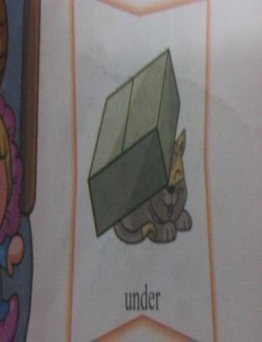
Where is the cat?
under
It’s ______ the box.

Slide 12
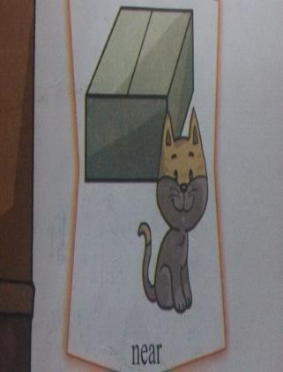
Where is the cat?
near
It’s ______ the box.

Slide 13
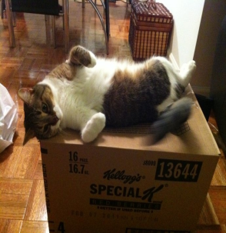
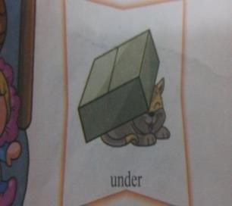
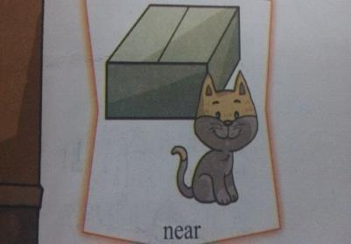
Where is the cat?

Slide 14
Where is the cat?
It’s ___ the box.
in
Is it in the box?

Slide 15
Is it in the box?
Yes,it is.
Is it on the box?
No,it isn't.

Slide 16
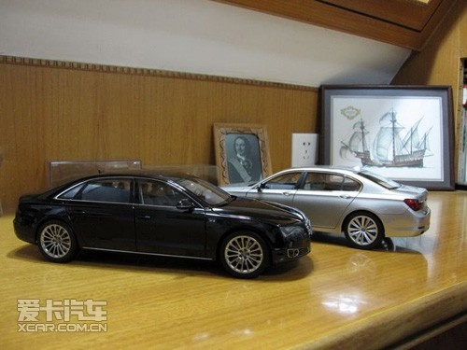
Is it in the box?
Is it under the chair?
Is it on the table?

Slide 17
1:Let’s play a game.
Where is my car?
2:Is it in the box?
3:No,it isn't.
4:Is it under the chair?
5:No, it isn’t.
6:Is it on the table?
7:Yes,it is.

Slide 18
Where is the cat?
It’s the box.
on/in/under/near
Is it in the box?
Yes,it is./No,it isn't.

Slide 19
Thank you for listening!
感谢聆听！

