Slide 1
Unit 5
What are the shirts made of?
Section B 3a-Self Check
WWW.PPT818.COM

Slide 2
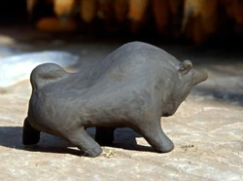
Talking
Describe how to make a Chinese clay piece.
First, the pieces are carefully shaped by hand from a very special kind of clay and then allowed
to air-dry.

Slide 3
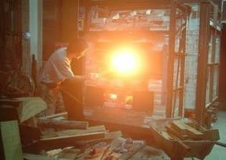
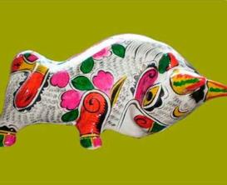
Second, after drying, they are fired at a very high heat.
At last, they are polished and painted.

Slide 4
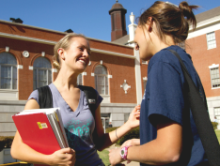
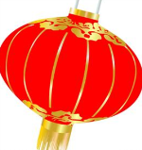
Discussion
Talk about some special things that your city is famous for.
What’s your city famous for?
Our city is famous for making lanterns.

Slide 5
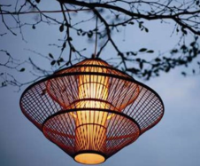

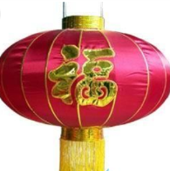
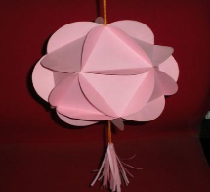
Really! What are they made of?
They’re made of bamboo, silk or paper.

Slide 6
What can they do?
They were first used for lighting in the old days. Today, they are used at festivals and other celebrations.

Slide 7
Chinese people love lanterns very much. Because they’re symbols of good luck and family reunion (团圆).
Why are they special?

Slide 8
3a What are some special things that your hometown or city is famous for? These can be food, artwork or any other products. Discuss them with a partner and take notes.
lantern
What the product is
What it is made of/from
Who it is made by
bamboo, paper, steel
craftsman

Slide 9
Where it is made
What it can do
Why it is special
family or factory
It is used at festivals and celebrations.
It is symbol of good luck and family reunion

Slide 10
3b Write a paragraph about the product. Use your notes in 3a.
Use the following expressions to help you:
My town/city is famous for…
…is famous in my town/city.
…is/are made of/from/with/by/in...
…is/are used for...
…is/are special because...

Slide 11
写作指导
这是一篇科普性说明文，让同学们介绍灯笼的相关情况，语态应为被动语态为主；时态应以一般现在时为主，辅以少量一般过去时态或其他时态的句子。

Slide 12
写作时，应按表格提示，理清写作思路，逐条清晰地进行介绍。比如，可以先介绍灯笼的历史、用途及意义。后介绍人们挂灯笼的时间。最后，介绍灯笼的制作材料、产地及其类型。
注意要恰当运用被动语态，检查
数、时态以及句子结构等是否正确。

Slide 13
One possible version
Lanterns have been around for about 1800 years. They were first used for lighting in the old days. Today, they are used at festivals and other celebrations. Chinese people love lanterns very much because they’re symbols of good luck and family reunion.

Slide 14
From Spring Festival to Lantern Festival, lanterns are hung up everywhere. Lanterns were usually made of bamboo and paper in the old days. Now they are made of many kinds of materials, such as steel, silk, cloth, plastic and so on. They are made all around China. Lanterns are made in the shape of different animals, vegetables, fruits and many other things.

Slide 15

Self Check

Slide 16
1 List some things you use every day. Write down what they are made of/from and where they were made.
Things | Made of/from ... | Made in ...
blanket pencil bag calculator chopsticks | cotton wood leather metal, plastic steel | India China Italy Japan Korea

Slide 17
2 Use the information above to write full
sentences.
1.______________________________________
______________________________________
2.______________________________________
3.______________________________________
______________________________________
I have a beautiful cotton blanket made in
India.
All of us use wooden pencils made in China.
Her mother has an expensive leather bag
that was made in Italy.

Slide 18
4.______________________________________
______________________________________
5.______________________________________
______________________________________
This calculator is made of metal and plastic,
and it was made in Japan.
The chopsticks are made of steel, and they
are made in Korea.

Slide 19
3 Complete the sentences using the correct forms of the words in brackets.
1.Cheese ________ (make) from milk.
2.Parents and students ___________ (invite)
to the school concert last night.
3.The underground parking lot ________
(close) at midnight every day.
4.There is a lot of research on how languages
__________ (learn).
5.Some classic films __________ (show) at
that cinema last week.
is made
were invited
is closed
are learned
were shown

Slide 20

Ⅰ. Complete the sentences.
1. 皮革是动物的皮做的。
Leather ____ _____ ____ the skin of
animals.
2. 这个小镇以其手工艺品而广为人知。
The small town ____ ______ ___ its handicraft products.
is made of
is famous for

Slide 21
3. 茶叶被手工采摘，然后送去加工。
The leaves for tea plants are picked
by hand and then ____ ____ for
_________.
4. 无论你做什么，都要尽力去做。
____ ______ _____ you do, you
must do it with great efforts.
are sent
processing
No matter what

Slide 22
5. 国际风筝节每年在潍坊举行一次。
The ___________ kite festival ___
_____ in Weifang every year.
6. 据新闻报道，纽约州昨晚下了大雪。
_________ ____ the news report, it
snowed heavily in New York last night.
international
is
held
According to

Slide 23
7. 饭桌上铺着一层塑料台布。
The table ___ _______ _____ a
plastic table clothes.
8. 大意驾驶酿成很多交通事故。
Careless _______ causes many
_______ _________.
is covered with
driving
traffic accidents

Slide 24
Ⅱ. Finish the sentences.
1. In spring, we can see green ______ (leaf) and grass everywhere.
2. The Internet is ______ (wide) used in most families in our country today.
3. English ________ (speak) by many people in the world.
leaves
widely
is spoken

Slide 25
4. The company hopes ____ (it) product will be successful on the European market.
5. My teacher did what he could to make
his class ______ (live).
6. If the traffic _____ (be not) heavy, it’ll
take us an hour to get there.
its
lively
isn’t

Slide 26
7. They spent one part of their holiday in
_______ (French) and the other in
England.
8. Bell is ______ (know) for inventing
the telephone.
9. The Chinese use _________ (chopstick)
instead of knives and forks.
France
known
chopsticks

Slide 27
Review what you have learned in this
unit and preview what you will learn
in next unit.

Slide 28
Thank You!

