Slide 1
Module 8 Story time
Goldilocks hurried out of the house
WWW.PPT818.COM

Slide 2
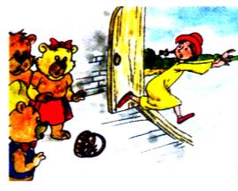
新课导入
Do you know why Goldilocks hurried
out of the house?

Slide 3
either
piece
in pieces
bed
asleep
return
cry
point
shout
jump
without
adv.也（不）
n.部件，碎片；一件/个/张
破碎
n.床
adj.睡着的
v.返回；归还
v.哭；喊叫
v.指着；指
v.高声说；大声喊
v.跳
prep.无，没有

Slide 4
1 Say what happened next in Goldilocks
and the Three Bears.
—I think Goldilocks decided to go home.
—Perhaps she stayed in the house.

Slide 5
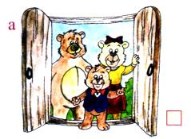
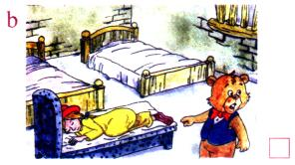
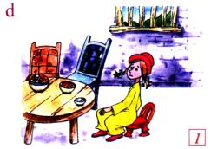
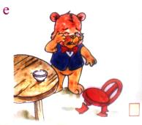
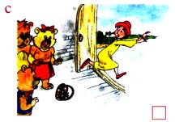
2 Presentation
Read the story and number the pictures in the correct order.
2
4
3
5
1

Slide 6
3 Match the sentences with the pictures.
1.Goldilocks opened her eyes, jumped out of bed and hurried out of the house.
2.She tried the small chair.
3.The Three Bears returned to their house.
4.Baby Bear cried because there was nothing in his bowl and his chair was in pieces.
5.Baby Bear pointed at Goldilocks. She was asleep in his bed.

Slide 7
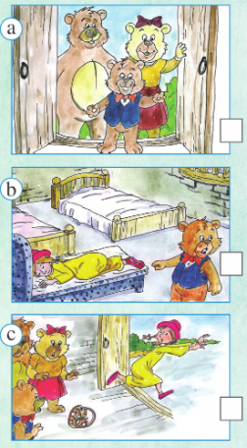
3. The Three Bears returned
to their house.
5. Baby Bear pointed at Goldilocks. She was asleep in his bed.
1.Goldilocks opened her eyes, jumped out of bed and hurried out of the house.

Slide 8
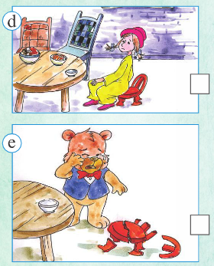
2. She tried the small chair.
4. Baby Bear cried because there was nothing in his bowl and his chair was in pieces.

Slide 9
√
4 Check ( ) the true sentences.
1. Goldilocks liked the big chair.
2. Goldilocks liked the small bed.
3. Baby Bear looked in the bedroom.
4. The Three Bears were happy to see Goldilocks.
5. Goldilocks didn’t like the Three Bears.
√
√
√

Slide 10
5 Complete the passage with the correct form of the words from the box.
asleep either piece point return shout without
Goldilocks tried the three chairs and liked the small chair , but she was very heavy and soon the small chair was in (1)______. She walked into the bedroom. She tried the middle bed, but it wasn’t comfortable and the big bed wasn’t comfortable(2) ______. Very soon she was (3)______ in the small bed.
pieces
either
asleep

Slide 11
Then the Three Bears (4)_________ to their house. They walked up to their bedroom. Baby Bear (5)__________ at Goldilocks and(6) _________, “That’s her! She finished my food and … look at my chair!” Goldilocks jumped up and hurried out of the house (7)________ her basket.
returned
pointed
shouted
without

Slide 12
5 Look at the sentences.
1. First, she tried the big chair.
2. Then she tried the middle chair.
3.Finally, she tried the small chair
Now write some new sentences. Use first, next/then and finally.
pick up / very big bowl / didn't like / too hot pick up / big bowl / didn't like / too cold
pick up / small bowl / like / good

Slide 13
Answers:
1. First, she picked up the very big bowl but she didn’t like it— it was too hot.
2. Next /Then, she picked up the big bowl but she didn’t like it— it was too cold.
3. Finally ,she picked up the small bowl and she liked it— it was good.

Slide 14
Work in pairs. Tell the whole story to your partner.
Once upon a time, there was a little
girl called Goldilocks. She lived
near a big forest.
One day, she decided …

Slide 15
Find out the phrases in Activities 1 & 2,
then write down the Chinese.
1) decide to go home
2) hurry out of
3) walk into the bedroom
4) be tired
5) be asleep
6) in pieces
决定回家
__________
匆忙冲出来
____________
走进卧室
__________
累的
______
睡着的
________
破碎
______

Slide 16
7) didn’t notice … at first
8) point at
9) jump out of bed
10) return to the forest
11) without her basket
起先没注意到……
_____________________
指向
______
从床上跳下来
________________
返回到森林里
________________
没有带上她的篮子
_____________________

Slide 17
Try to understand.
1) try 的用法
try the small chair 名词
try to answer 动词不定式
try jumping 动名词
try 后可接 _____________ ，
_______________
和_____________。
try 也可作名词
例如： have a try (试一试)
名词
动词不定式
动名词

Slide 18
2)asleep 是 sleep的形容词形式，但不能作定语，只能作表语。happy是形容词, 后接名词时，就是这个名词的定语。
例：the happy girl根据上面的解释，判断一下：
the asleep girl 对不对？
不对,因为asleep不能作定语，不能用来修饰名词,只能作表语,用于be+ asleep结构。

Slide 19
3) return (返回) = _______ _________
return 还可意为“归还”，这时它又相当
于 ________ ________。
go
back
give
back

Slide 20
4) without (无，没有)
+______词或_____词。
We can’t live without water.
They left(离开) without ________
(say) goodbye.
名
动名
saying

Slide 21
5) point at / to 的区别
试解：
point ______ 指着（在近处的人或物）
point ______ 指向（在远处的人或物）
at
to

Slide 22
当堂小练
一、根据句意和首字母提示，用单词的适当形式填空。
1.There are some _________ (块) of meat in the bowl.
2.The baby didn’t _________ (哭) any more.
3.Don’t _________ (大声喊) at anybody.
4.She didn’t _________ (归还) my book to me,so I called her
yesterday afternoon.
5.He went to bed late and fell _________ (睡着的) in class.
pieces
cry
shout
return
asleep

Slide 23
当堂小练
二、完成句子，每空一词。
1.他从床上跳起来，没吃早餐就上学了。
He _________ _________ _________ the bed and went to school
________ _________.
2.起初，他没告诉我。
_________ _________,he didn’t tell me about it.
3.这些椅子都碎了。
The chairs were _________ _________.
4.你想试试这辆新自行车吗？
Will you _______ _______ _______ _______?
5.老师正指着那个穿红衣服的女孩。
The teacher _________ _________ _________ the girl in red.
Jumped out of
without breakfast
At first
in pieces
try the new bike
is pointing at

Slide 24
当堂小练
三、单项填空。
( )1.She took my pen without _________ me.
A.ask B.asking
C.asked D.asks
( )2.I don’t like playing football _________.
A.also B.either
C.too D.as well
( )3.She didn’t _________ home again after she left home.
A.return to B.return
C.return back to D.return back
B
B
B

Slide 25
当堂小练
( )4.Jenny _________ the yard,but Ted did.
A.didn’t enter B.doesn’t enter
C.will enter D.is entering
( )5.Yesterday evening I was _________ very soon and
_________ for nine hours.
A.asleep;sleep B.asleep;asleep
C.asleep;slept D.sleep;asleep
A
C

Slide 26
Unit 2 Goldilocks hurried out of the house.
1.New words:
either, piece, in pieces, asleep, return, cry, at first, point, point at, shout, jump, without, jump out of
2.Structures:
①Goldilocks wanted to sit down because she was tired.
②It was nice and comfortable, but Goldilocks was very
heavy and soon the chair was in pieces.
③Very soon she was asleep in it.
④The three Bears returned.
⑤They didn’t notice Goldilocks at first.
归 纳

