Slide 1
Unit 5 Good manners
Comic strips & Welcome to the unit
WWW.PPT818.COM

Slide 2
Free- talk
Can we talk in class?
Can we listen to the teacher carefully?
Can we take down the notes carefully?
Can we make faces in class?
…

Slide 3
good manners in class
Ss talk about good manners in class in groups.

Slide 4
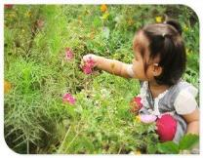
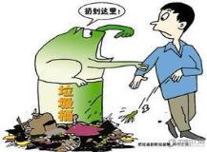
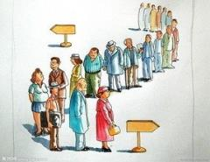
Choose the right things to do in public places
Match the pictures with the phrases
Do the right things in public places
drop litter everywhere
leave the tap running
keep quiet in the library
obey traffic rules
pick flowers in the park
queue for your turn

Slide 5
Good manners in the library
Discuss:
What can we do in the library?
What can’t we do in the library?

Slide 6
Listen and complete
We should…
We shouldn’t…
keep quite
keep the library clean
put the books back after reading
drop litter everywhere
eat in the library
write in the books

Slide 7
Comic strips
What does Eddie want Hobo to do?
He wants Hobo to learn about manners.
He wants Hobo to share his things with others.
He wants Hobo to wait quietly.
He wants Hobo not to cut in on others.

Slide 8
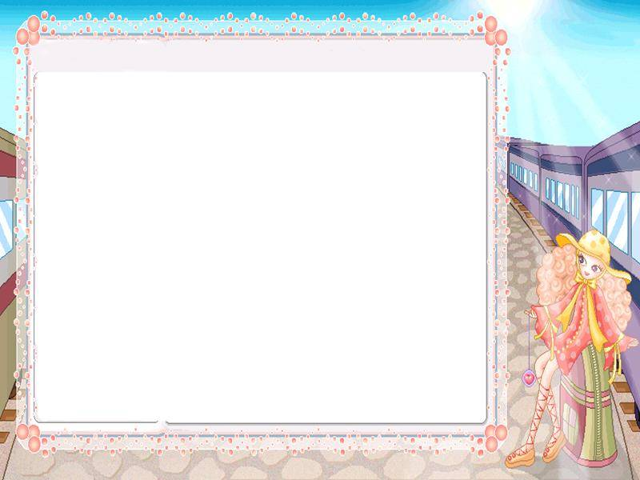
Act out the dialogue

Slide 9
Summary
1. 随意乱扔垃圾
2. 让水龙头的水一直流着
3. 遵守交通规则
4. 排队等候
5. 打断别人
6. 你够大了可以学习礼仪了。
7. 活到老，学到老。
drop litter everywhere
leave the tap running
obey traffic rules
queue for your turn
cut in on others
You’re old enough to learn about manners.
You’re never too old to learn.

Slide 10
Homework
Ss make dialogues about good manners
in public, at school…
2. Search more information about good
manners in different countries.

