Slide 1
Unit 5 Weather
Lesson 2 It's snowing.
WWW.PPT818.COM

Slide 2
Let's chant
Sunny, sunny, It's sunny.
Cloudy, cloudy, It's cloudy.
Windy, windy, It's windy.

Slide 3
Aims （学习目标）
1. 学会听、说、认读单词
snow, weather, rain, sorry, dad, raincoat.
2.学会运用句型
How's the weather in ...?
It's ...来谈论天气。

Slide 4
snow
rain

Slide 5
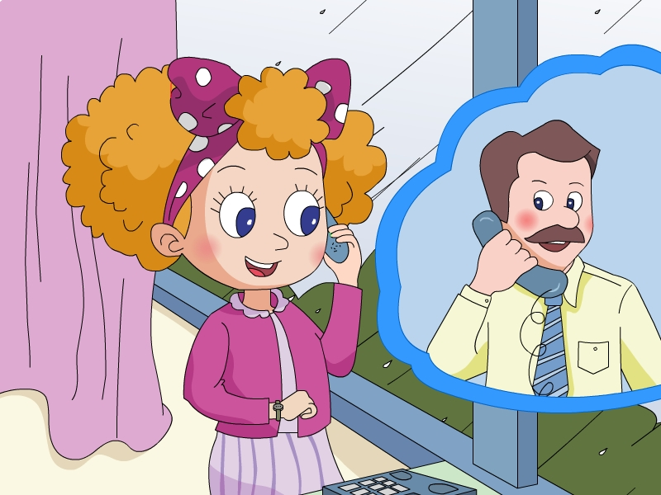

Slide 6
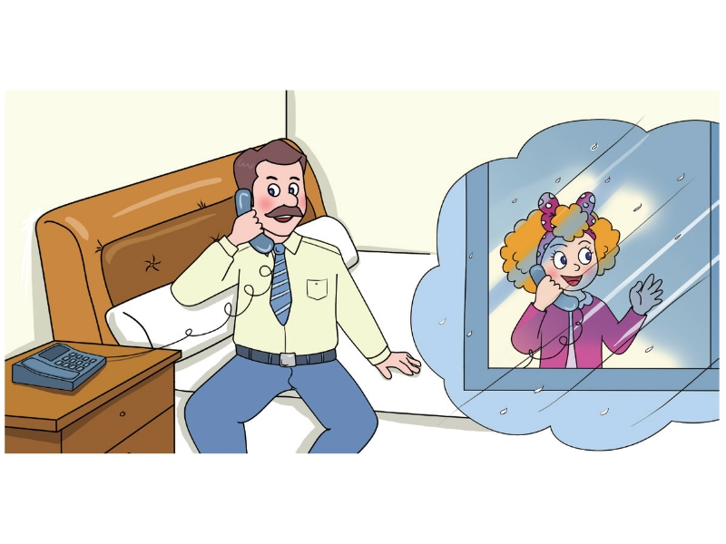
How's the weather
in Beijing, Jenny?
It's raining.

Slide 7
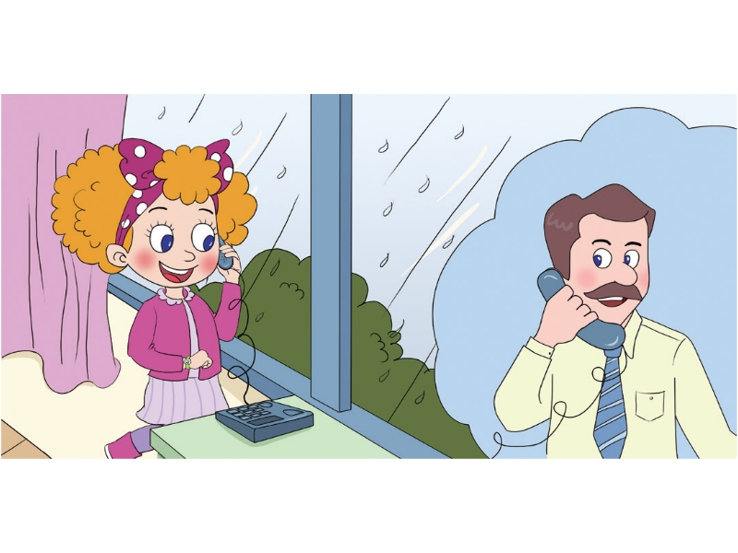
Sorry, dad.It's
time for school.
Put on your
raincoat.
OK. Bye!

Slide 8
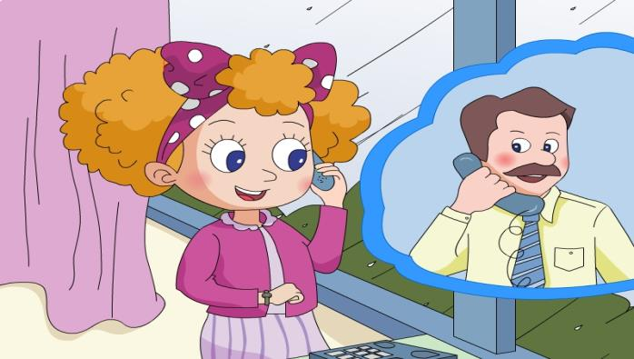
Role play

Slide 9
Let's talk
Shanghai
Harbin

Slide 10
Beijing
Hainan
Tibet

Slide 11
How's the weather in Shanghai?
It's raining.

Slide 12
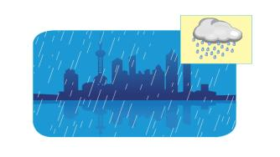
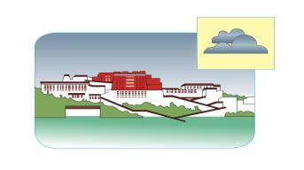
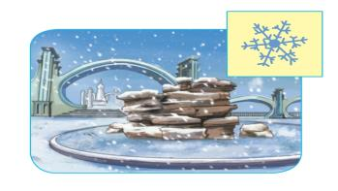
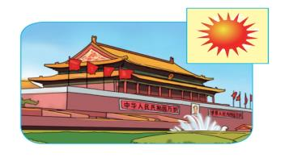

Slide 13
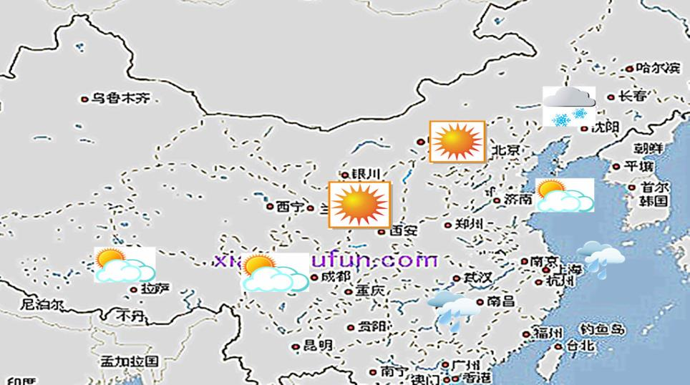
How's the weather in Beijing today?
It's sunny.

Slide 14
Summary
1. Can you read these words?
snow weather rain
sorry dad raincoat
2. Can you read these sentences?
How's the weather in Beijing?
It's raining.

Slide 15
Homework
1. Listen to the tape and repeat it.
2. Listen to the weather report and talk about "How's the weather in ...?" with your parents.

