Slide 1
Unit 5 Topic 2 He is really the pride of China.
Section C
WWW.PPT818.COM

Slide 2
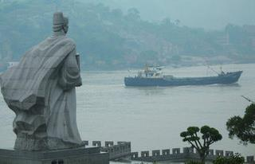
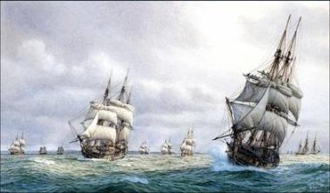
Zheng He was a Ming dynasty explorer.
We Chinese people are proud of him.
Zheng He was a Ming dynasty explorer whom we Chinese people are proud of.

Slide 3
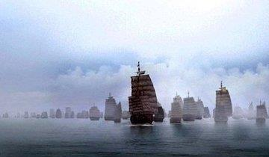
Zheng He led seven ocean journeys.
He took over 200 ships and 27 000 people every time.
Zheng He who/that led seven ocean journeys
took over 200 ships and 27 000 people every time.

Slide 4
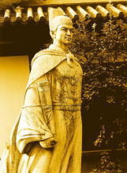
Zheng He died on his way home in 1433.
We Chinese people respect him.
Zheng He whom we Chinese people respect died on his way home in 1433.

Slide 5
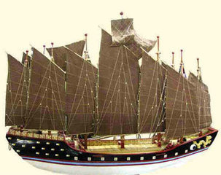
The ship is about 151.8 meters long and 61.6 meters wide.
Its size was the biggest.
The ship whose size was the biggest is about 151.8 meters long and 61.6 meters wide.

Slide 6
The journeys were to develop trade and friendship between China and other countries.
The journeys covered more than 30 countries and areas.
The journey which /that were to develop trade and friendship between China and other countries covered more than 30 countries and areas.

Slide 7
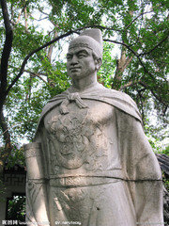
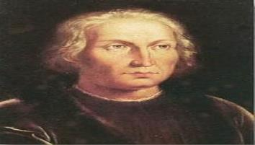
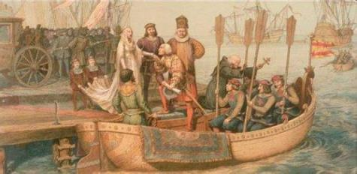
1371 A.D.-1433 A.D.
1451 A.D.-1506 A.D.

Slide 8
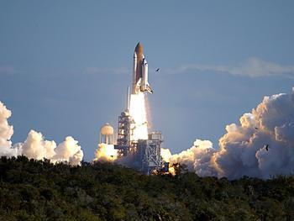
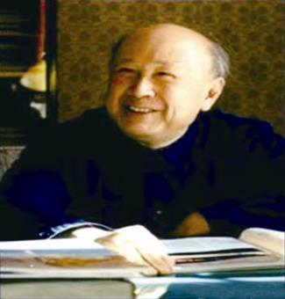
n.导弹
Qian Xuesen – the Father of China’s Missiles

Slide 9
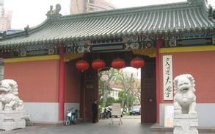
He graduated from Shanghai Jiao Tong University in 1934.
v.毕业
n.大学

Slide 10
He received his Ph.D. degrees in both aerospace and mathematics in the United States.
n.（大学）学位

Slide 11
1b-1. What happened to Qian Xuesen in the following years? Write them down.
1911:___________________________________
1934:___________________________________
1955:___________________________________
1956:___________________________________
2009:___________________________________
born in Hangzhou, Zhejiang Province
graduated from Shanghai Jiao Tong University
returned to his motherland
set up the first research institute of rockets and missiles
passed away

Slide 12
1b-2. Answer the following questions.
1. What happened after Qian Xuesen graduated
from Shanghai Jiao Tong University?
He traveled to the USA for further study.
2. Why did Qian Xuesen come back to his
motherland from the USA?
Because he loved his motherland.
3. What contributions did Qian Xuesen make to the
development of aerospace in China?
In 1956, he set up the first research institute of
rockets and missiles. From then on, he was in
charge of developing China’s missile, rocket
and spacecraft research programs.

Slide 13
1c Work in groups. Read the following words by Qian Xuesen and discuss what kind of person he is and what you can learn from him.
My career is in China, my success is in China and my destination is in China.
我的事业在中国，我的成就在中国，我的归宿也在中国！
2. My family name is Qian, but I don’t like qian.
我姓钱，但是我不爱钱。

Slide 14
Notes:
1. make important contributions to (doing) sth.
为……做出重要贡献
2. return to… 返回……
3. in charge of 主管；负责

Slide 15
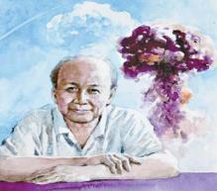
2 Make up conversations by following the example and pay attention to the attributive clauses.
Qian Xuesen/scientist/
be honored as
“The Father of
China’s Missiles”
Example:
A: Who is Qian Xuesen?
B: He is a scientist who was
honored as “The Father of
China’s Missiles”.
A: What should we learn from him?
B: His love and devotion to our country.

Slide 16
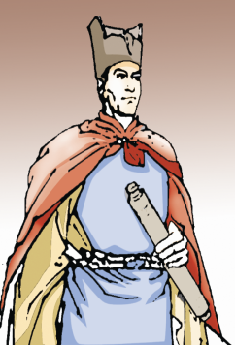
A: Who is Zheng He?
B: He is an explorer who led
seven ocean journeys.
A: What should we learn from him?
B: His devotion to our country’s
sailing and trading.
Zheng He/explorer/
lead seven
ocean journeys

Slide 17
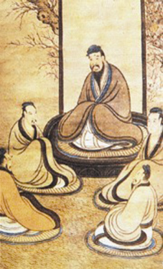
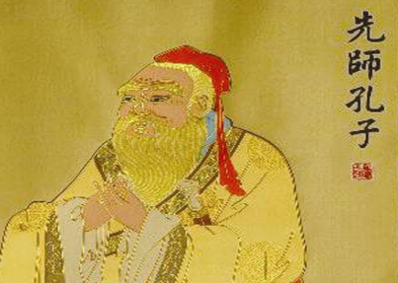
A: Who is Confucius?
B: He was a thinker who had great
influence on Chinese education.
A: What should we learn from him?
B: His ideas about kindness and
good manners.
Confucius/thinker/
have great influence
on Chinese education

Slide 18
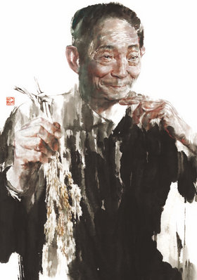
A: Who is Yuan Longping?
B: He is a scientist who
developed hybrid rice.
A: What should we learn from him?
B: His devotion to the science.
Yuan Longping/
scientist/
develop hybrid rice

Slide 19
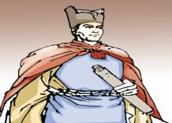
3 Choose one famous person who has influenced you a lot and write a short passage about him or her.
Zheng He/explorer/
lead seven
ocean journeys
Qian Xuesen/scientist/
be honored as “The Father of
China’s Missiles”
Confucius/thinker/have
great influence on
Chinese education
Yuan Longping/
scientist/
develop hybrid rice

Slide 20
Sum up
Words and phrases:
university n. 大学
degree n.（大学）学位
express v. 表达；表露
make important contributions to (doing) sth.
为……做出重要贡献
return to… 返回……
in charge of 主管；负责

Slide 21
Sum up
Sayings:
My career is in China, my success is in China
and my destination is in China.
我的事业在中国，我的成就在中国，我的归宿也在
中国！
2. My family name is Qian, but I don’t like qian.
我姓钱，但是我不爱钱。

Slide 22
Homework
1. Finish the written work.
2. Search for some information about the Four Great Inventions of ancient China.

