Slide 1
陕旅版四年级下册
Unit1 Our New House
第四课时
WWW.PPT818.COM

Slide 2
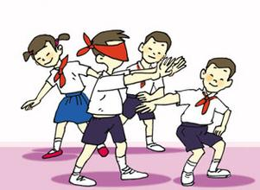
Play a game

Slide 3
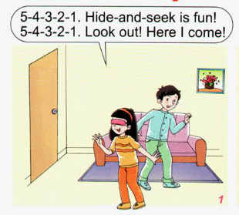
Look and answer
Who is in Picture 1?
Li Shan and Su Nan.

Slide 4
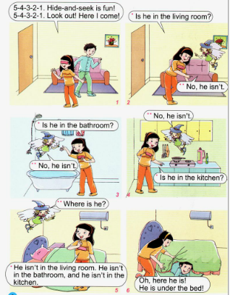
How many rooms are there?
There are four rooms.

Slide 5
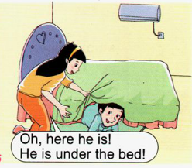
Where is Su Nan?
He is under the bed.

Slide 6
5-4-3-2-1. Hide and seek is fun!
5-4-3-2-1. Look out! Here I come!
Is he in the living room?
No, he isn’t.
No, he isn’t.
Is he in the bathroom?
No, he isn’t.
Is he in the kitchen?
Where is he?
He isn’t in the living room. He isn’t in the bathroom, and he isn’t in the kitchen.
Oh, here he is!
He is under the bed!

Slide 7
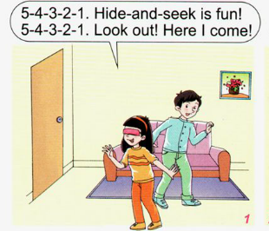
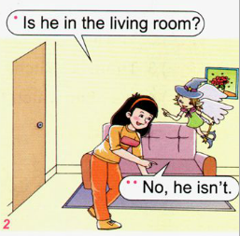
Let’s learn
5-4-3-2-1. Hide and seek is fun!
5-4-3-2-1. Look out! Here I come!
Is he in the living room?
No, he isn’t.

Slide 8
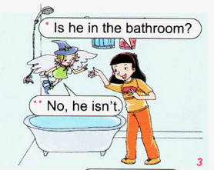
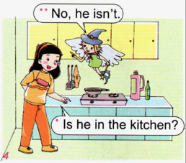
Let’s learn

Slide 9
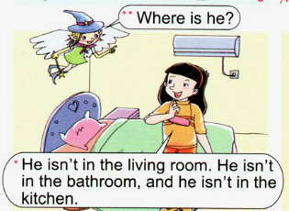
Let’s learn
Where is he?
He isn’t in the living room. He isn’t in the bathroom, and he isn’t in the kitchen.
Oh, here he is!
He is under the bed!

Slide 10
Read it by yourselves for one minute .
自读课文一分钟。
一分钟倒计时
60
Learning tip :
50
10
当你自己朗读时，遇到不会读或不明白意思的单词或句子，可以把它圈起来，请教同学或老师！
20
40
30
开始

Slide 11
Super Mary:表演我最棒！
小组合作：
1.3人一小组
2.根据课文分角色练习
3.适当加上一些动作辅助表演

Slide 12
Look and say
kitchen
study
living room
bedroom
dining room
bathroom

Slide 13
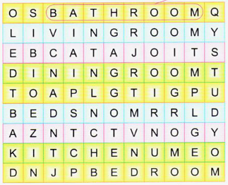

Slide 14
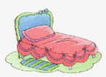
Think and write
in the kitchen
______
______
in the living room
in the living room
in the bedroom
______
______
______
______
______
in the bedroom
in the bedroom
in the study
in the dining room

Slide 15
My house
I have a new house. There is/are … My bedroom is … My living room is … My kitchen is … My bathroom is … I love my house.

Slide 16
如何用一般疑问句进行提问并回答？
Is he/she in the …?
Yes, he/she is./No, he isn’t.
He /She is …
例如
Is he in the bathroom?
Yes, he is.

Slide 17
1.听课文录音并跟读，按照正确的语音、语调朗读并表演课文对话。 2.根据本单元所学的内容，写一篇介绍自己家的小短文（不少于5句话）。
3.预习Unit2 Let’s learn。

