Slide 1
Unit4 How’s the weather today?
人教精通版四年级上册
WWW.PPT818.COM

Slide 2
Let’s sing
Review

Slide 3
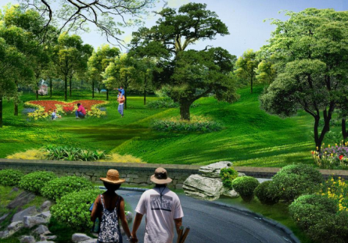
Look and say
Review
It’s … today. Shall we … ?

Slide 4
Presentation
Let’s learn
hot
It’s hot.

Slide 5
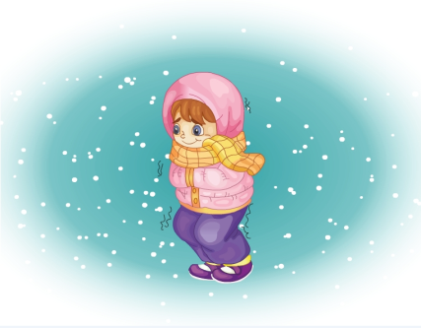
Presentation
Let’s learn
cold
It’s cold.

Slide 6
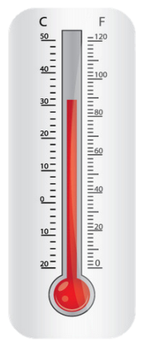
Presentation
hot
warm
cool
cold
40℃
26℃
14℃
-14℃

Slide 7
Game 1
大小声
hot cold
warm cool

Slide 8
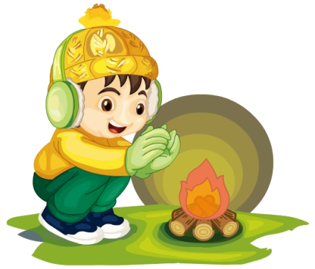
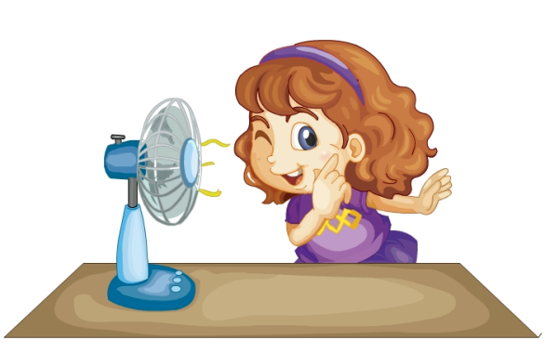
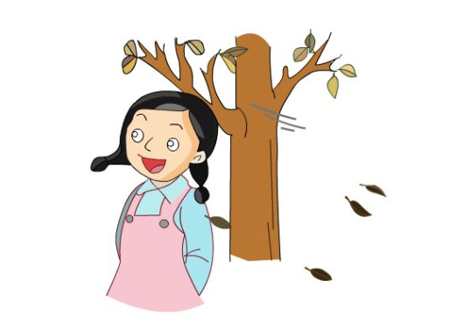
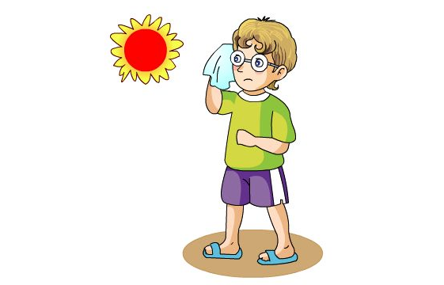
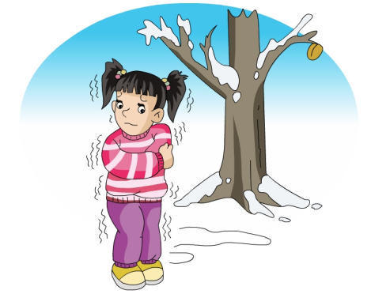
Game 2
Quick response

Slide 9
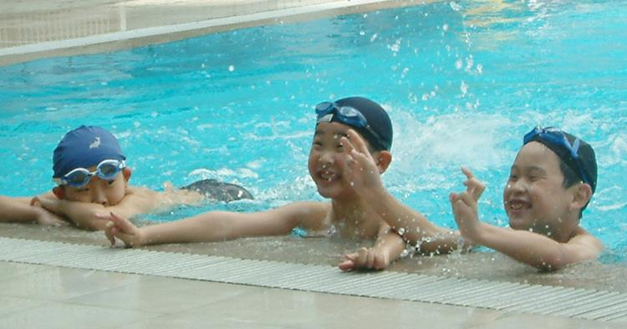
Presentation
It’s hot today. Shall we go swimming?

Slide 10
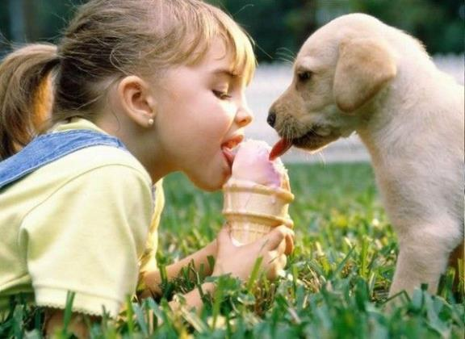
Presentation
It’s hot today. Can I have ice cream?

Slide 11
Presentation
It’s cold today. Can I have some hot water?

Slide 12
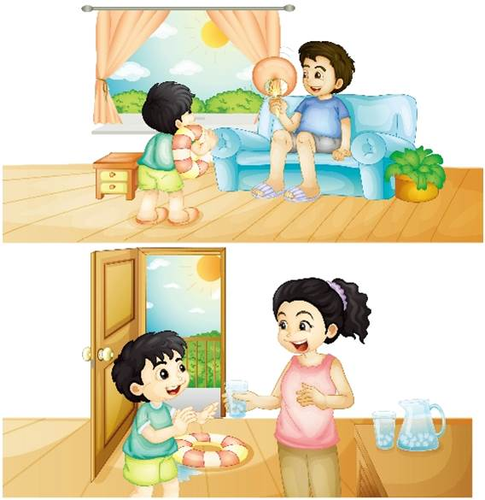
Presentation
Look and say
Guess! What are they talking about?

Slide 13
Presentation
Listen and imitate
1
2
Dad, it’s hot today. Shall we go swimming?
Good idea! Let’s go.
3
Mum, can I have some cold water, please?
4
Here you are.
5
Thank you, Mum.

Slide 14
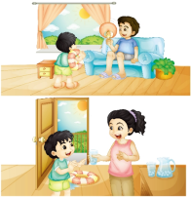
Practice
Let’s read
1
2
3
Read together.
(齐读)
Read in roles.
（分角色读）
Read in groups.
(分组读）

Slide 15
Show time
两人一组，练习对话并表演，其他同学评价。
 | 模仿录音中的语音语调，有感情地朗读。
 | 可以脱离课本，适当改动其中部分，语音地道。
 | 适当添加内容，意思完整，有创新，表演生动。
Good
Great
Excellent

Slide 16
Just read and write
Practice

Slide 17
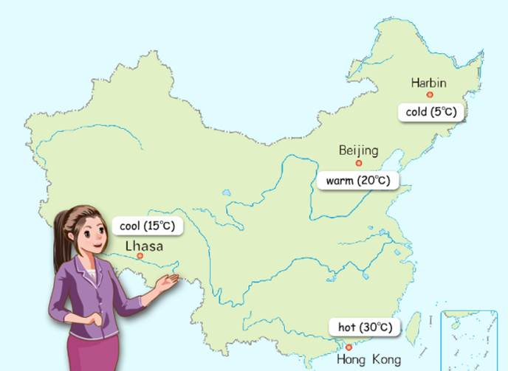
Practice
活动1
小小天气预报员
Hello. This is the weather report. I’m … It’s cold in Harbin.

Slide 18
Practice
活动
Do a survey
The weather you like
The activities you like
The food and drinks you like
Name
Mary
hot weather
go swimming
watermelon
（注意使用“What weather do you like? Shall we …?
Let’s … Can I have …?”等语句进行问答。）

Slide 19
Let’s chant
Practice

Slide 20
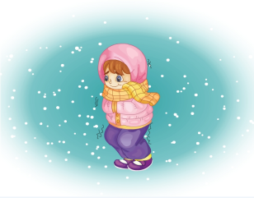
Summary
本课学习的描述天气状况的单词有:
hot
cold

Slide 21
Summary
如何表达天气炎热或寒冷，并提出请求或建议呢？
It’s hot/cold today.
Can I have … ?

Slide 22
Homework
1. 跟读Just talk部分的课文录音，并注意语音、语调。
2.查找并了解我国冬天有哪些城市气候寒冷，夏天有哪些城市气候炎热，并记录在本子上或做成英文手抄报。
3. 预习Lesson 22。
Close

