Slide 1
九年级英语 [冀教版]
Unit 6 Movies and Theatre
Theatres Are Fun!
WWW.PPT818.COM

Slide 2
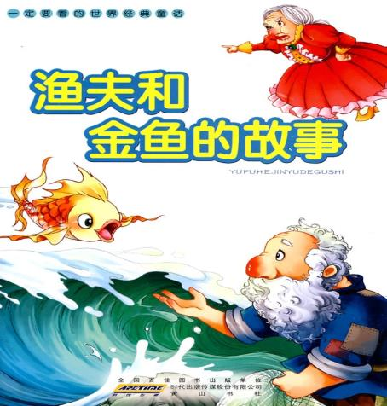
Review The Fisherman and the Goldfish
Retell the play
Catch a talking fish
Tell his wife about that
Ask for a new house
Make his wife a rich lady
Want to be Queen of the Sea

Slide 3
Lead-in
Introduction of the types of the play (drama)
tragedy (悲剧) : serious, sad, suffering （受难）,
end with the death of the main character
comedy (喜剧) : humorous , laughing, satire（讽刺）,
a happy ending
Think About It !
What kinds of plays do you like? Why?

Slide 4
New Lesson Fast Reading
Find out the playwrights that appeared in the text
Look for their famous dramas.

Slide 5
Topic Discussion & Literature Background
The Renaissance period (文艺复兴时期)
William Shakespeare (威廉·莎士比亚)
The Neoclassical period (新古典主义时期)
Richard Brinsley Sheridan(理查德 布林斯利·谢里丹)
The Modern period (现代时期)
George Bernard Shaw(萧伯纳)

Slide 6
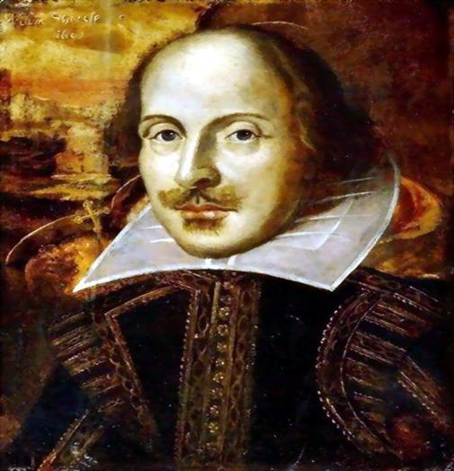
William Shakespeare 威廉·莎士比亚

Slide 7
William Shakespeare
Four Tragedies
(四大悲剧)
Hamlet《哈姆雷特》
King Lear 《李尔王》
Othello 《奥赛罗》
Macbeth 《麦克白》
Four comedies
(四大喜剧)
The Merchant of Venice
《威尼斯商人》
A Midsummer Night’s Dream
《仲夏夜之梦》
As You Like It 《皆大欢喜》
Twelfth Night 《第十二夜》

Slide 8
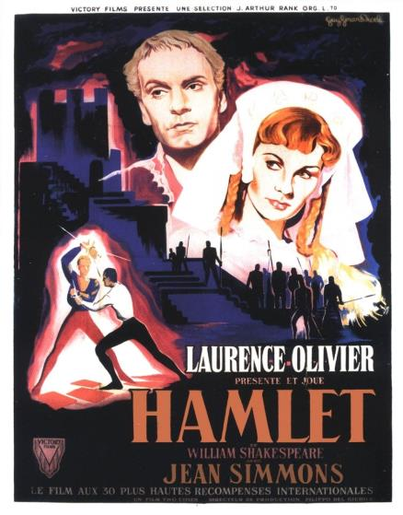
Hamlet《哈姆雷特》
Theme （主题）
Revenge （复仇）
Weakness of human nature：hesitation
（人性的弱点：犹豫）

Slide 9
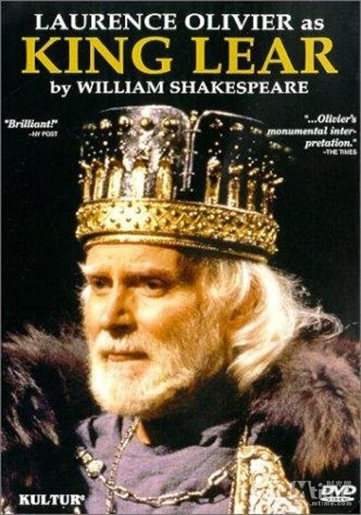
King Lear 《李尔王》
Theme （主题）
power（权力）
desire（欲望）

Slide 10
Othello 《奥赛罗》
Theme （主题）
doubt （怀疑）
Envy （嫉妒）

Slide 11
Macbeth 《麦克白》
Theme （主题）
Ambition（野心）
Fear（恐惧）
Suspicion（猜疑）

Slide 12
The Merchant of Venice 《威尼斯商人》
Theme （主题）
Praise friendship and love
（歌颂友谊和爱情）
Satire greed
（讽刺贪婪）

Slide 13
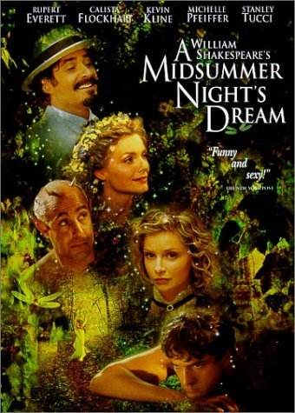
A Midsummer Night’s Dream 《仲夏夜之梦》
Theme （主题）
Misfit （乱点鸳鸯谱）

Slide 14
As You Like It 《皆大欢喜》
Theme （主题）
kindness defeats evil
（以善胜恶）

Slide 15
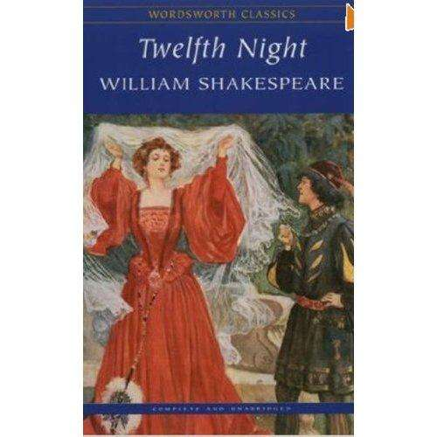
Twelfth Night 《第十二夜》
Theme （主题）
Praise women’s talent
（赞美女性才华）
Equality between men and women
（男女平等）

Slide 16
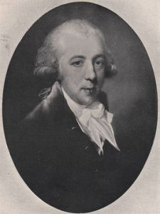
Richard Brinsley Sheridan 理查德 布林斯利·谢里丹

Slide 17
The School for Scandal 《造谣学校》
Theme （主题）
Satire immorality and hypocrisy of the upper class
（讽刺上流社会的不道德与伪善）

Slide 18
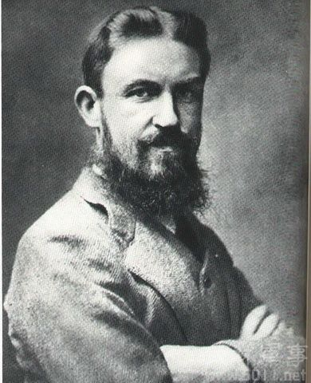
George Bernard Shaw（萧伯纳）
Mrs. Warren’s Profession
《华伦夫人的职业》
Pygmalion 《卖花女》
Widowers’ Houses
《鳏夫的房产》

Slide 19
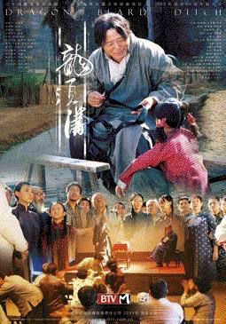
Lao She Teahouse Longxu Slum

Slide 20
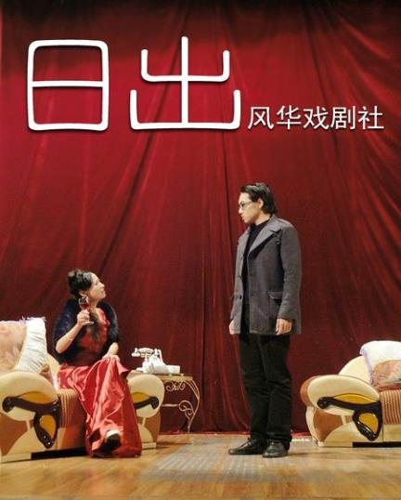
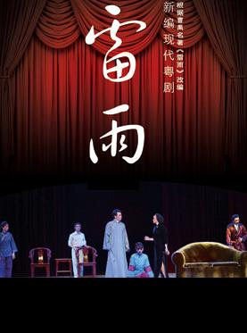
Cao Yu Sunrise Thunderstorm

Slide 21
Matching Game
Team work:
Match each play with its playwright.

Slide 22
Reading for
Detail Questions（细节题）
Main Idea Questions （主旨题）
Word Guessing Questions （猜词题）
Inference Questions（推断题）

Slide 23
Reading for Detail Questions（细节题）
Find out the answer directly in the passage
Look for the source of information （信息源）
Location words （定位词） : name （人名）, place name （地名）, time （年代）, figure （数字） , proper noun （专有名词） , etc.

Slide 24
Reading for Detail Questions （细节题）
Read the lesson and write true (T) or false (F).
(1)William Shakespeare is a world-famous playwright.
(2)Shakespeare’s works are all comedies and historical pieces.
(3)Hamlet is a famous comedy.
(4)Teahouse was written by Lao She.
(5)Cao Yu wrote the play Thunderstorm.
(6)In Lao She Teahouse Theatre, you can drink tea while enjoying a play.
T
F
F
T
T
T

Slide 25
Reading for Main Idea Questions （主旨题）
Pay attention to the first paragraph and the last paragraph of the passage.
Focus on the repeated content（重复的内容）of the passage.
Notice the topic sentence in each paragraph.

Slide 26
Reading for Main Idea Questions （主旨题）
The dialogue among Jenny, Danny and Li Ming are mainly about ________ . A．fiction B．drama C．poem D．playwrights and drama
D

Slide 27
Reading for Word Guessing Questions （猜词题）
Accumulate new words and phrases（积累生词和短语）
make use of the context （利用语境）
Judge structural relation （判断结构关系）

Slide 28
Reading for Word Guessing Questions （猜词题）
(1) What does the word “handsome” mean in this dialogue? ________ .
A．可观的 B． 慷慨的
C．英俊的 D． 相当大的
(2) What does the word “works” (the fourteenth line) mean in this dialogue? ________ .
A．工作 B． 作品
C．作业 D． 工厂
C
B

Slide 29
Reading for Inference Questions（推断题）
Judge from the given information （已知信息）
Exclusive method （排除法）
Complex reasoning （综合推理）

Slide 30
Reading for Inference Questions（推断题）
(1) From the dialogue we can learn that ________ .
A．Danny might become a good actor in the future.
B．Li Ming knew nothing about foreign playwrights and dramas.
C．Danny might like the Lao She Teahouse in Beijing.
D．Jenny and Danny have never been to the Lao She Teahouse in Beijing.
(2) Jenny probably agrees that________ .
A．every member in her team worked very hard to make this play.
B． Danny is a very good and handsome actor.
C． the Lao She Teahouse in Beijing is an ordinary tea house.
D． most of William Shakespeare’s early plays are tragedies.
D
A

Slide 31
Exercise
Reading Comprehension A, B,C&D.
P110-113

Slide 32
Homework
1.Complete Let’s Do It! No. 3.
2.Finish off the exercises in the activity book.
3.Preview Lesson 36.

