Slide 1
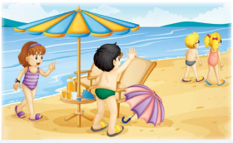
Unit5 Is this your schoolbag?
人教精通版五年级上册
WWW.PPT818.COM

Slide 2
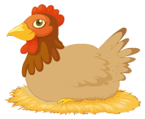
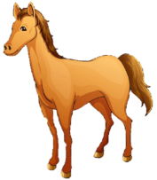
>>Review
Look and say
hen
goose
cow
horse
elephant
fish

Slide 3
>>Review
Look and say
Is that your fish?
Yes, it is.

Slide 4
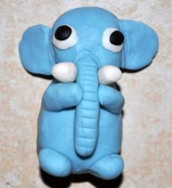
>>Review
Look and say
Is that your elephant?
No, it isn’t.

Slide 5
>>Presentation
Let’s learn
umbrella

Slide 6
>>Presentation
Let’s learn
fan

Slide 7
>>Presentation
Let’s learn
sun cap

Slide 8
>>Presentation
Let’s learn
camera

Slide 9
>>Practice
Game 1
魔法手指
umbrella fan
sun cap camera

Slide 10
>>Practice
Game 2
What’s missing

Slide 11
>>Presentation
Look and say
What can you see in this picture?

Slide 12
>>Presentation
Listen and answer
1. Whose umbrella is this?
It’s Peter’s umbrella.
2. Whose fan is this?
It’s Kate’s fan.

Slide 13
>>Presentation
Just talk
Listen and imitate
Lisa: Hi, Gao Wei. It’s six o’clock now.
Gao Wei: Oh! It’s time to go home.
Lisa: Let’s go home, Peter and Kate!
Gao Wei: Whose umbrella is this?
Lisa: It’s Peter’s umbrella.
Gao Wei: Whose fan is this? Is it your fan, Lisa?
Lisa: No, it isn’t. It’s Kate’s fan.
Gao Wei: Peter and Kate, come back! Your umbrella
and fan!
Peter & Kate: Thank you. Here we come!

Slide 14
>>Practice
Read it by yourself for one minute .
自读对话一分钟。
一分钟倒计时
60
Learning tip :
10
10
50
自己读对话，比一比看谁能在一分钟内读完，并且读得准确、流利！
20
20
40
30
30
开始

Slide 15
>>Practice
Show time
小组合作，练习对话并表演，其他同学评价。
Pronunciation (语音) |  | Fluency (流利) | Cooperation (合作)
OK!
Great!
Super!

Slide 16
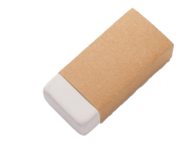
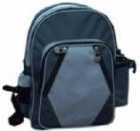
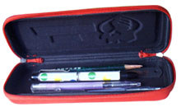
>>Practice
Pair work
—Whose … is this?
—It’s my/your/his/her …

Slide 17
>>Practice
活动1
猜一猜
学生分成4人一组，然后学生甲低头蒙住眼睛不看，另外三个学生分别拿出一样物品放在课桌上。三个学生一起问学生甲：Whose … is this? 学生甲看着物品说：It’s XXX’s. 并通过询问：Is it your…, XXX? 再次确认，被问到的学生按照实际回答。

Slide 18
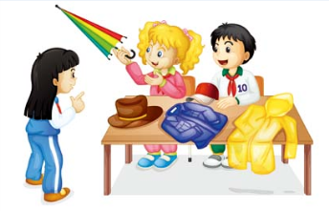
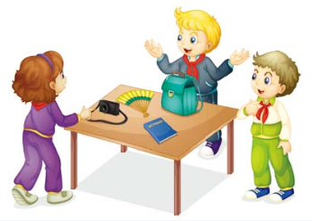
>>Practice
活动2
失物招领
1
Whose umbrella is this?
2
It’s Lisa’s umbrella.
4
No, it isn’t. It’s John’s camera.
3
Is this your camera?
5
Yes, it’s my camera.

Slide 19
>>Summary
本课的重点单词：
umbrella
fan
sun cap
camera

Slide 20
>>Summary
如何询问某物是谁的，并做回答呢？
—Whose umbrella is this?
—It’s Peter’s umbrella.

Slide 21
>>Homework
1.观看课文动画，按照正确的语音、语调朗读课文对话。 2.制作本课单词卡片，并在卡片背面写出单词对应的英文。
3.预习 Lesson 31。

