Slide 1
陕旅版四年级上册 Unit4 When Do You Have Classes? 第2课时
WWW.PPT818.COM

Slide 2
Let’s sing---Are you sleeping

Slide 3
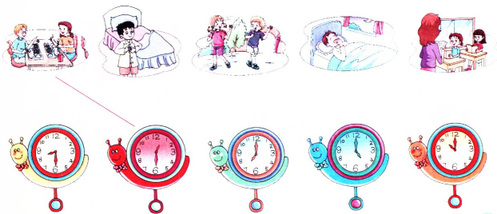
Think and match

Slide 4
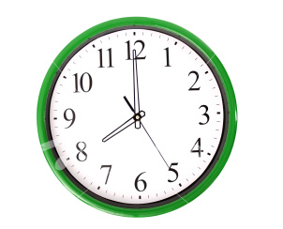
When do you have classes?
I have classes at eight in the morning.

Slide 5
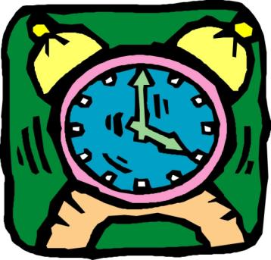
When do you play games?
I play games at four in the afternoon.

Slide 6
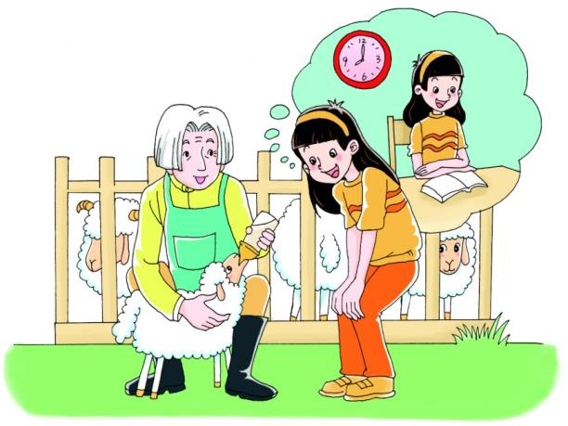
Let’s talk
听录音，回答问题：
When does Shanshan have classes?

Slide 7
When do you have classes, Shanahan?
I have classes at eight in the morning.

Slide 8
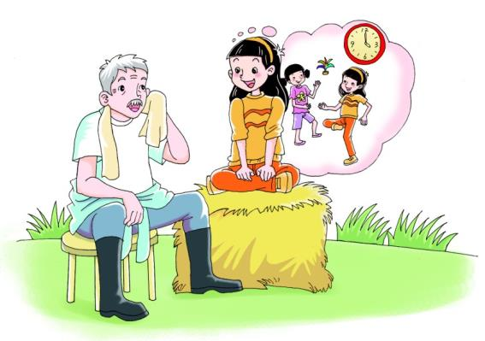
Let’s talk
听录音，回答问题：
When does Shanshan play games at school?

Slide 9
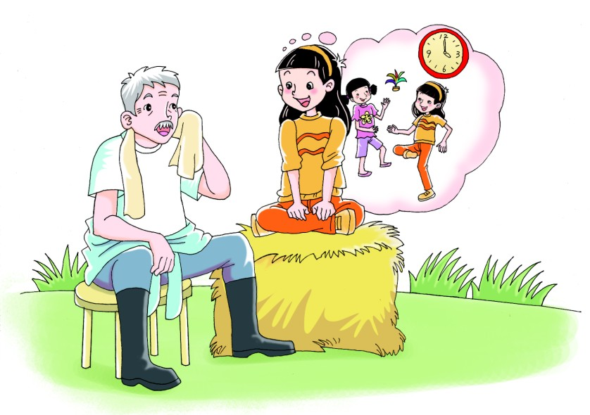
Yes, we do.
Do you play games at school?
When do you play games?
At four in the afternoon.

Slide 10
Role play
两人一组，用句型：
—When do you + 动词短语？
—I…轮流问答。

Slide 11
Practice
When do you get up
When do you have breakfast
When do you go to school
When do you have a class
in the morning?

Slide 12
Practice
When do you play games
When do you go home
in the afternoon?
When do you watch TV
When do you go to bed
in the evening?

Slide 13
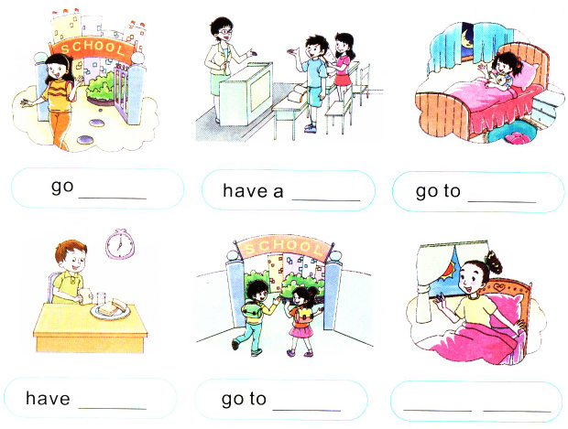
Look and write
home
class
bed
lunch
school
get up

