Slide 1
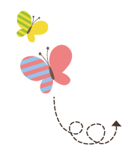
Unit 1 Sports
六年级下册
Lesson 4 Did You Have Fun?
WWW.PPT818.COM

Slide 2
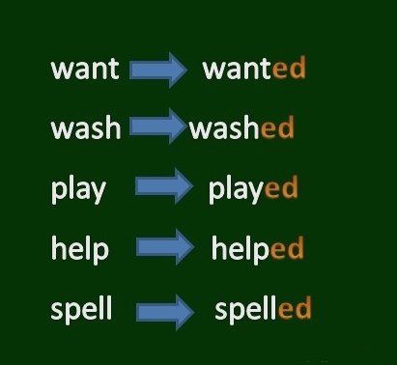
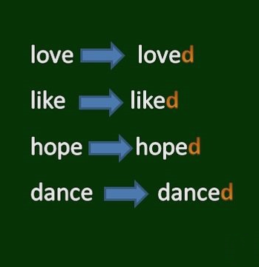

Slide 3
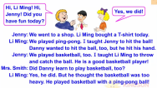
1. We're home!
Mrs. Smith: Hi, Li Ming! Hi, Jenny! Did you have fun today?
Jenny: Yes, we did!
Jenny: We went to a shop. Li Ming bought a T-­shirt today.
Li Ming: We played ping­-pong. I taught Jenny to hit the ball! Danny wanted to hit the ball, too, but he hit his hand.
Jenny: We played basketball, too. I taught Li Ming to throw and catch the ball. He is a good basketball player!
Mrs. Smith: Did Danny learn to play basketball, too?
Li Ming: Yes, he did. But he thought the basketball was too heavy. He played basketball with a ping-­pong ball!

Slide 4
— Did you have fun today?今天你们玩得高兴吗？
—Yes, we did!是的，我们玩得很高兴！
知识点 1
询问某人过去是否做了某事的句型
Did+主语+动词原形+其他？
问句：
Yes，主语+did. / No，主语+didn’t.
回答：
—Did you go shopping yesterday? 昨天你去购物了吗？ —Yes，I did.是的，我去了。
例句：

Slide 5
have fun 玩得高兴
have a good time; enjoy oneself
同义短语：
The children are having fun. 孩子们正玩得高兴。
例句：
用所给单词的适当形式完成句子。
________ they ________ (see) the film last night?
典例1
Did
see
选出能替换画线部分的选项。
Did you have a good time last Sunday?
A. have fun B. have a fun C. have funny
典例2

Slide 6
Li Ming bought a T-­shirt today.
今天李明买了一件T恤衫。
知识点 2
这是一般过去时的句子，陈述某人过去做了某事。
用法：
主语＋实义动词过去式＋其他.
句型结构：
主语+didn’t+动词原形+其他.
否定形式：
I went to the park last Sunday. 上个星期日我去公园了。
例句：

Slide 7
易错点
提示
含实义动词的一般过去时没有人称和数的变化，句子中的动词一律用过去式。
I bought some books yesterday. (改为否定句)
I ___________________________ yesterday.
典例
Didn’t buy any books

Slide 8
知识点 3
thought /θɔːt/ v. 想；认为(think的过去式)
Danny thought the basketball was too heavy. 丹尼认为篮球太重了。
例句：
字母组合ou的发音是/ ɔː/。
发音：
bought(buy的过去式) 买；brought(bring的过去式) 带来
形近词记忆法：

Slide 9
选词填空。
—What did you think of the film?
—I________(think, thought) the film was funny.
典例
thought
本题考查动词的时态。根据was可知时态是一般过去时，所以前面的动词也要用过去式。
点拨：

Slide 10
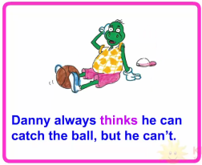
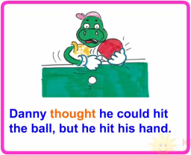
2. Bought, taught and thought

Slide 11
could /kʊd/ aux. v. 能(can的过去式)
知识点 4
I thought I could play football, but it was too difficult. 我认为我能踢足球，但是它太难了。
—What did the teacher say? 老师说什么了？
—He said we could go home. 他说我们可以回家了。
例句：

Slide 12
易错点
提示
could是情态动词can的过去式，后面必须跟动词原形。
would aux. v．将要
形近词：
couldn’t = could not 不能
否定形式：

Slide 13
I thought I ________ make dumplings. But it was too difficult.
A．can B．could C．couldn’t
典例
B
根据thought可知时态为一般过去时，所以排除A；句意为“我认为我能包饺子，但是它太难了。”所以选B。
点拨：

Slide 14
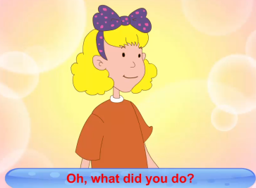
3. Let’s sing!
Oh, what did you do? Oh, what did you do?
Oh, what did you do? Li Ming and Jenny.
We went to a little shop.
We bought a new heavy ball.
We taught each other a sport.

Slide 15
4. Let's do it!
ate
saw

Slide 16
4. Let's do it!
taught
went
bought

Slide 17
点兵点将
全班同学。一名同学说“点兵点将，点到谁，谁就做我的搭档。”点到自己的搭档，一问一答有关自己上周日所做的事情，然后角色互换。两名同学完成任务后，由被点到的同学再点一名同学，活动继续。如：
Jim: 点兵点将，点到谁，谁就做我的搭档。（点到Lily）
Jim: What did you do last Sunday?
Lily: I went shopping with my mother. What did you do last Sunday?
Jim: I played football with my friends.

Slide 18
一、单项选择。
( ) 1. Did you have ________ last Sunday?
A. a fun B. fun C. funny
( ) 2. —Did you play ping­-pong yesterday?
—__________.
A. Yes, I did B. No, I did C. Yes, I didn’t
B
A

Slide 19
二、按要求完成句子。
1. Li Ming goes to school by bus. (加上yesterday改写句子)
Li Ming ________ to school by bus ________.
2. We played basketball last Sunday. (改为一般疑问句)
________ you ________ basketball last Sunday?
3. We taught each other a sport. (改为否定句)
We ________ ________ each other a sport.
4. Did Danny learn to play ping­-pong? (作否定回答)
No, ________ ________.
went
yesterday
Did
play
didn’t
teach
he
didn’t

Slide 20
四、写出下列动词的过去式。
1. do ⇨______________ 2. go⇨_____________
3. buy⇨______________ 4. teach⇨___________
5. play⇨_____________ 6. can⇨__________________
did
went
bought
taught
played
could

Slide 21
本节课我们学习了以下知识，请同学们一定加强巩固，以便能和同学们进行灵活交流哦！
重点词汇：thought, could
重点句式：— Did you have fun today?
—Yes, we did!
Li Ming bought a T-­shirt today.

Slide 22
1 熟记本节课所学的句型、短语和单词，必须会听、说、读、写。
2 将We're home!的对话朗读流利。
3 完成配套的课后作业。

