Slide 1
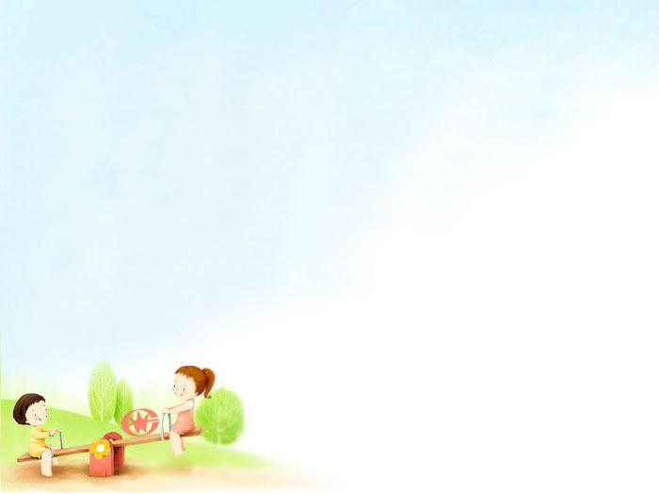
Unit 8
Natural disasters
Integrated Skills
WWW.PPT818.COM

Slide 2
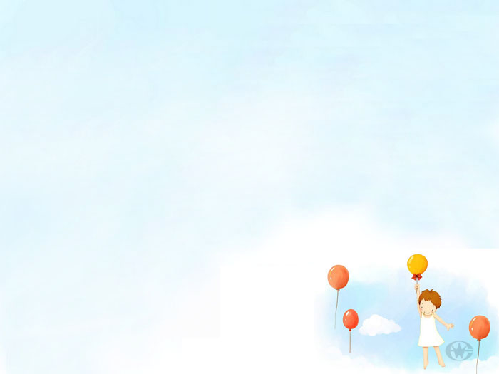
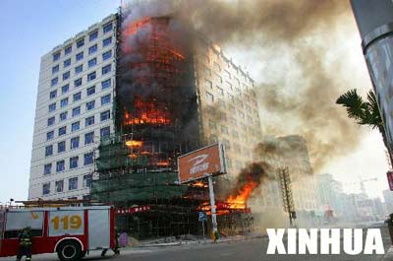
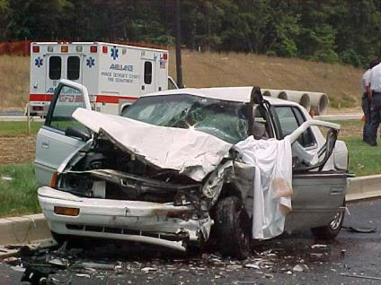
What is happening?
Disasters and accidents
a car accident
a fire

Slide 3
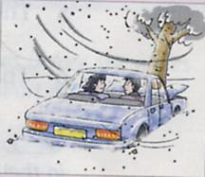
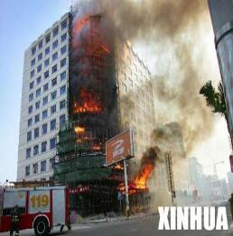
Away from danger
122- Traffic
119- Fire

Slide 4
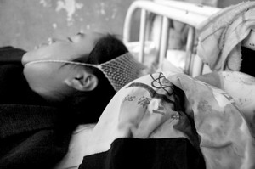
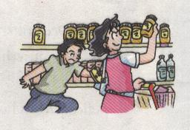
Away from danger
110-Police
120- Hospital

Slide 5
Listen to a talk called Away from danger at Sunshine Hall, then help Simon complete his notes.

Slide 6
Listen again and answer Annie’s questions in Part A3, Page 100.

Slide 7
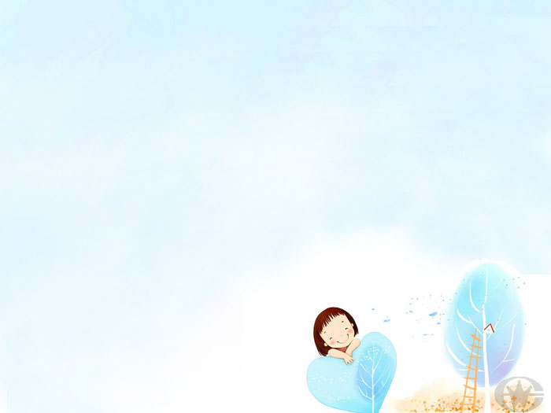
Speak up
What should we do first?

Slide 8
Listen to the tape and answer the following questions:
What are they talking about?
2. What can they do first?
3. Do they need to go and see the doctor?
What to do when burning oursevles.
Keep the hand in cold water for ten minutes, then cover the burn with a clean towel.
Yes.

Slide 9
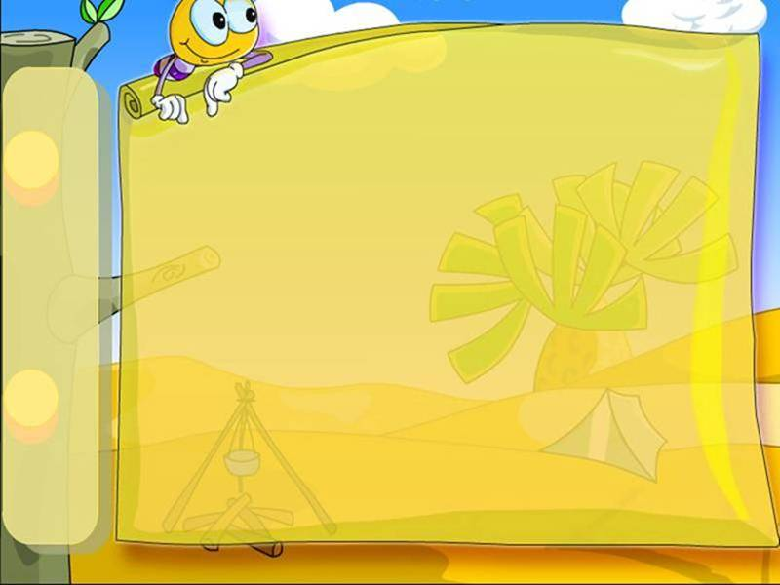
Act out the dialogue in pairs.
Make up the similar dialogue in pairs.

Slide 10
Homework
1.Revise what we have learnt today.
2.Collect more ways which can help us
stay away from danger.

Slide 11
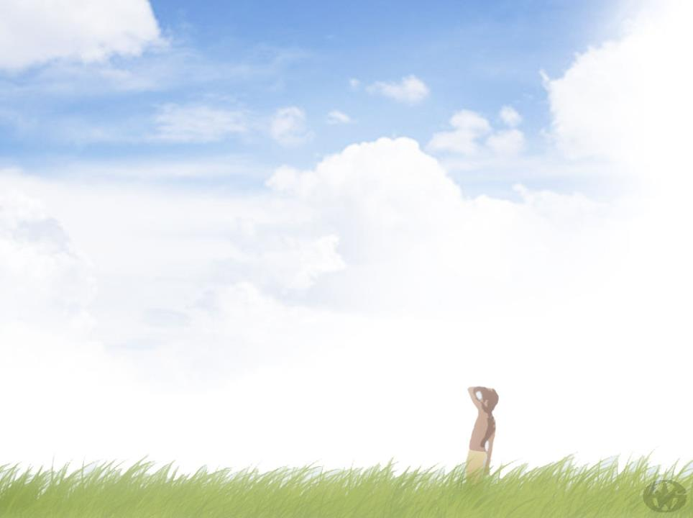
Thanks for your coming!

