Slide 1
Unit 14
I remember meeting all of you
in Grade7.
Section B Period 2 3a-4b
WWW.PPT818.COM
Notes:
1
1

Slide 2
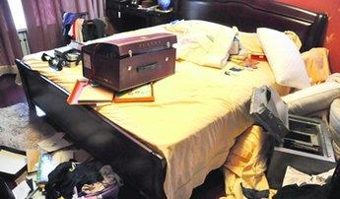
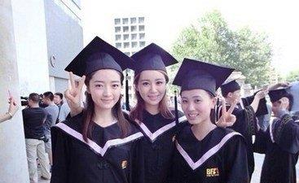
make a mess
弄得一团糟
graduate v.
毕业；获得学位

Slide 3
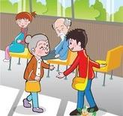
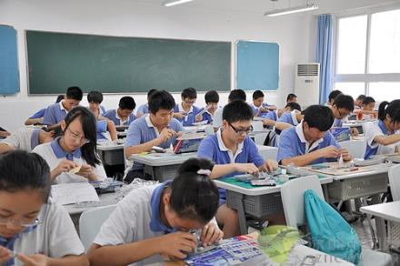
caring adj.
体贴人的；关心他人的
senior high (school)
高中

Slide 4
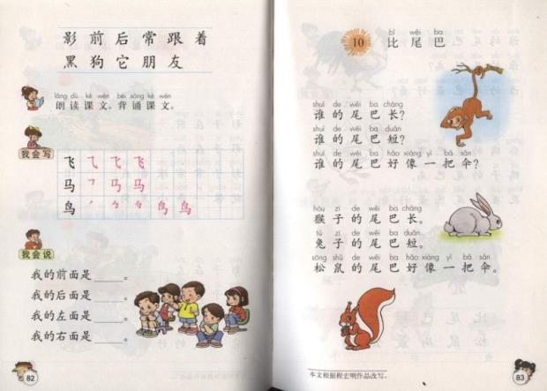
text n.
课文； 文本

Slide 5
Read the passage and answer
the questions.
3a
1. What kind of writing is this?
2. What is the main subject of this writing?
3. Who do you think the writer is?
Poem.
The memory of the junior high school.
A student in Grade 3.

Slide 6
Read the poem again. Write the words
that rhyme with the words below.
3b
things
rings
land
________
understand
fear
school
________
year
________
cool
class
________
flowers
________
pass
teachers

Slide 7
3c
Have you experienced any of the
following things? How did you feel?
How does the writer feel about them?

Slide 8
1.trying to be on time for morning
readings?
2.running to the dining hall when the
lunch bell rings?
3.training for sports day
4.starting the first day in Grade 7

Slide 9
5.slowly making some new friends
6.helping classmates with homework
7.preparing for art festivals
8.going to New Year’s parties
9.learning English

Slide 10
Grammar Focus
What happened in Grade 7 that was special? | Our team won the school basketball competition.
How have you changed since you started junior high school? | I've become much better at speaking English.
How do you think things will be different in senior high school? | I think that I’ll have to study much harder for exams.
What are your plans for next year? | I'm going to join the school volleyball team.

Slide 11
Grammar Focus
What do you remember about Grade 8? | I remember being a volunteer.
What did you use to do that you don't do now? | I used to take dance lessons, but I don’t anymore.
What are you looking forward to? | I'm looking forward to going to senior high school.

Slide 12
Number the sentences to make
a paragraph.
4a
_____When I get to senior high, I will join the school swim team.
1 My time in junior high school has been enjoyable.
_____In Grade 8, I studied harder but I still got poor grades in English. I had problems with pronunciation and reading texts. So the next year, I worked much harder and got better grades.
6
3

Slide 13
_____ Next year, I will be in senior high school. I
can’t believe how fast the time went by!
_____ This year, with Mr. Trent’s help, my English
level has been improving and I hope to get
good grades at the end of the year.
_____ In the first year, I didn’t work very hard in
class, but I joined many different school clubs
and had a lot of fun.
5
4
2
6 1 3 5 4 2

Slide 14
4b
Write your own answers to the questions.
1. What do you remember about Grade 7?
2. What happened in Grade 8 that was special?
3. What did you use to do that you don't do now?
I remember being friends with Jack in Grade 7.
I learned to play piano.
I used to fly kites but I don’t do it now.

Slide 15
4. How have you changed since you started junior
high school?
5. How do you think things will be different in senior
high school?
6. What are your plans for next year?
7. What are you looking forward to?
I become much mor outgoing/happy/hard-working...
May be there will be a lot of difficulties...
I will go to Peking...
I’m looking forward to learning English well.

Slide 16
Language points
1.Pride of overcoming fear
overcome可用作不及物动词，也可用作及物动词，意为“战胜，克服”。
如：She was trying to overcome her physical
repugnance for him.
她努力克制对他非常强烈的反感。
We need a confident leader to overcome these difficulties.
我们需要一个有信心的领导者来克服这些困难。

Slide 17
Language points
2. And making a great big mess
make a mess意为“弄得一团糟；弄得一塌糊涂”。
如：He contrived to make a mess of the whole thing.
他挖空心思反而把事情全盘弄糟了。
He managed to make a mess of it.
他真不错，把事情弄得一团糟。
She always makes a mess of things; she's a prize idiot.
她总是把事情弄糟；她是个不折不扣的大笨蛋。
If you cook, please just don't make a mess.
你要是做饭的话, 拜托别弄得一团糟。

Slide 18
Language points
3.And now it’s time to graduate
graduate可用作不及物动词，也可用作及物动词，意为“毕业；获得学位”，为非延续性动词，现在完成时的肯定式不与表示一段时间的状语连用。graduate作动词表示“从……毕业”用from，表示某科的毕业生用in，表示所获学位或成绩情况多用as 或with。
如：He graduated at Oxford.他毕业于牛津大学。
It is three years since he graduated.他毕业三年了。
The university graduated 1500 students last year.
该大学去年有1500位学生毕业。

Slide 19
Language points
4. I’m trying to keep my cool. 我试图保持冷静
keep one’s cool 意为“沉住气；保持冷静”。
如：One of Hal's great strengths is the ability to keep cool when start to go wrong. 哈尔最大的优点之一就是出问题时，他能保持沉着、冷静。
At this moment of truth, you must keep cool.
在这紧急关头，你要保持镇静。
John couldn't keep cool when he met his rival.
约翰见到他的对手就不能冷静下来。

Slide 20
Language points
5. And our kind and caring teachers
caring 作形容词，意为“体贴人的；关心他人的”。
如：He's a very caring person.
他是个非常体贴人的人。
You're very lucky to have a caring family.
你很幸运有一个温馨的家庭.
Are children and young people in school mastering the art of caring? 在校的孩子和年轻人是不是在掌握关心他人的艺术呢 ?

Slide 21
I. 选择最佳答案。
1. There will be no difficulty in the world that they cannot ______.
A. conquer B. defeat
C. win D. overcome
2. ---Tommy, don't ______ in your room.
--- OK, mum, I will put away my toys at once.
A. take out B. make a mess
C. play with D. look for
D
B

Slide 22
II. 根据汉语提示填空。
We can _________ (克服) any difficulty.
She _________ (毕业) in English and Drama from Manchester University.
Not everyone in the world will be kind and ______ (体贴人的) towards you.
There are few strangers in a town like ____ (我们的).
overcome
graduated
caring
ours

Slide 23
Review the grammar focus.

