Slide 1
Colours
WWW.PPT818.COM

Slide 2
Chant
What is green? The tree is green.
What is white? The cloud is white.
What is yellow? The sun is yellow.
What is red? The flower is red.
What is blue? The sky is blue.
What is orange? The doll is orange.
What is purple? The kite is purple.
What is colourful? The rainbow is colourful.

Slide 3
rainbow
red
green
violet
orange
blue
紫罗兰色
yellow
purple

Slide 4
Look at the rainbow in the sky.
It is colourful.
The rainbow has seven colours.
They are red, orange, yellow, green, blue, purple and violet.
Look at the rainbow.
How beautiful it is!

Slide 5
argue(争论)
/a:/
Mother Rainbow
Mother Rainbow is sad. Because colour brothers like to
argue all day . They all say: ‘I’m the most beautiful colour
of the rainbow family.’

Slide 6
Violet flowers are beautiful. People like them very much. I am the most beautiful colour of the rainbow family.
violet

Slide 7
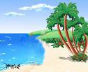
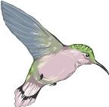
Birds can fly in the blue sky.
Fish can swim in the blue sea.
I am the most beautiful colour of the rainbow family.

Slide 8
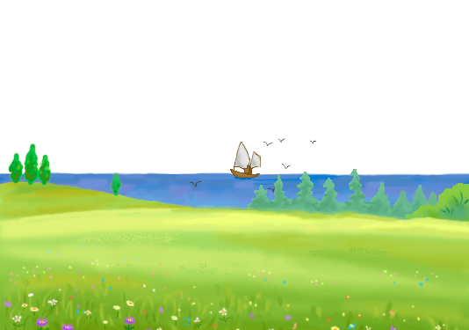
What colour is…?
What colour is …?
What colour is the sea?
The sea is blue.
The sea is blue.
It is blue.
sea

Slide 9
In Spring, you can see the green trees and mountains.
Green! Green!
Who’s the most beautiful colour of the rainbow family? It’s me.

Slide 10
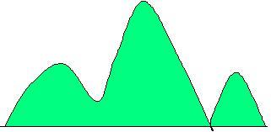
What colour are the mountains?
They’re green.
mountain

Slide 11
Read the words:
mountain cloud
house count
mouse out
mouth

Slide 12
What colour …?
What colour…?
What colour are the mountains?
The mountains are green.
The mountains are green.
They are green.

Slide 13
Mother Rainbow is sad. Because colour brothers like to
argue all day . They all say: ‘I’m the most beautiful colour
of the rainbow family.’
Violet flowers are beautiful. People like them very much.
I am the most beautiful colour of the rainbow family.
Birds can fly in the blue sky. Fish can swim in the blue sea.
I am the most beautiful colour of the rainbow family.
In Spring, you can see the green trees and mountains.
Green! Green!
Who’s the most beautiful colour of the rainbow family? It’s me.

Slide 14
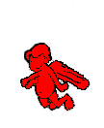
I am____________.
Look, the __________is __________.
The _________s are _________.
People like me.
I am the most beautiful colour of the rainbow family.

Slide 15
I am yellow.
Look, the sun is yellow.
The stars are yellow.
I am the most beautiful colour.

Slide 16
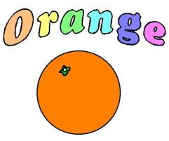
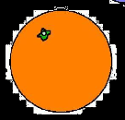
Look at me.
I am orange.
Orange oranges taste very nice.
I’m the most beautiful colour.
Do you like me?

Slide 17
Chinese like red.
Red is a lucky colour.
So I’m the most beautiful colour of the rainbow family.

Slide 18
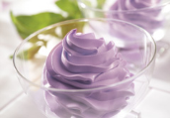
Purple,purple.
Purple is the most beautiful colour of the rainbow family.
Taro pies and taro ice-creams are very delicious.

Slide 19
Your show time
read and act out the story.

Slide 20
How silly you are!
People love and need you all.
All the colours are important in the world.
They make the world colourful.
Colour brothers don’t argue now. They live together happily!

Slide 21
All the colours are important in the world.
They make the world colourful.
So we should protect the colourful nature.
保护多姿多彩的大自然.
Please don’t pick the flowers.
Don’t climb the trees.
Don’t walk on the grass.
And don’t leave rubbish.

Slide 22
Homework:
1. Tell the story to your friends.
2. Write about your favourite colour.

Slide 23
See you!

