Slide 1
Unit6 Is this your skirt?
人教精通版三年级下册
WWW.PPT818.COM

Slide 2
Review
Look and say
Game
What’s missing?

Slide 3
Lead-in
Look and say
你能看出图片中的字母吗？

Slide 4
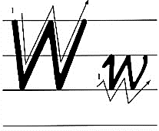
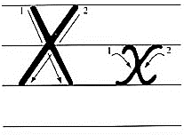
Presentation
Let’s learn

Slide 5
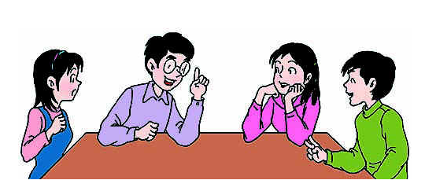
Presentation
Discussion
你都知道哪些含有字母w或x的单词呢？
two, twelve, textbook, six …

Slide 6
Presentation
Let’s learn
watch
water

Slide 7
Presentation
Let’s learn
box
taxi

Slide 8
Practice
Game1
大小声
watch
water
box
taxi

Slide 9
Practice
Game2
魔法手指
watch
water
box
taxi

Slide 10
Presentation
Listen and say
What are they talking about?

Slide 11
Presentation
Let’s learn
Excuse me. Is that your watch?
Oh! Yes, it is.

Slide 12
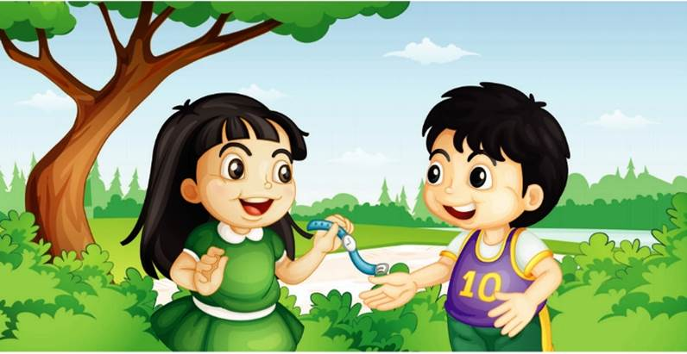
Presentation
Let’s learn
Here you are.
Thank you!

Slide 13
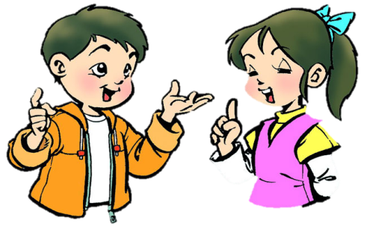
Practice
Role-play
分角色朗读对话，注意模仿语音语调。
两人一组，试着表演出来吧。

Slide 14
Practice
Read it by groups for one minute .
小组读对话一分钟。
一分钟倒计时
60
Learning tip :
50
10
10
四人一组，比赛读句子，看谁能在一分钟内读完，并且读得准确、流利！
20
20
40
30
30
开始

Slide 15
Presentation
Key points
Is this your watch?
Yes, it is.

Slide 16
Presentation
Key points
Is that your box?
Yes, it is.

Slide 17
Practice
Let’s do
That is a ____.
taxi
A: ___________?
B: Yes, _____.
Is that a taxi
it is

Slide 18
Practice
Let’s do
watch
That is my _____.
A: ______________?
B: Yes, _____.
Is that your watch
it is

Slide 19
Practice
Let’s sing

Slide 20
Summary
本课学到的重点单词：
watch
water
box
taxi

Slide 21
Summary
询问那是否是某人的东西并作出肯定回答，该如何表达？
—Is that your …?
—Yes, it is.

Slide 22
Homework
1. 观看Just talk部分的课文动画，跟读对话并注意语音、语调。
2. 在四线三格中正确书写本课所学的新单词和字母，不少于5遍，并听写1遍。
3. 预习Lesson 34。
Close

