Slide 1
Unit 3 Topic 1
English is widely spoken throughout the world.
Section A
WWW.PPT818.COM

Slide 2
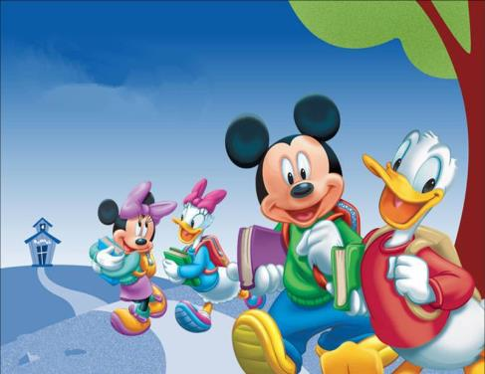
Mickey Mouse
Donald Duck
n.漫画
cartoon characters
n.(书、剧本、电影等中的 ）人物，角色；（汉）字，字体；品格

Slide 3
3 Listen to the passage and mark T (True) or F (False).
Before listening, try to guess the pronunciations and meanings of the new words in the statements.
T
( ) 1.Walt Disney was a great film-maker as well as an artist.
( ) 2.Walt used to sit in the family garage and draw pictures.
( ) 3.One day, a mouse came and played on the floor of the
garage.
( ) 4.When he first met the mouse，Walt was afraid.
( ) 5.At last, he was pleased with one of his pictures of the
mouse. He called it Mickey Mouse.
T
T
F
T
对… 满意
My mother is pleased with my good results.

Slide 4
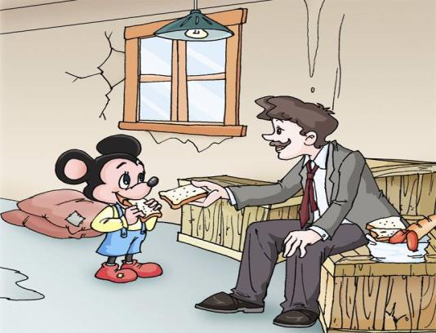
The story of Mickey Mouse
Walt Disney: film-maker
The story happened in a garage.
n.停车房；车库

Slide 5
Mickey Mouse is enjoyed by millions of people throughout the world.
prep.遍及；贯穿
She comes from Disneyland.

Slide 6
1b Listen to 1a and choose the correct answers.
( ) 1. Who is going to Disneyland?
A. Wang Junfeng. B. Wang Junfeng’s parents.
C. Wang Junfeng and his parents.
( ) 2. What language is widely used throughout the
world now?
A. Chinese. B. English. C. French.
( ) 3. What are the boys mainly talking about?
A. English. B. Visiting Disneyland.
C. A poster.
C
B
B

Slide 7
1c Read1a again and fill in the blanks.
Wang Junfeng and his parents will go to Disneyland in America next week. Disneyland ____________ by millions of people throughout the world. He will have a good chance to ____________ because English is important for communication there. English _________ as the main language in America. It _____ also widely ______ around the world.
is enjoyed
practice English
is spoken
used
is

Slide 8
Group Activity: A dialog show
Situation: Suppose you were Jim from Canada, and you have got a chance to fly to China to visit the Great Wall.

Slide 9
Match the following phrases with proper Chinese meanings.
stick it on the wall
will be able to
millions of
all over/throughout the world
be ready for
have a good chance to do
can’t wait to do
be spoken as the main language
from now on
为… 做准备
有做某事的好机会
数以百万的
将要能做某事
被当做主要语言
粘贴在墙上
迫不及待要做某事
从今往后
遍及全世界

Slide 10
Language points
I will be able to see more cartoon characters.我将
可以看到更多的卡通人物。
will be able to do sth.
将要能干某事
表能干某事,可以用can do, 但情态动词can 只有一般现在时，和一般过去式could do, 表将有能力干某事只能用will be able to do.
如果我多练习，我将能参加中国好声音。
will be able to take part in
If I practice more, I _______________________ the Voice of China.
2. I can’t wait to fly there.我都等不及飞到那里了。
can’t wait to do sth.
迫不及待做某事
暑假到了,我迫不及待要回到农村看望我的祖父母.
can’t wait to return
Summer is coming, and I ___________________ to the countryside to see my grandparents.

Slide 11
被动语态(Passive Voice ) be + done
Read and Find
Disneyland is enjoyed by millions of people from all over the world.
English is spoken as the main language in America.
It is also widely used throughout the world now.

Slide 12
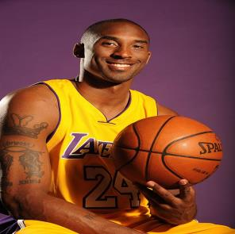
He comes from America.
He speaks English.
English is spoken by him.
She is from China.
She speaks Chinese.
Chinese is spoken by her.

Slide 13
被动语态(Passive Voice ) be + done
He speaks English.
He
English.
English
him.
is spoken by
She
She speaks Chinese.
Chinese
Chinese
is spoken by
her.
主动语态： 主语 + 动词 + 宾语
被动语态： 主语 + be + 过去分词 + by + 宾语

Slide 14
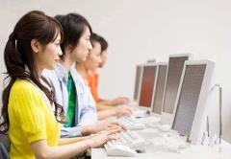
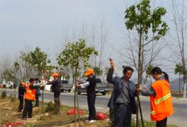
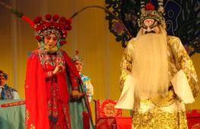
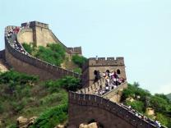
2a Study the example and find out how to change the active voice into the passive voice. Then complete the sentences.
1.Many people use computers.
Computers _____ ________
by _______ _________.
are used
many people
2.The workers plant trees in the garden.
Trees _____ _______ in the
garden ____ the workers.
are planted
by
3.Lots of foreigners enjoy Beijing Opera.
is enjoyed by lots of foreigners.
Beijing Opera_______________________
4.Many visitors visit the Great Wall every year.
The Great Wall _____________________________
is visited by many visitors every year.

Slide 15
2b Work in groups of three and play the game by the following example.
English is spoken.
English is spoken
by many people.
Many people
speak English.

Slide 16
Fill in the blanks.
Exercises
1. Trees __________ (water) in our school every
three days.
2. The zoo ___________ (visit) by lots of children
on weekends .
3. A Journey to West ________ (show) on CCTV
every summer.
4.On Christmas Day, children wake up early
and can’t wait ______ (open) the boxes of
presents.
5. We’ll have a chance _____ (see) the flower
show this weekend.
are watered
is visited
is shown
to open
to see

Slide 17
Translate the following sentences.
Exercises
1.如果他努力学习，就能取得好成绩。
He will ___ ____ ___ get good results if he
studies hard.
2. 你为期中考试做好准备了吗？
_____ you ______ ______ the mid-term exam?
3. 足球风靡全世界。
Football is popular with people from ____ ____
_________ _____________.
4. 世界上有许多人讲英语。
English ______ ______ by many people in the
world.
5.他把林丹的照片贴在了他卧室的墙上。
He ________ a photo of Lin Dan ____ the
wall of his bedroom.
be able to
Are ready for
all over
the world
is spoken
stuck on

Slide 18
Summary
We learn:
Some words: cartoon, character, widely, throughout
foreigner, film-maker, garage
2. Some phrases: be pleased with
will be able to, all over/throughout the world
have a good chance to do, can’t wait to do
be spoken as the main language, from now on
3. Some sentences:
I can’t wait to fly there.
Try your best and work much harder from now on.
We can:
1.Express ourselves using Passive Voice.
(1)Disneyland is enjoyed by millions of people from all over the world.
(2)English is spoken as the main language in America.
2.Talk about the history of Mickey Mouse.

Slide 19
Assignment
Read 1a.
Memorize the useful expressions and key sentences which we learn today.
Finish Section A in your workbook.
Preview Section B.

