Slide 1
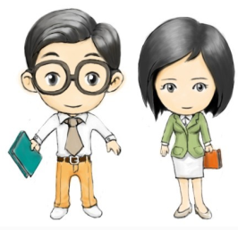
Unit5 What Is He like?
陕旅版六年级下册
第一课时
WWW.PPT818.COM

Slide 2
>>Review
have a sports meeting throwing
100-meter race long jump
high jump running race
Magic fingers

Slide 3
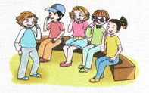
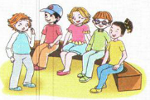
>>Warm-up
Listen and do
Simon says
Simon says “Touch your nose.”
Touch your hair.

Slide 4
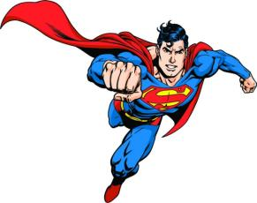
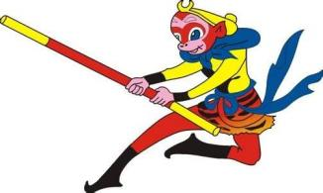
>>Lead-in
Ask and answer
A: Do you know ____?
B: ______________.
A: Is _____ ______?
B: ______________.

Slide 5
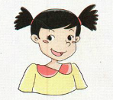
>>Presentation
Let’s learn
-What is she like?
-She is outgoing.
outgoing

Slide 6
>>Presentation
Let’s learn
-What is he like?
-He is very clever.
clever

Slide 7
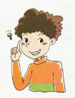
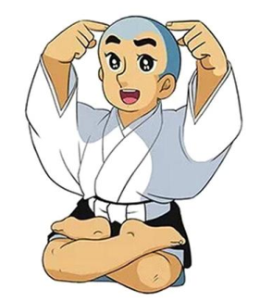
>>Presentation
Let’s learn
They are very clever.

Slide 8
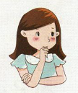
>>Presentation
Let’s learn
-What is she like? Is she outgoing?
-She is not outgoing, she is shy.
shy

Slide 9
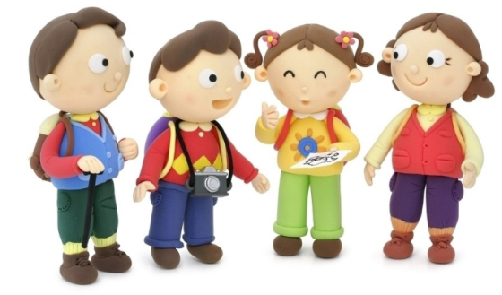
>>Presentation
Let’s learn
You have so many friends. They all like you.
You must be friendly to them.
friendly

Slide 10
>>Presentation
Let’s learn
Look at the grandma! What is she like?
She is kind, very kind.
kind

Slide 11
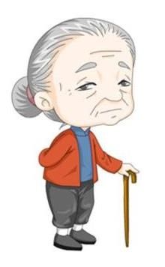
>>Presentation
Let’s learn
What is this grandma like? Is she kind now?
No. She is not kind. She is serious.
serious

Slide 12
>>Presentation
Let’s learn
She is kind, but he is serious.
kind
serious

Slide 13
>>Presentation
Let’s learn
Look at the bee. It is always busy.
It is hard-working.
hard-working

Slide 14
>>Presentation
Let’s learn
clever
kind
friendly
outgoing
shy
hard-working
serious

Slide 15
>>Practice
Magic fingers
kind
clever
friendly
outgoing
shy
serious
hard-working

Slide 16
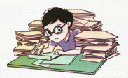
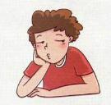
>>Practice
Look and say

Slide 17
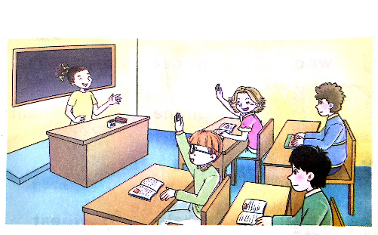
>>Practice
Let’s guess
Kitty: She is a little short and has short hair. She is
Outgoing, and she likes singing and dancing.
Guess, who is she?
Kevin: Is she Alice?
Kitty: Yes. You are right.

Slide 18
>>Summary
本课所学的描述人物性格的单词？
outgoing clever shy
kind friendly lazy
hard-working serious

Slide 19
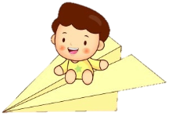
>>Homework
1.听课文录音并跟读，按照正确的语音、语调朗读并表演课文对话。 2.正确书写本课所学单词5遍，并让家长听写1遍。
3.预习A Let’s talk。
close

