Slide 1
Unit 2 Topic2
All these problems are very serious.
Section A
WWW.PPT818.COM

Slide 2
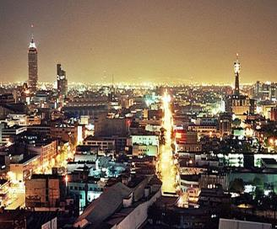
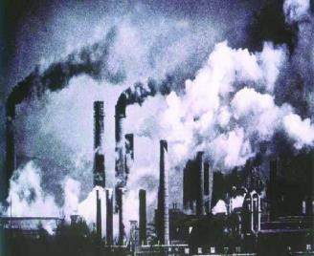
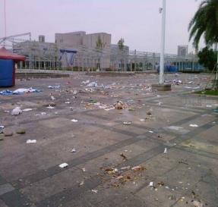
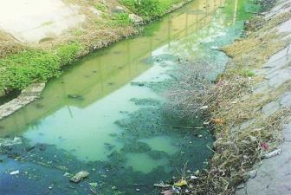
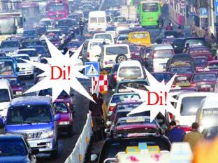
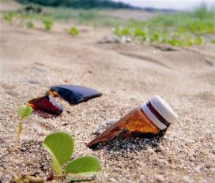
pollution

Slide 3
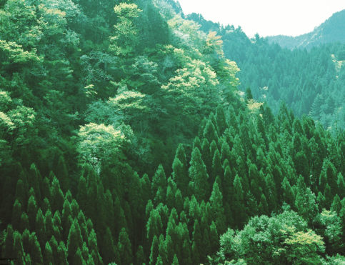
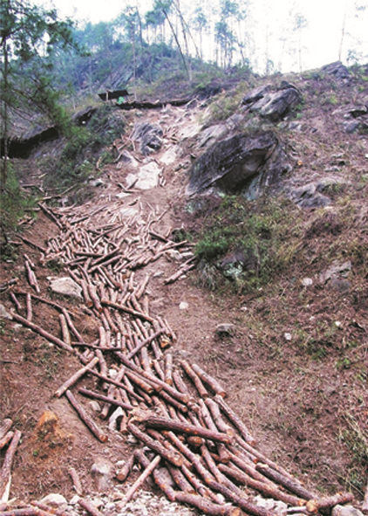
many trees
cut down

Slide 4
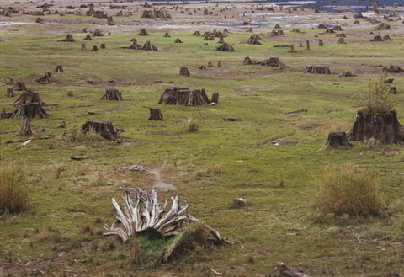
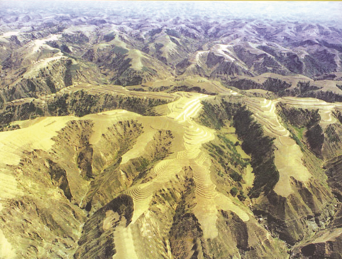
forests gone
冲走
wash the earth away

Slide 5
change into desert
沙漠
转换成，变成
e.g. A lot of rich land has changed into desert because people have cut down too many trees.

Slide 6
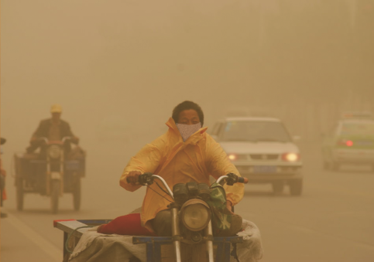
sandstorms
n. 沙尘暴
come into being

Slide 7
1b Listen to 1a and choose the best answer.
Focus on the main idea of the conversation when you listen for the first time.
The boy and girls are
talking about —————.
different types of sandstorms
the reasons for sandstorms
sandstorms in different cities
√

Slide 8
Listen and answer the questions
1.What’s the weather like today ?
It’s bad. The wind is so strong . And the sand really
hurts face.
2.What causes these sandstorms ?
People have cut down too many trees.
As a result, a lot of rich land has changed into desert.
3.Do we still need to do something to protect the
environment ?
Yes, we do. Although we have built “The Green Great
Wall”, we still need to do something to protect the
environment .
n.沙
conj. 虽然，尽管，即使

Slide 9
the indefinite pronoun and adverb
somebody, someone, something, somewhere
anybody, anyone, anything, anywhere
none, nobody, nothing, nowhere
everybody, everyone, everything, everywhere
一般情况下用于肯定句
一般情况下用于否定句和疑问句
表否定含义
可用于各种句式

Slide 10
Do you know?
B
1.I have ____ to tell you.
A. important something
B. something important
形容词修饰不定代词和不定副词时，要放在不定代词/不定副词之后
A
2.Everybody ___ ready for the match.
A. is B. are
不定代词作主语时，谓语动词要用单数。

Slide 11
1c Read 1a and complete trees’ functions.
Tree’s functions
Trees can stop the wind from blowing the earth away.
A lot of water can be saved by forests.
They can also stop the water from washing the earth away.

Slide 12
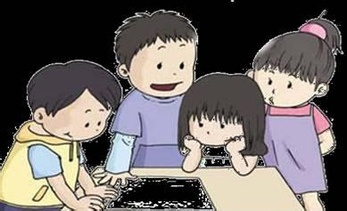
Act out the dialog in pairs
K: wind; sand; anything
M: sandstorms
J: cut down; as a result; change into
M: affect
J: stop…from…; blow… away
K: can be saved
J: wash … away
K: is harmful to; although; do something

Slide 13
2 Complete the sentences with the correct forms of the given phrases in the box.
as a result, change into, do something,
stop…from, blow…away
1.People have cut down such a large number of trees that
the land _____________________desert.
2.There are fewer trees left, so the wind always _______
the earth ________.
3.Air pollution has become a serious problem, so we must
______________ to reduce it.
4.we should try our best to _________ people ________
cutting down the trees.
5.In the future, human beings can protect the trees well.
_____________, animals will live a happy life in the forest.
has changed into
blows
away
do something
stop
from
As a result

Slide 14
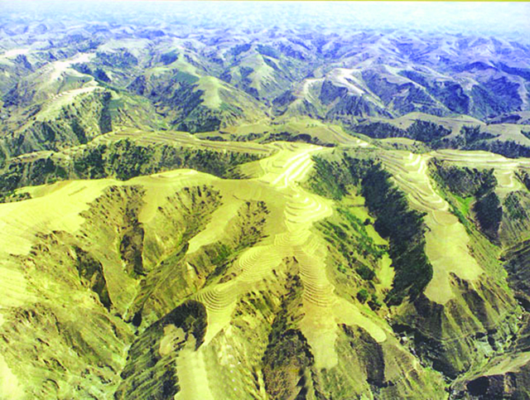
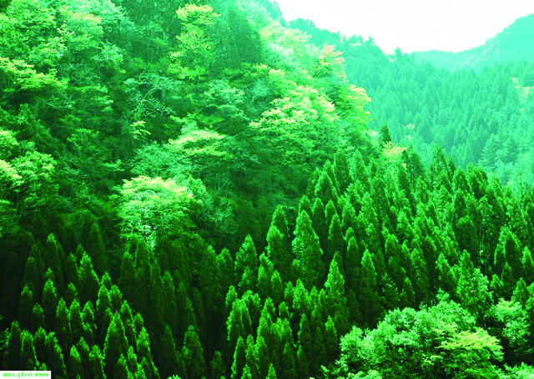
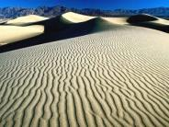
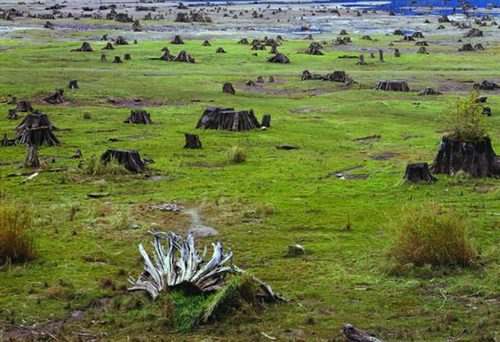
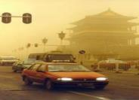
3 Do you know how sandstorms come into being? Number
the pictures and talk about the sandstorm in groups.
( )
4
( )
1
( )
5
wash the earth away
many trees
change into desert
( )
3
( )
6
( )
2
sandstorms come
into being
cut down trees
forests gone

Slide 15
4 A. Listen to the passage and circle the phrases you hear.
become weaker
destroy the environment
disappear rapidly
on the earth
enough bamboo to eat

Slide 16
4 B. Listen again and fill in the blanks.
1. Now some kinds of animals are becoming
______ ______ _______.
2. Some animals are_____ ______ ____dying out
completely.
3. In the past, pandas lived a quiet life and had
________ ______food.
4. Humans have _____ _____ __________ the importance of protecting animals.
5. We should ______ ______ ____to protect them.
fewer and fewer
in danger of
plenty of
come to understand
do our best

Slide 17
Use someone, something, anything, somewhere, anywhere to fill in the blanks.
Exercises
Lily, would you like ___________ to drink?
Cindy is very busy now. She needs _______ to help her.
Is there _________ wrong with your computer?
Jim looked for his pencil-box ____________ , but he didn’t find it.
I stayed at home last week. I didn’t go __________.
something
someone
anything
somewhere
anywhere

Slide 18
We learn: 1.Some words: sand, although 2.Some phrases: change into, human being 3.Some sentences: (1)As a result, a lot of rich land has changed into desert. (2)Trees can stop the wind from blowing the earth away. We can: 1. Use the indefinite pronoun and adverb. 2.Talk about the sandstorm and its harm.
Summary

Slide 19
Assignment
Read 1a.
Memorize the useful expressions and key sentences which we learn today.
Finish Section A in your workbook.
Preview Section B.

