Slide 1
Module 9 Great inventions
Unit 2
Will books be replaced by the Internet?
WWW.PPT818.COM

Slide 2
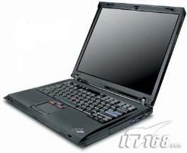


Lead in
Do you use computers?
How often do you use computers?
How do you get information? Reading books? Or surfing the Internet?
Do you think books will be replaced by the Internet? Now let’s enjoy a video about it.

Slide 3
Words review
Words Review
look through
printing
at a time
by hand
development
trade
快速阅读；浏览
n. 印刷
每次；一次
用手；靠手做
n. 发展；进步
n. 买卖；交易

Slide 4
Words Review
result
spread
in a way
compare…to…
introduction
v.（因……而）产
生；发生
v. 扩展；蔓延；传播
从某一角度；从某
一点上看；从某种
程度上
把……比作
n. 引进；才用；推行

Slide 5
Words Review
amount
store
varied
form
connection
n. 量；数量
v. 存储；储藏
adj. 各种各样的；
各不相同的
n. 种类；类型；形
态；存在形式
n. 电话连接；计算
机网络连接

Slide 6
Words Review
single
direction
replace
wait and see
adj. 仅一个的；单
个的
n. 方向
v. 替换；取代
等等看；等着瞧

Slide 7
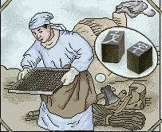
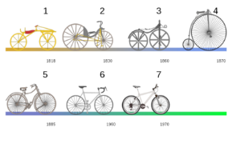



Vocabulary
printing n. 印刷
development n. 进步\发展
trade n. 买卖；交易
New words
introduction n.
引进；采用；推行
spread v. 扩展；蔓延；传播

Slide 8
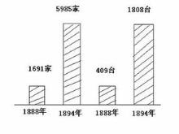

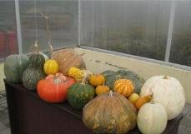
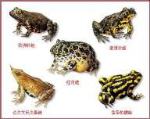
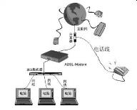
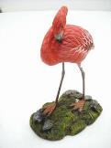
amount n. 量，数量
store v. 存储；储藏
varied adj. 各种各样的
form n. 种类；类型
connection n. 电话连接；计算机网络连接
single adj. 仅一个的；单个的

Slide 9


direction n.
方向
replace v.
替换，取代
result v. （因……而）产生；发证
e.g. When water levels rise, flooding
results.
水位上升，就会发生洪水。

Slide 10

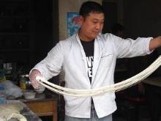
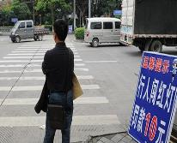
look through
浏览
by hand
用手；靠手做
wait and see
等着瞧
at a time 每次；一次
e.g. We had to go and see the principal one
at a time.
我们得逐一去见校长。

Slide 11
in a way
e.g. In a way it was one of our biggest
mistakes.
从某种意义上来说，这是我所犯的最大的错误之一。
compare to 把…… 比作
e.g. Shakespeare compared the world to a
stage.
莎士比亚把世界比作舞台。

Slide 12
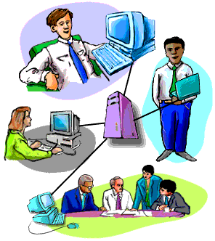
P74
1.Work in pairs. Read the title of the passage in Activity 2.
Pre-reading
Will books be replaced by the Internet?
Discuss and make a list of the advantages of books and the Internet.

Slide 13
Advantages of books | Advantages of the Internet
Books are inexpensive.
Books can go with you anywhere and be read everywhere.
Books can help you keep your brains sharp.
…
You can get information quickly.
You can get a great amount of information at a time.
The machine is smaller and lighter.
…

Slide 14
Listening
Listen to the passage and answer the questions.
1. What does his mother do at home every
evening?
She looks through magazines.
2. When was paper first created?
About 2,000 years ago.

Slide 15
Reading
Read the passage and match the main ideas with the paragraphs.
a) The world before printed books
b) The world after the invention of
printing.
c) Life with paper and printing
d) Technology and books
e) The future of books
2
3
1
4
5

Slide 16
Read the passage again and answer the questions.
1 What may become more powerful than printing?
The Internet.
2 When was printing invented in China?
During the Sui and Tang Dynasties.
3 When was the Internet introduced to China?
In the twentieth century.

Slide 17
Complete the table.
When | What
About 2,000 years ago | paper created
During the Sui and Tang Dynasties
Today
printing invented
Internet and computer used

Slide 18
Complete the passage with the words in the box.
developments direction introduction powerful replace spread trade
Books were expensive because they were
made by hand, but (1) _____________ in
printing made it cheaper and faster to make
books. A(n) (2) _________ in books resulted,
and knowledge (3) ________ more quickly
than ever before. The (4) ___________ of
the Internet has
developments
trade
spread
introduction

Slide 19
developments direction introduction powerful replace spread trade
changed the world in a similar way, and the
Internet is much more (5) _________. With
more and more people using the Internet, the
(6) _________ that traditional printing
will take in the future is uncertain, and
computers may (7) _______ books one day.
powerful
direction
replace

Slide 20
Writing
Writing
P75
5
Read the sentences and notice how we give reasons and results.
1. Books were only produced one at a tie by hand. As a result, there were not many books.
2. Because there were not many books, few people learnt to read.
3. These machines are smaller and lighter than books, so they are easy to carry.
( give result )
( give reason )
( give result )

Slide 21
Now work in pairs. Ask and answer the questions. Write full sentences with as a result, because or so.
Why is it hard to imagine a world without printing?
2. What was the result of few books being oduced?
It’s hard to imagine a world without printing because we have so many printed things now.
Few books were produced and, as a result, few people could read .

Slide 22
3. What happened after the printing technology developed?
4. What will happen to books in the future? Why?
After printing technology developed, books were cheaper, so more people learnt how to read.
Books might not be needed in the future because the Internet is growing quickly.

Slide 23
6
P75
Write full sentences with the notes in Activity 3.
About 2,000 years ago, paper was first created.
Printing was invented during the Sui and Tang Danasties.
Today, the Internet is growing very fast. Computers and the Internet are used in classrooms now, and newspapers and magazines are read online.

Slide 24
7
Write a passage about traditional printing and its future. Use the sentences you have written in Activity 5 and 6 to help you.
P75
It’s hard to imagine a world without printing because we have so many printed things now, for example, menus, comics and schoolbooks. Paper was first created about 2,000 years ago, but books weren’t printed at that time. They were written by hand, so few books were produced, and, as a result, few people could read.

Slide 25
Printing was invented during the Sui and Tang Dynasties. After printing developed, books became cheaper, so more people learnt how to read. Today, the Internet is growing very fast. A much larger amount of information can be stored in more varied forms on the Internet than in books. As a result, in the future, the Internet will probably be more important than printing.

Slide 26
Language points
1. Every evening, my mother looks through
magazines at home.
look through 快速阅读，浏览
e.g. I haven’t looked through the books yet.
我还没浏览这本书。
2. As a result, there were not many book.
as a result 结果
e.g. As a result, they got the cheapest TV set yesterday.
结果，他们昨天买到了最便宜的电视。

Slide 27
3. Books were only produced one at a
time by hand.
at a time 每次，一次
e.g. Please come in one at a time, not all
together.
每次进来一个，不要一起进来。
by hand 用手（做）
e.g. All these toys are made by hand.
所有这些玩具都是手工的。

Slide 28
4. Later, developments in printing made it
possible to produce books more quickly and cheaply.
development n. 发展，进步
develop v. 发展，进步
e.g. With the development of our country,
our life will become better and better.
随着我们国家的发展，我们的生活也会越来越好。

Slide 29
5. A much larger amount of information can
be stored in more varied forms on the
Internet than in books.
amount n. 量，数量
a large amount of 大量的
varied adj. 各种各样的，等于all kinds of。
e.g. There are a large amount of varied
dresses and I don’t know what to buy.
这里有许多各式各样的裙子，我不知道
该买哪个。

Slide 30
6. So what direction will traditional printing
take in the future?
direction n. 方向
e.g. Tom went off in the direction of home.
汤姆朝家的方向去了。
7. Will books be replaced by the Internet?
be replaced by 被……代替
e.g. The old textbook was replaced by the
new one.
旧的教材被新的代替了。

Slide 31


Exercises
1. Let’s look ______ the text and then
answer the questions.
A. at B. through C. for D. after
2. The children are making kites ____ hand.
A. by B. for C. with

Slide 32
3. With the _____ of our school we’ll have a
better environment for studying.
A. develop B. developed
C. development
4. -How many music are there in the world?
-There are ______ forms of music now.
A. vary B. varied C. much D. little

Slide 33

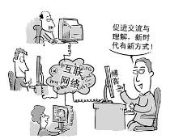
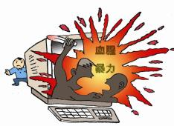
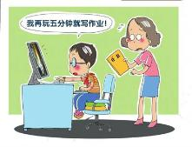
Homework
介绍互联网的优点和缺点。60词左右。

