Slide 1
Unit 2
His hobby is drawing
WWW.PPT818.COM

Slide 2


New words:
coloured
=colour(名词，颜色）+ed

Slide 3
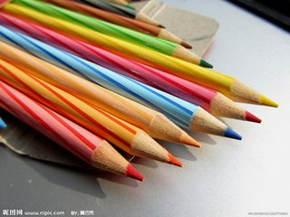
coloured pencils

Slide 4
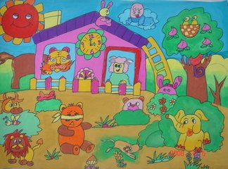
a coloured picture

Slide 5
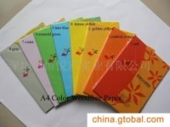
coloured books

Slide 6

New words:
sky
蓝天：
blue sky

Slide 7
在天空中：
in the sky
There are many birds in the sky.

Slide 8
New words:
their = there (读音)
they 的形容词性物主代词， 宾格是them, 后接名词。
翻译：1.他们的邮票
2.他们的国家

Slide 9
New words:
place
翻译：1.我们的地方
2.在我们的国家有许多漂亮的地方。

Slide 10
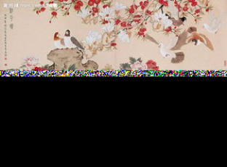
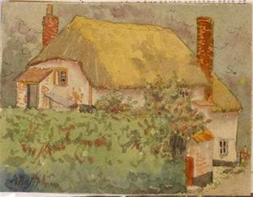
New words:
drawing(名词，画作）
= draw(动词，画画）+ing

Slide 11
Answer the questions:
(7) How often does Mike draw?
(8) Where can you see Amy's drawings?

Slide 12
短语：
1.a great painter 一个了不起的画家
2.drawing cartoons 画卡通
3.after school 放学后
4.coloured pencils 彩色铅笔
5.draw a picture 画一幅画

Slide 13
短语：
in the sky 在天空中
on one’s birthday
在某人生日的时候
interesting people 有趣的人
beautiful places 美丽的地方
grow up 长大
every room in the house
屋子里的每个房间

Slide 14
课文句子:
1.He likes drawing animals.
2.She doesn't like drawing animals.
3.She likes drawing interesting people and beautiful places.

Slide 15

Please read the passage aloud!
请同学们大声地读出这篇短文。

