Slide 1
Seeing a film
7
WWW.PPT818.COM

Slide 2
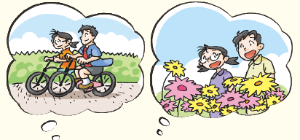
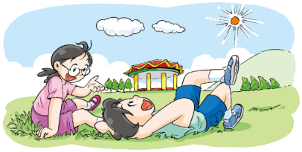
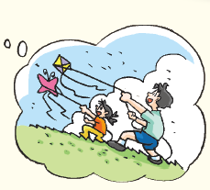
Think and talk
What do you like doing at the weekend?
I like …

Slide 3
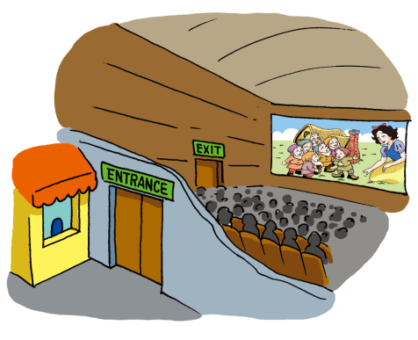
Think and talk
Do you like seeing films?
Yes, I like
seeing films.

Slide 4
Think and talk
film
cinema
cola
popcorn
people
…

Slide 5
Think and talk
What would you like to see?
建议教师自行插入一些电影海报
建议教师自行插入一些电影海报
建议教师自行插入一些电影海报

Slide 6
Think and talk
What do you think of this film?
It’s a/an … film.
建议教师自行插入一些电影海报
建议教师自行插入一些电影海报
boring
建议教师自行插入一些电影海报
touching
interesting
exciting
…
funny

Slide 7
Make a dialogue
建议教师自行插入一些电影海报
— What would you like to see?
— I’d like to see … It’s a/an … film. How about you?
— I’d like to see … because I think it’s a/an … film.
建议教师自行插入一些电影海报
建议教师自行插入一些电影海报

Slide 8
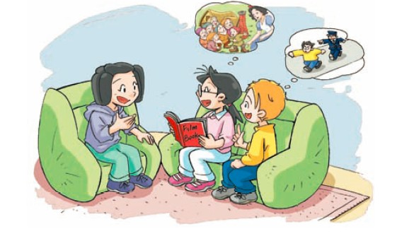
What are they going to do this weekend?
What film would Kitty like to see?
What does Kitty think of the film?
What would Peter like to see?

Slide 9
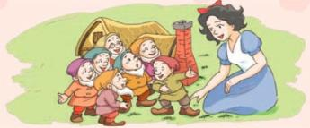
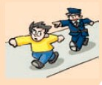
What
How
Who
It’s about a beautiful princess. She meets seven little friends in the forest.
It’s about a brave policeman. He catches bad people.
interesting
exciting

Slide 10
Think and report
What
How
Who
It’s about a beautiful princess. She meets seven little friends in the forest.
It’s about a brave police man. He catches bad people.
interesting
exciting
Which film are they going to see?

Slide 11
How did Jill invite Kitty and Peter to go to see a film?
What did she say?

Slide 12
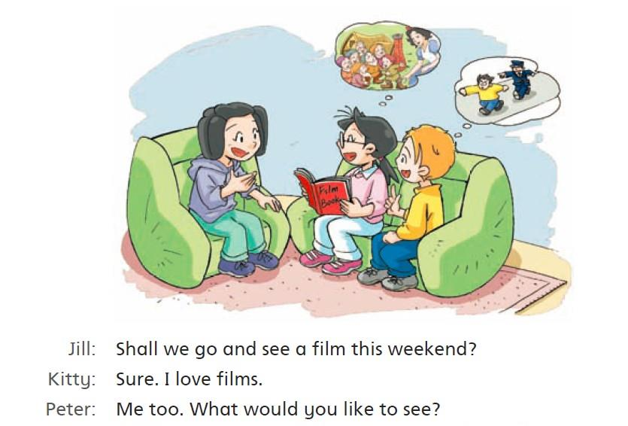
Read and underline.

Slide 13
Read and learn
Shall we go and see a film this weekend?
invite somebody in a very polite way

Slide 14
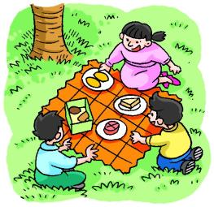
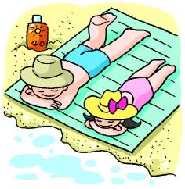
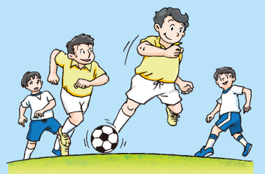
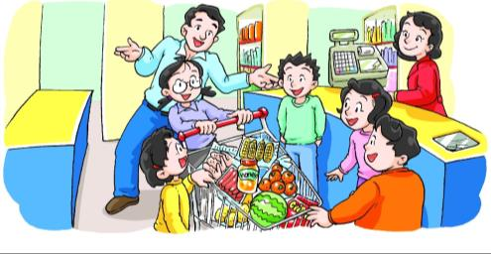
Make sentences
Shall we …?
go … together
have …

Slide 15
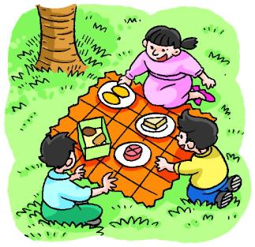
Make sentences
Shall we …?
Shall we have a picnic this weekend?

Slide 16
Make sentences
Shall we …?
Shall we go to the beach together
this summer vacation?

Slide 17
Make sentences
Shall we …?
Shall we go and play football
together after class?
Shall we go to the supermarket together
this Saturday afternoon?

Slide 19
Make sentences
Shall we …?
Sure.
I’m sorry, ...
Certainly.
My pleasure.

Slide 20
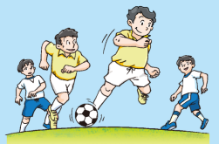
Make sentences
Shall we …?
Sure./Certainly./My pleasure.
I’m sorry, ...

Slide 21
Make sentences
Shall we …?
I’m sorry ...
Certainly.
...
Sure.

Slide 22
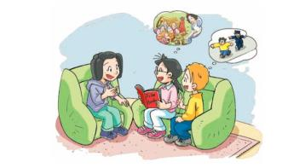
Jill: Shall we go and see a film this weekend?
Kitty: Sure. I love films.
Peter: Me too. What would you like to see?
Kitty: I’d like to see Snow White. It’s a story about a beautiful
princess. She meets seven little friends in the forest. It’s an
interesting film.
Peter: But I’d like to see Police Story. It’s an exciting film.
Kitty: What is it about?
Peter: It’s about a brave policeman. He catches bad people.
Jill: I’d also like to see Snow White. Shall we see Police Story next
time, Peter?
Peter: OK. Let’s go and see Snow White on Sunday afternoon. We
can see Police Story next Saturday or Sunday.

Slide 23
Act it out
Step 1: Find your friends.
Step 2: Choose the roles.
Step 3: Act.

Slide 24
Think and talk
建议教师自行插入一些电影海报
建议教师自行插入一些电影海报
建议教师自行插入一些电影海报
What would you like to see?
What’s it about?

Slide 25
Make a dialogue
Step 1: Choose a colour.
Role A
Role B
Role C
Step 2: Find your partners.

Slide 26
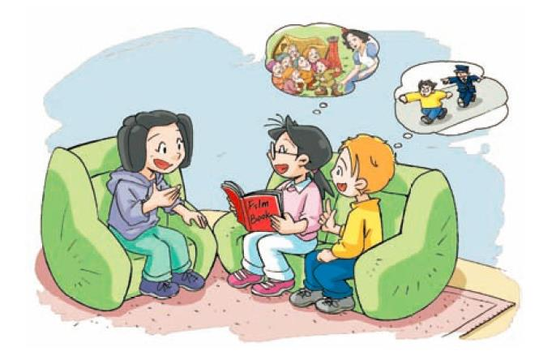
Make a dialogue
Step 3: Make a new dialogue.
“Shall we …?”

Slide 27
Act it out
Step 4: Act out the dialogue.

Slide 28
Discuss and report
建议教师自行插入一些电影海报
建议教师自行插入一些电影海报
建议教师自行插入一些电影海报
Which film do you want to see?
Who would you like to see a film with?
Why do you want to see it?

Slide 29
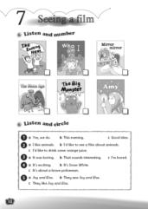
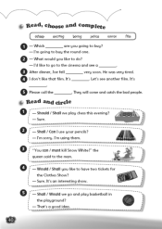
Homework
1. Recite the dialogue on Student’s Book page 46.
2. Act out the dialogue.
3. Make four sentences that start with “Shall we ...?”
4. Finish Workbook pages 38 and 39.

