Slide 1
Unit 8 Topic 2
We can design our own uniforms.
Section A
WWW.PPT818.COM

Slide 2
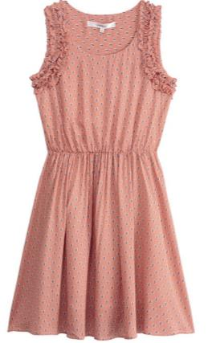
Talk!
M
Beautiful or ugly?
What ... made of?
What size?
What color ?

Slide 3
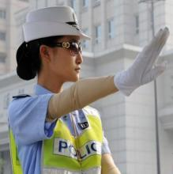
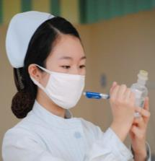
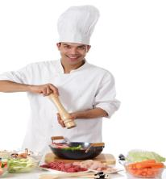
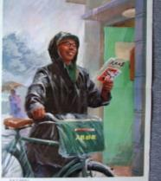
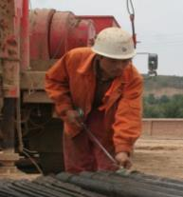
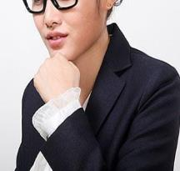
Who often wears uniforms?
policeman
policewoman
doctor
nurse
cook
postman
worker
office worker

Slide 4
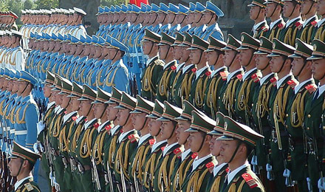
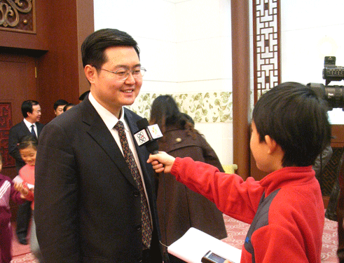
discipline
n. 纪律，风纪
Because suitable uniforms
can show good discipline.
Why do they need to
wear uniforms?
interview v. 采访
Li Lei is interviewing an office worker.

Slide 5
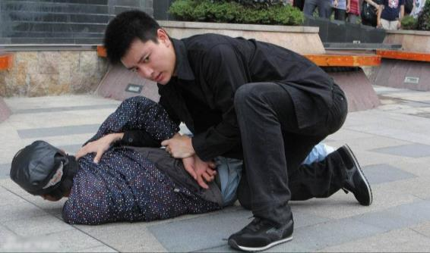
plain
adj.普通的；家常的
The policeman wears plain clothes.
He is carrying out a special task.
carry out 执行，开展

Slide 6
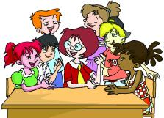
1b
Listen to 1a and answer the following questions.
1.What are Miss Wang and the children mainly talking about?
They are talking something about school uniforms.
2.Do all the children like school uniforms?
No,they don't.
3.What is Jane's idea?
She thinks they can design their own uniforms by themselves.
4.What's Miss Wang's suggestion?
She suggests that the children should survey the students about styles of uniforms before designing their own uniforms.
survey v.调查;查看

Slide 7
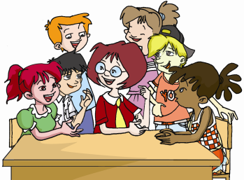
Listen and follow.
Miss Wang: Boys and girls, our school plans to make uniforms for you.
Jane: Kangkang, can you tell me what Miss Wang says?
Kangkang: She says that our school plans to make uniforms for us.
Maria: I like to wear my own clothes because school uniforms will
look ugly on us.
Michael: Not really. It depends on who will design our uniforms.
Jane: I think we can design our own uniforms by ourselves.
Kangkang: Good idea! It’s true that suitable uniforms can show good
discipline.
Miss Wang: I agree with you. You’d better survey
the students about styles of uniforms.
Then you can design your own
uniforms, and you’ll be glad to
wear them.

Slide 8
Key points of 1a
1. It's true that suitable uniforms can show good discipline.
(1)本句是一个由it作形式主语的复合句，真正的主语是that从句，其结构为
It is +adj.+that从句。
E.g:人们穿不同的衣服是很有必要的。
It is necessary that people wear different clothes.
(2)suitable uniforms得体的制服
2. Can you tell me what Miss Wang says?
本句为含有特殊疑问词what引导的宾语从句的复合句。
拆散为两个简单句看看其变化：
(1)Can you tell me ? (2) What does Miss Wang say ?
把特殊疑问句转为宾语从句的变化步骤：
①引导词：特殊疑问词(不能省略)；
②语序：陈述句语序，即“主语+谓语+其他”
③人称变化④时态变化(第八单元三话题学习)
E.g:Can you tell me ? Who are you waiting for ?
Can you tell me who you are waiting for ?
Do you know? Where is he from ?
Do you know where he is from ?

Slide 9
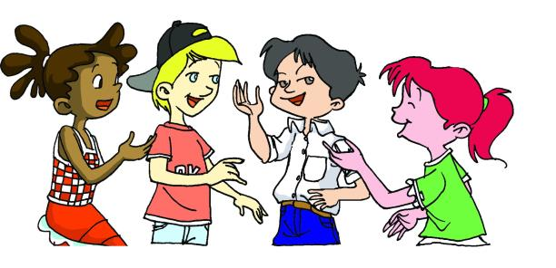
1c
The children are discussing how to design their school uniforms. Make up conversations after the example.
Example:
A:Can you tell me what Maria asks?
B:She asks what materials they should choose.
What materials should
we choose?
What style do you like?
Where can we make them?
What color do you want ?

Slide 10
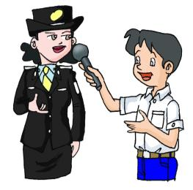
2a
Listen to the coversation and put A,B and C in the right places.
(Kangkang is interviewing a policewoman.)
(K—Kangkang,P—Policewoman)
K:Excuse me,madam._________________________
P:We usually wear uniforms when we are at work,but sometimes we wear plain clothes to carry out special tasks.
K:____________________________
P:Sure.When we are wearing uniforms,people in trouble can find us.
_______________________________
K:Uniforms can also show good discipline and
make you look important.
P:Yes.You're right.
B
A
C
A.Is it important for you to wear uniforms at work?
B.Could you tell me when you wear your uniforms?
C.And our uniforms may stop some people from
doing bad things.

Slide 11
2b
Read 2a and answer the following questions.
Then try to give a short report.
1.When does the policewoman wear uniforms?
They wear uniforms when they are at work.
2.Why does the policewoman think it's important to wear uniforms?
Because when they are wearing uniforms,people in trouble can find them,and their uniforms may stop some people from doing bad things.

Slide 12
Key points of 2a
◆Could you tell me when you wear your uniforms?
你能告诉我你们什么时候穿制服吗？
1、when 引导宾语从句时译为“什么时候”。如：
I don’t know when he will come. 我不知道他什么时候会来。（宾语从句）
2、when 引导时间状语从句时译为“当······时”。如：
Patients can find us easily when they are in need.
当病人有需要时，他们能够很容易地找到我们。（时间状语从句）
◆And our uniforms may stop some people from doing bad things.
我们的制服可以防止一些人干坏事。
stop ... from doing sth. = keep ... from doing sth. 阻止，防止······干某事
E.g: 你无法阻止人们说出自己的想法。
You can’t stop people from saying what they think.
她父母试图阻止她和他见面。
Her parents tried to stop her from seeing him.
〖知识拓展〗：
stop doing sth. 停止做某事（停止正在做的事情） 如：
Suddenly everyone stopped talking. 突然每个人都停下来不说话了。
stop to do sth. 停下（正在做的事）去做（另一件事）如：
We stopped to take pictures. 我们停下来去照相。

Slide 13
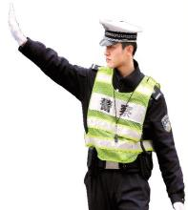
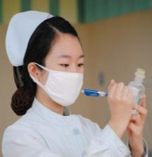
Suppose you are one of the following persons.Pretend to interview each other and make a conversation similar to 2a. Then role-play in pairs.
policeman
policewoman
doctor
nurse
cook
postman
worker
office worker

Slide 14
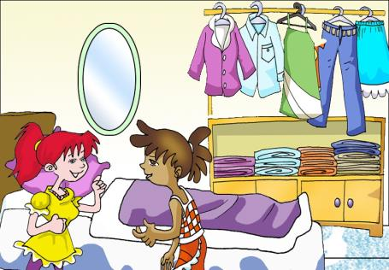
Project
3
Make up conversations after the example,using the sentences in the box. Pay attention to the word order of object clause.
Example:
A:Could you please tell me what clothes you like best?
B:Sure. I like jeans best.
What clothes do you like best?
What do you like to wear in summer?
When/Where do you wear school uniforms?
Why do/don't you like school uniforms?
How often do you go shopping?
Who usually buys clothes for you?
...

Slide 15
Exercises in class
根据首字母或汉语提示完成句子。
1.— The CCTV reporter is i____________the policeman. She wants to make a report of him.
2. We must _____ _____ （执行）the plan at once.
3.People _____ __________(处于困境之中) can find the police easily if they wear uniforms.
4.People often wear _______ ______ (便装)after work.
5.—Will you go fishing tomorrow?
—I'm not sure now,it will ________ _______ (取决于)the weather.
nterviewing
carry out
in trouble
plain clothes
depend on

Slide 16
Exercises in class
单项选择。
( ) 1. _____ is necessary for students to get up early and go to bed early.
A. This B. That C. What D. It
( ) 2. — I think maths is more important than English.
— But I really can't agree______you.
A. of B. at C. with D. for
( ) 3. Policemen uniforms may stop some people from______ something bad.
A.to do B.do C. doing D. does
( ) 4. — Could you tell me ______ tomorrow morning?
— Well, it will start at 9 o’clock.
A. when the meeting will start B. where will the meeting start
C. where the meeting start D. When the meeting would start
( ) 5. The girl ______ trouble is a middle school student from Japan.
A. on B. at C. in D. of
D
C
C
A
C

Slide 17
Summary
We learn:
1.Some new words and phrases:
depend,discipline,survey,interview,plain
depend on,plain clothes,carry out,stop...from doing...
2.The object clauses:
Can you tell me what Miss Wang says?
She asks what materials they should choose.
We can:
◆Talk about uniforms:
I like to wear my own clothes because school uniforms will look ugly on us.
We usually wear uniforms when we are at work.
Our uniforms may stop some people from doing bad things.
Uniforms can also show good discipline and make you look important.

Slide 18
Homework
1.Try to design a school uniform that you like.
2.Finish Section A in your workbook.
3.Preview Section B.

