Slide 1
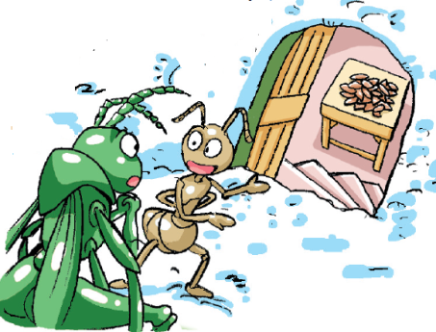
Hobbies
第三课时
WWW.PPT818.COM

Slide 2
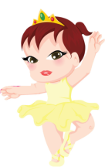
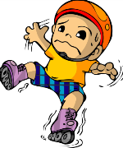
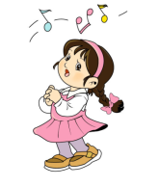
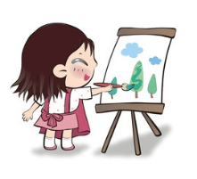
Look and say
skate
swim
sing
paint
read
dance

Slide 3
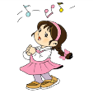
Look and spell
read
skate
paint
sing
dance
swim
reading
skating
painting
singing
dancing
swimming

Slide 4
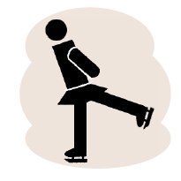
Ask and answer
What do you like (doing)?

Slide 5
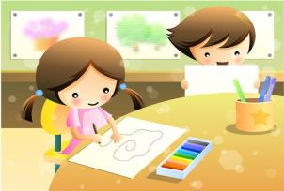
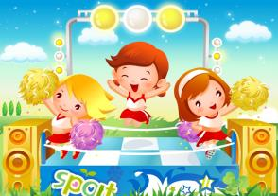
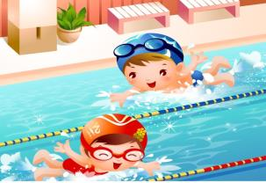
Choose and talk
My colourful life
Hello, I am …
I like …
I like …
I can ...

Slide 6
Make and say
My colourful life
Hello, I am ...
Look, this is me.
I like ...
I like ...
I can ...
I am…
Your picture
here!

Slide 7
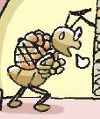
Read and think
What do they like doing?
 | spring | summer | autumn | winter
Ben
Bob

Slide 8
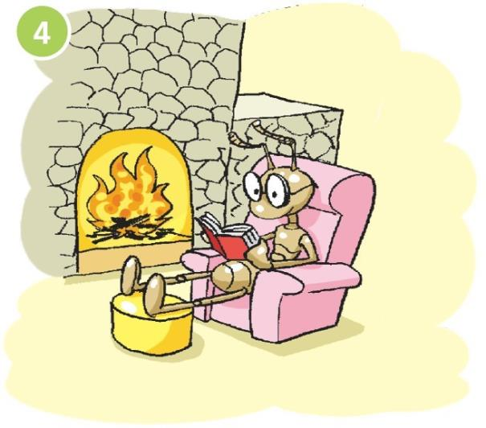
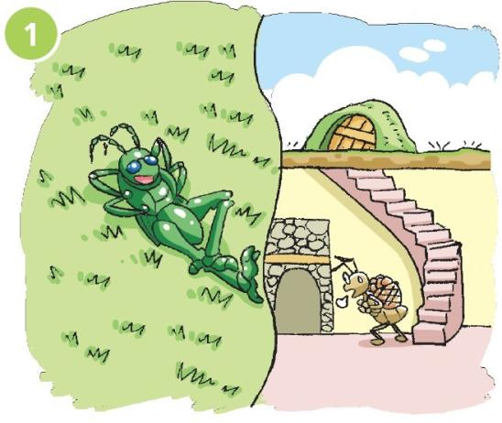
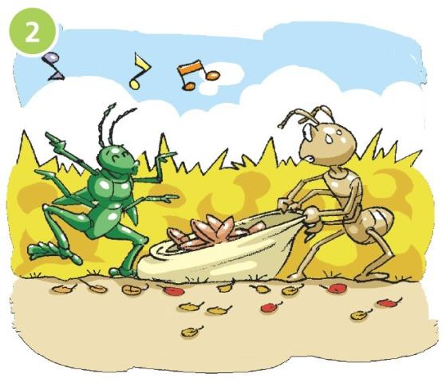
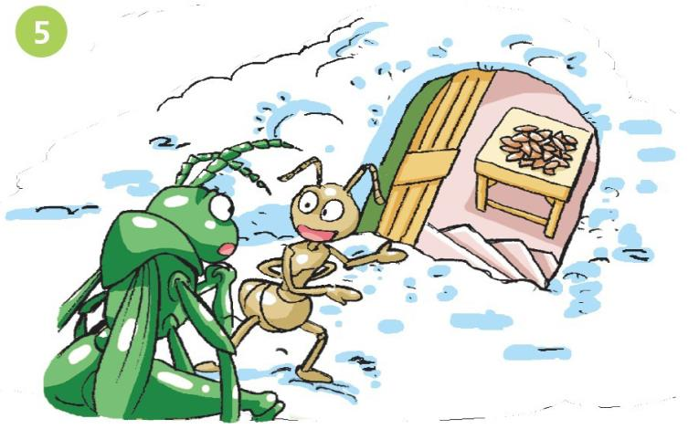
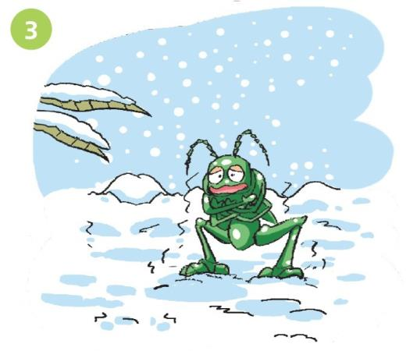

Slide 9
Think and answer
What do they like doing?
 | spring | summer | autumn | winter
Ben
Bob
sleeping
sleeping
singing
dancing
working
working
working
reading

Slide 10
Listen and read
Hi, I’m Ben. I like sleeping in spring and summer.

Slide 11
Listen and read
I like singing and dancing in autumn.
I’m Bob. I like working.
I’m a good worker.

Slide 12
Listen and read
I don’t like winter.
It’s cold!

Slide 13
Listen and read
In winter, I like reading at home.

Slide 14
Listen and read
It’s cold here. Please come in!
Thank you!

Slide 15
Say and act

Slide 16
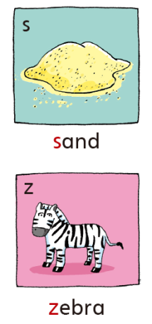
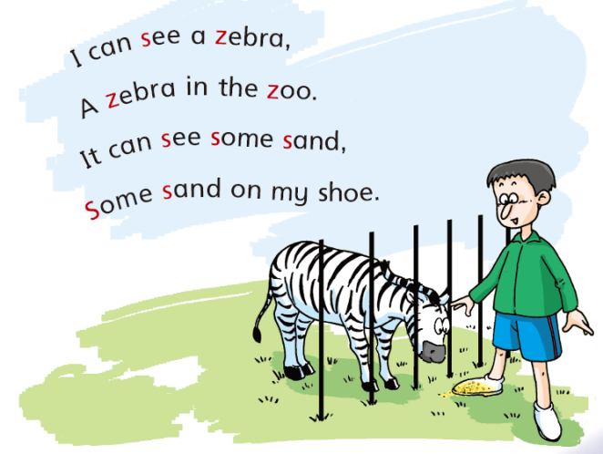

Slide 17
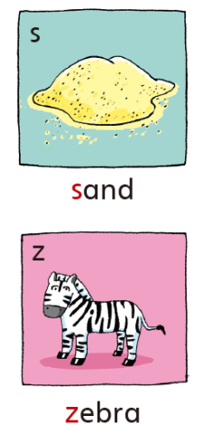
s s s
/s/ /s/ /s/
s /s/ sand
s /s/ s
s /s/ sun
s /s/ six
s /s/ …
z z z
/z/ /z/ /z/
z /z/ zebra
z /z/ z
z /z/ zoo

Slide 18
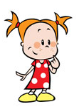
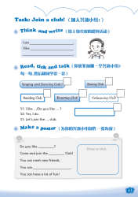
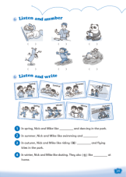
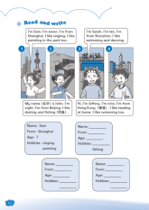
Homework
1 Talk about your hobbies.
2 Read the story, Ben and Bob.
3 Complete Workbook pages 39, 42 and 43.

