Slide 1
Unit 5 MUSIC
Section Ⅱ Reading and Thinking(1)
WWW.PPT818.COM

Slide 2
1.Discussing—How can computers and the Internet help us experience music differently?
We can enjoy our favorite music without going to the concert hall.
We can form our virtual band at home...
________________________________________________________________________
________________________________________________________________________

Slide 3
2.Predicting—Look at the picture on Page 52 and tell its difference from the traditional concert.
The virtual concert：
________________________________________________________________________
The traditional concert：
________________________________________________________________________
There is no real singer on the stage.People can enjoy it online.
Singers shall appear on the stage.People shall enjoy it at a fixed time and place.

Slide 4
1.First reading—Read the text and finish the following exercises.
(1)How does a virtual choir work according to the first paragraph?
①____________________________________________________________________
②____________________________________________________________________
③____________________________________________________________________
record themselves alone on video
uploaded onto the Internet
put together into one video

Slide 5
(2)Fill in the blanks about a virtual choir.
member | location | equipment
①____________ | ②____________ | a video ③____________ and an Internet ④____________
camera
anyone
anywhere
connection

Slide 6
(3)Fill in the blanks about the introduction of Eric Whitacre.
in January ①____________ | born in the USA
in 1988 | began ②______________
in 1995 | ③______________ university
in 1997 | ④__________________________ in musical composition
from 1997 to 2007 | his original compositions ⑤__________________
1970
studying music
graduated from
received a master’s degree
became quite popular

Slide 7
(4) What is his first virtual choir and how many singers took part in it?
________________________________________________________________________
________________________________________________________________________
(5)What is the main purpose of his virtual choir?
________________________________________________________________________
________________________________________________________________________
His first virtual choir is “Lux Aurumque”， and 185 singers from 12 different countries took part in it.
It is a wonderful way for people around the world to sing with one voice and thus make the world a better place.

Slide 8
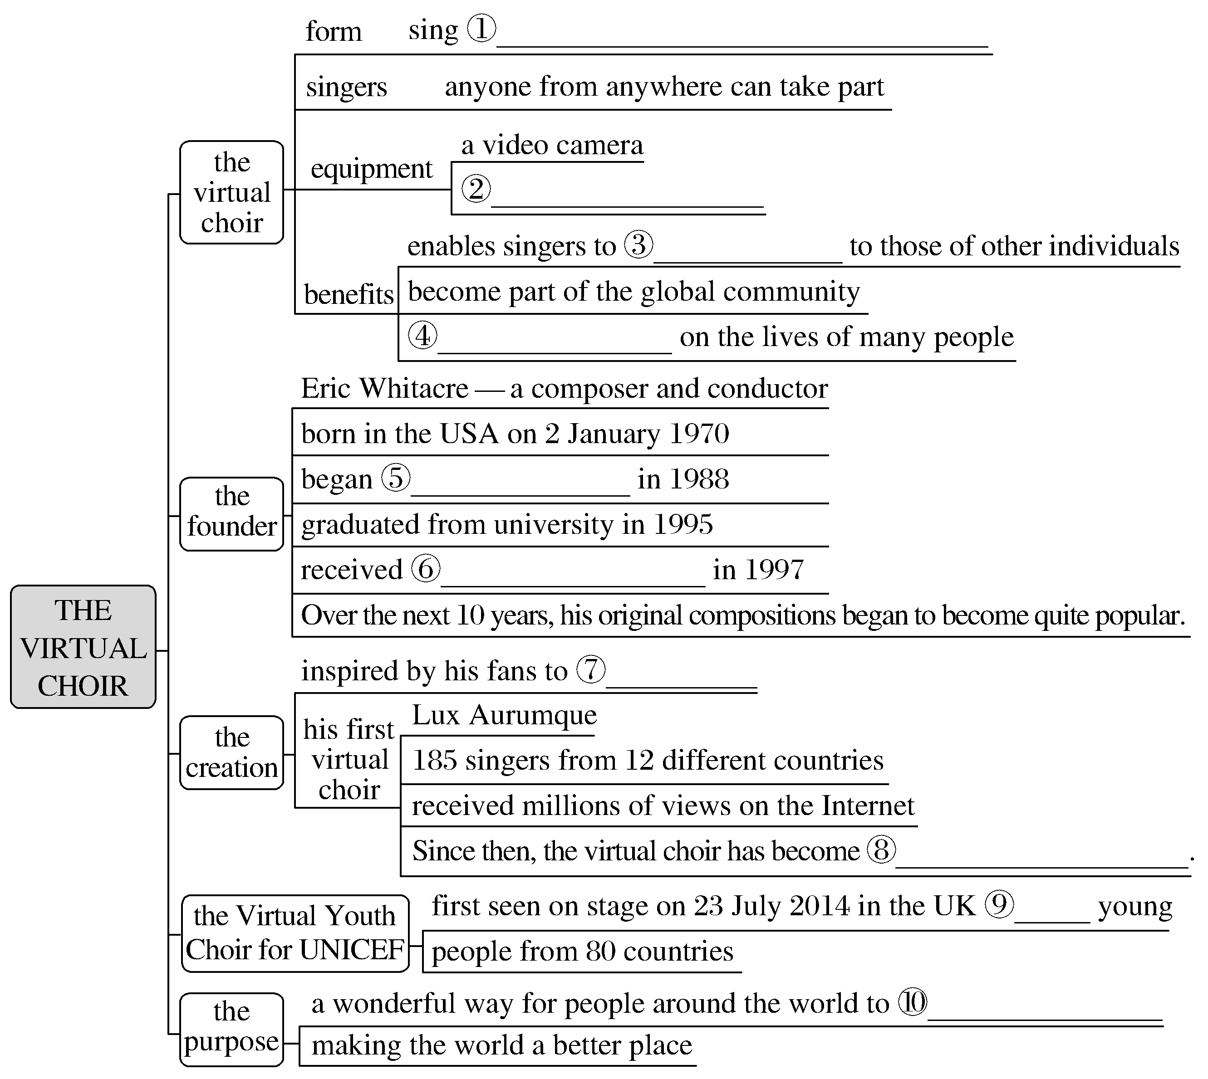
2.Second reading—Fill in the blanks according to the text.
at home alone together with other people
an Internet connection
add their voices
a positive influence
stuying music
a master’s degree
make videos
a worldwide phenomenon
2,292
sing with one voice

Slide 9
3.Third reading
(1)Read the text again and summarize the main idea in one sentence.
________________________________________________________________________
(2)What are the advantages and disadvantages of being a member of a virtual choir?
The advantages：
①____________________________________________________________________
______________________________________________________________________
②____________________________________________________________________
The disadvantages：_____________________________________________________
The text is about how the virtual choir came into being.
It enables them to add their voices to those of other individuals and become part of the global community.
It has a positive influence on the lives of many people.
(The answer is open.)

Slide 10
1.Group work：You, as a journalist of school English newspaper, is interviewing Li Hua，who is a member of a virtual choir.You may start like this：
A：Hello，I’m a journalist of our school English newspaper.When did you begin to fall in love with the virtual choir?
B：...
A：Would you please tell us how the virtual choir work?
B：...

Slide 11
A：As we know, you have taken part in the Virtual Youth Choir for UNICEF.Which song did you choose in it?
B：Well, we chose Whitacre’s song “What If”.It was really wonderful.
A：In your opinion, what is the advantage of the virtual choir?
B：...

Slide 12
2.Does a virtual choir really bring people together? Why or why not?
________________________________________________________________________
The answer is open.

Slide 13
虚拟合唱团
在Web 2.0的数字时代，人们可以在世界范围内轻松地沟通，为什么不通过网络一起歌唱呢？虚拟合唱团就可以使这件事情变成可能。
不同国家的人们可以一起上线，通过共同歌唱把他们对音乐的热爱结合在一起。虚拟合唱团的特点是互相不认识的歌手和指挥不在一个地方，但是通过网络他们能够一起演唱。通过国际网络，成千上万的人们可以一起加入这个活动。美国作曲家和指挥Eric Whitacre给许多虚拟合唱团以生命。

Slide 14
阅读技巧点拨
寻读(scanning)
寻读(scanning) 是指以问题为线索带着问题去寻找某一特定信息的阅读。
以什么词为定位词(或线索词)到原文中去查找是很关键的。
寻读(scanning)常用的定位词有：
(1)数字、年代
(2)第一次出现的人名、地名等专有名词
(3)事物的性质特征或比较关系
(4)题干中不同于其他题的新信息。这些定位词在原文中的形式与在题干中的形式可能会有所变化，同学们要注意。

Slide 15
语言现象感知
Ⅰ.单词理解
体会句中加黑单词的词性和含义
1.You do not even need a studio.____________
2.Many people do not have close friends or contacts who have the same interest in music.____________
3.Over the next 10 years, Whitacre’s original compositions began to become quite popular among choirs and singers.____________
n.工作室
n.联系人
adj.原创的

Slide 16
Ⅱ.词块积累
写出下列词块的含义
1.have the opportunity to do...______________
2.be uploaded onto the Internet_______________
3.an Internet connection_______________
4.the global community____________
5.a positive influence on...____________________
6.an award-winning composer________________
7.receive a master’s degree in..._________________
有机会做某事
上传到互联网上
一个互联网连接
全球社区
对……有积极的影响
一位获奖作曲家
获得……硕士学位

Slide 17
8.since then____________
9.a worldwide phenomenon___________________
10.sing with one voice_________________
从那时起
一种世界性的现象
同一个声音唱歌

Slide 18
Ⅲ.句式欣赏
1.时间状语从句
①Virtual choir members record themselves while they perform alone on video.
②He fell in love with Mozart’s classical music when he sang for the university choir.
2.定语从句
①As one virtual choir member said, “Music helps me to...forget my problems.With music, I become someone else.”
②In 2009，Whitacre received a video of a girl who was singing one of his works.

Slide 19
3.过去分词短语作状语
①Born in the USA on 2 January 1970, Whitacre began studying music at the University of Nevada in 1988.
②Moved by this music, he said, “It was like seeing color for the first time.”
4.名词短语作同位语
His first virtual choir, “Lux Aurumque”， had 185 singers from 12 different countries.

