Slide 1
Unit 12 Four season in one day
WWW.PPT818.COM

Slide 2
Questions :
How many seasons are there in a year?
what are they?

Slide 3
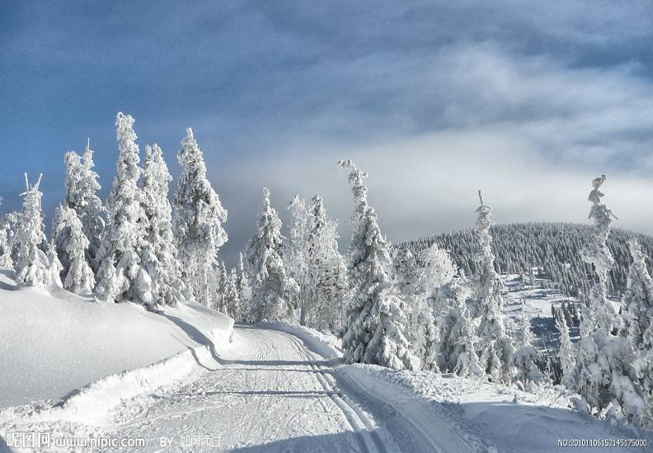
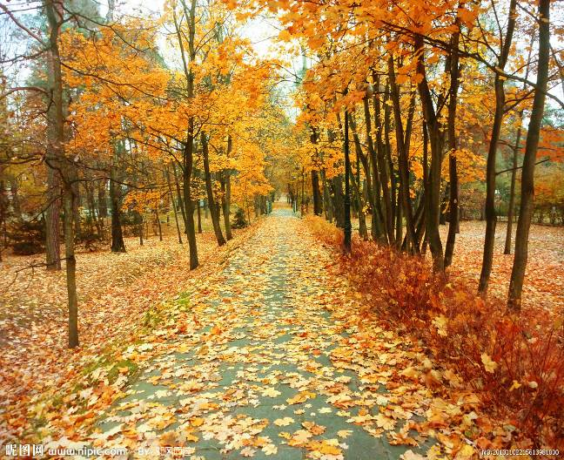

Slide 4
Answers:
There are four seasons in a year.
They are: spring, summer, autumn/fall, winter

Slide 5
The type of the passage 文章的类型
What kind of types we have learned?
Text,dialogue
What kind of type of this passage?
A letter.

Slide 6
The form of the letter 信件的格式
一、开头
Dear***
二、正文
空四格
三、结尾
问候 Yours sincerely
署名 ***

Slide 7
The form of the letter 信件的格式
————
Dear***
——————————————
————————————————
——————————————-——
————————————————
————
————

Slide 8
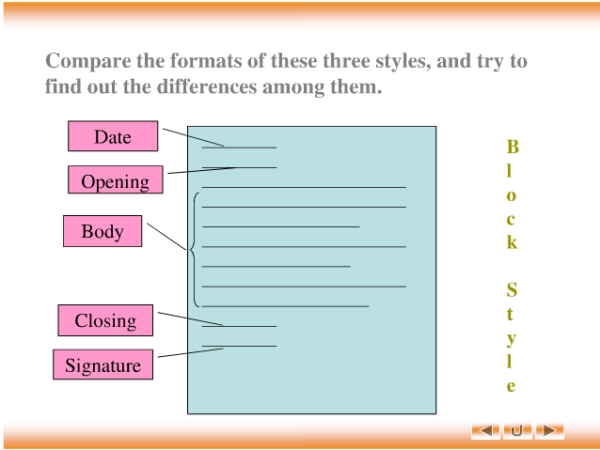

Slide 9
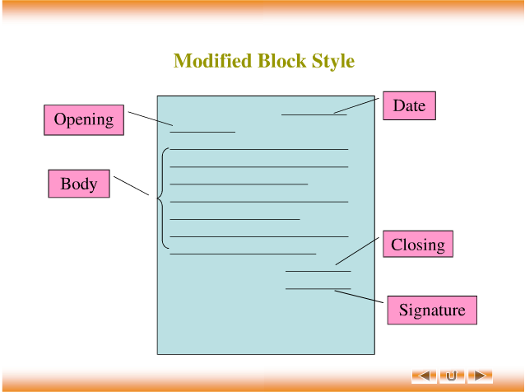

Slide 11
Tenses:(时态)
一般现在时
现在进行时
一般将来时
一般过去时

Slide 12
一般现在时 （经常发生的动作）
标志词：always, usually, often, sometimes, seldom, never,every
动词的变化：只有第三人称单数的时候发生变化
当主语是第三人称单数的时候，谓语动词：
1.多数在谓语动词后面加s play-plays
2.以s,x,ch,sh结尾时要加es watch-watches
3.以辅音字母加y结尾时，改y为i加es fly—flies
4.以元音字母加y结尾时，直接加s buy-buys
5.不规则变化 have—has

Slide 13
现在进行时 （正在进行的动作）
标志词：now，listen，look，it's+时间
表示正在进行的动作
结构：be+ving
be：am，are，is
I am watching TV.
She is doing her homework.

Slide 14
一般将来时 （将来某一时刻发生的动作）
标志词：tomorrow，next，soon
结构：1.be going to do
2.will+动词原型
I will do my homework after class.

Slide 15
一般过去时 （过去某个时间发生的动作）
标志词：yesterday，last，this moring，before，in last year（in 2001/last summer）
用法：表示过去某个时间发生的动作或存在的状态。
动词过去式的变化规则：
1.一般在动词末尾加ed 如：watch-watched
2.结尾是e的直接加d 如：taste-tasted
3.末尾只有一个元音字母和一个辅音字母的重度闭音节，应双写末尾的辅音字母再加ed stop-stopped
4.以“辅音字母+y结尾”，改y为i加ed 如：study-studied
不规则动词的过去式
are-were am/is-was do-did go-went say-said
have，has-had think-thought

Slide 16
一般过去式的用法
1.be动词在过去式中的变化
A. am和is变成was （否定形式：was not=wasn't）
eg：I am a student.我是一名学生。
I was a student.我之前是一名学生。
B. are 变成were （否定形式：were not=weren't）
eg：We were not students.我们都不再是学生了。
You were not a child. 你不再是一个小孩。
C.一般疑问句：把was were调到句首。

Slide 17
2.行为动词在一般过去式中的变化
A.否定句：didn't+动词原形
eg: Jim didn't go home yesterday.
B.一般疑问句：在句首加did，句子中的动词过去式变为原形。
eg：Did Jim go home yesterday?
C.特殊疑问句:（1）疑问词+did+动词原形？
eg: What did Jim do yesterday?
（2）疑问词当主语时：疑问词|+动词过去式
eg：Who went to school yesterday?

Slide 18
Think about the questions?
1. Where is Wang Jun?
2. What was the weather like in the morning?
3. When did the sky turn blue and the sun come out?
4. What was the weather like at lunchtime?
5. What does Wang Jun think of England's weather?

Slide 19
1.is-was 表示过去
eg：Yesterday（昨天） was
2.something 某事 （不定代词）形容词修饰它时要放在形容词后面
如：something important（重要的事），something interesting（有趣的事情）
3.weather report 天气预报
temperature 1.温度，气温 2.高温，高烧 3.体温
（1）询问温度是多少 What's the temperture?
（2）回答 It's 14 degrees.
4.only 只，仅仅
(1)与the连用，表示“唯一的”eg：John is the only boy in his family.
(2)做副词，表示“只，仅仅”eg: The temperture is only 5 degree.

Slide 20
5.put on=wear 穿上，穿
区别：put on是指穿的动作 eg：put on a coat wear是指穿的状态。eg：He wears a jacket.
6.lots of= a lot of =plenty of 很多，大量
7.before在...之前 after 在...之后
eg:我在上学之前吃了早餐。
I went to school before I had my breakfast.

Slide 21
8.change 改变，变化，兑换零钱
eg：We can not change the past(过去).
I want to change some money.
9.go away 走开，离开
10.turn 转，转变，变成
turn on 打开（电器）turn on the light
turn off 关闭（电器）turn off the light
11.start 动身，开始+Ving/to do
eg: Let's start working.
I start to work hard.

Slide 22
12.then 然后
13lunchtime 午餐时间 at lunchtime
14.It was raining hard.雨下的很大。hard adj 努力的，困难的，猛烈的，辛苦的，硬的 eg：work hard 努力工作， study hard 努力学习
15. finish 完成 +Ving/n
eg:在午饭前，他读完了那本书。
He finished that book before lunch.
I finish my homework at 10 a.m.
a.m 上午
p.m.下午

Slide 23
16.具体几点之前要用介词 at
eg：at 6o'clock at 5.30
17.there be 句型 有....
桌子上有几本书。
There are several/some books on the desk.
教师里有5个学生和两名老师。
There are five students and two teacher in the classroom.
18.ture 真实的，正确的。

Slide 24
Discussion
Why the weather in England is so changable?

Slide 25
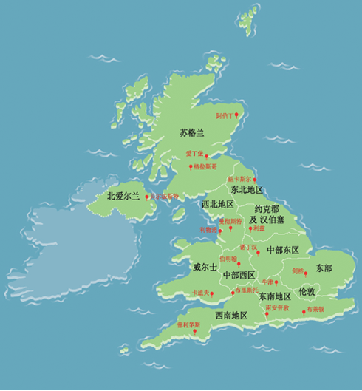
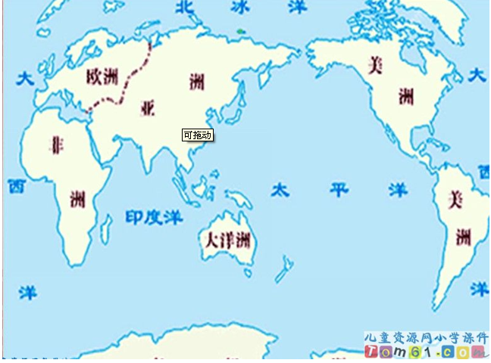
英语处于欧洲西部，大西洋东岸，是一个气候温和的国家。

Slide 26
雾气较重，主要是岛国的潮气所致。英国天气变化无常。一日之内，时晴时雨。多变的天气也为人们提供了日常的话题，在英国无论男女老少，甚至最沉默寡言的人也喜欢谈论天气。

Slide 27
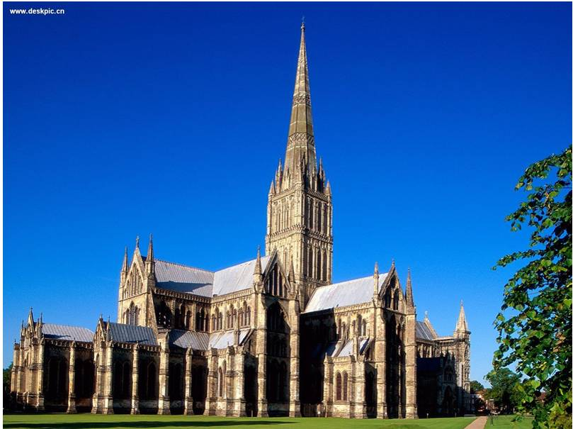
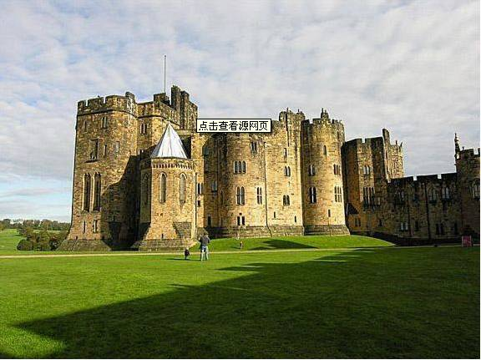
爱丁堡城堡

Slide 28
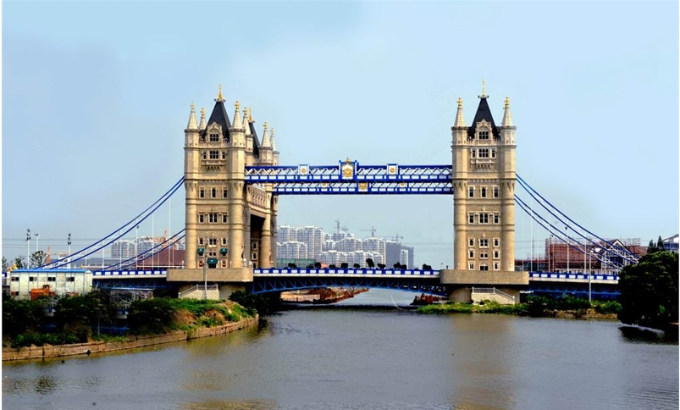
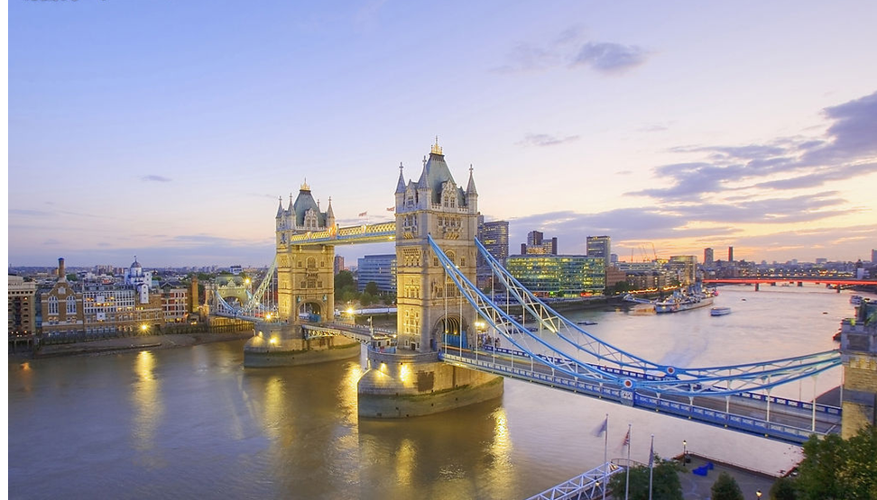
伦敦塔桥

Slide 29
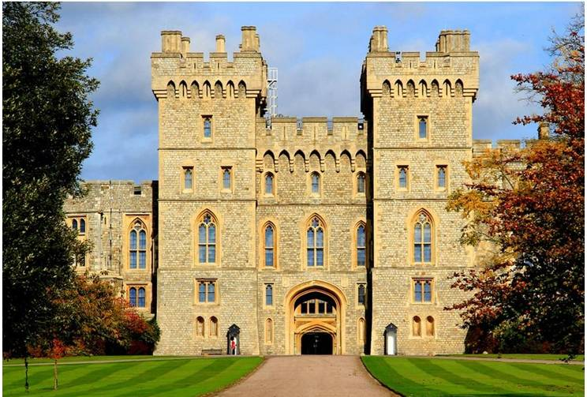
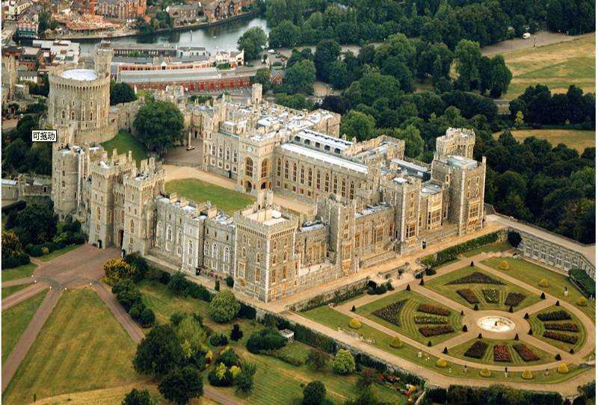

Slide 30
