Slide 1
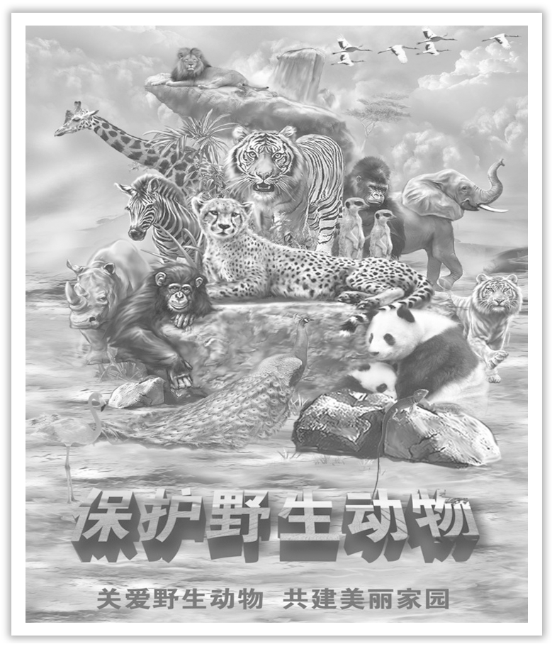
Unit 2 Wildlife Protection
Section Ⅱ Reading and Thinking(1)
WWW.PPT818.COM

Slide 2
1.Discussing—Look at the following pictures and answer the questions.

Slide 3
(1)What do you know about the animals in the picture?
______________________________________________________________________
(2)Why are these animals hunted?
______________________________________________________________________
2.Predicting—Look at the pictures and the title on Page 16 and predict what the text is probably about.
______________________________________________________________________
The animals are hunted illegally by some people.
Because their fur or skin are rare and hunters can make money.
The text is probably about the Tibetan antelope.

Slide 4
1.First reading—Match the main idea of each part.
Part 1(Para.1-2) A.The reason for Zhaxi saving animals.
Part 2(Para.3) B.What I thought about wildlife protection.
Part 3(Para.4-6) C.What we saw on the plain and my feeling about antelopes.
Part 4(Para.7) D.The bad time for antelopes and the government’s protection
programmes.
答案 Part 1 C Part 2 A Part 3 D Part 4 B

Slide 5
2.Second reading—Choose the best answer according to the text.
(1)Why did the author and his friends go to the Changtang National Nature Reserve?
A.To climb the mountains. B.To enjoy the beautiful scenery.
C.To watch Tibetan antelopes. D.To catch the man who hunt antelopes.
(2)Some people hunt antelopes ________.
A.for their valuable fur
B.to protect other animals
C.because of their mass population
D.to practise their hunting skills

Slide 6
(3)What can be inferred from the last but one paragraph?
A.The Tibetan antelope species is still endangered.
B.The antelopes has been moved out of the reserve.
C.The government has stopped protecting antelopes.
D.The threats to the antelope still exist.
(4)What’s the author’s attitude towards the wildlife protection?
A.Unconcerned. B.Positive.
C.Negative. D.Unmentioned.
答案 (1)C (2)A (3)D (4)B

Slide 7
3.Third reading—Read the passage again and discuss the following questions.
(1)How can we change our ways of life to protect the planet?
①___________________________________________________________________；
②___________________________________________________________________；
③___________________________________________________________________；
④___________________________________________________________________.
(2)What do you think of Zhaxi, the guide of the author?
Zhaxi is a _______________________________________________________ villager.
Never eat the meat of wild animals
Never buy any goods made of rare animals
Reduce the damage to the animals’ habitats
Protecting animals under the government’s direction
kind, devoted, strong-willed, kind-hearted and cooperative

Slide 8
As a middle school student, what do you think you should do to protect wildlife?
________________________________________________________________________
________________________________________________________________________
________________________________________________________________________
First, we must learn about the laws about protecting wildlife.Second, we can tell our families and others not to do harm to wildlife and buy any goods made of animals’ fur or bones.Third, we must protect the wildlife’s habitats as possible as we can.

Slide 9
阅读技巧点拨
如何理解句子的字面意义和隐含意义？
1.字面意义：根据所掌握的单词和短语的基本意义，通过直译法理解句子的字面意义。
2.隐含意义：根据上下文解释或说明推测；根据已有知识推测；根据文章大意推测。

Slide 10
语言现象感知
Ⅰ.单词理解
体会句中加黑词(语)的词性和含义
1.On the plain in front of us, we can just make out a herd of graceful animals.____________
2.This is why we’re here—to observe Tibetan antelopes.____________
3.Hunters were shooting antelopes to make profits.____________
4. The antelope population has recovered...____________
看清
v.观察
n.利润
v.恢复

Slide 11
Ⅱ.词块积累
写出下列词块的含义
1.disappear into clouds________________
2.be struck by their beauty__________________
3.be reminded of the danger________________
4.place it under national protection______________________
5.watch over the antelopes________________
6.keep them safe from attacks__________________
耸入云端
被它们的美丽打动
被提醒危险
把它置于国家保护之下
守护藏羚羊
保护它们不受袭击

Slide 12
Ⅲ.句式欣赏
1.why引导表语从句
This is why we’re here—to observe Tibetan antelopes.
2.only＋状语(从句)置于句首，主句用部分倒装
Only when we learn to exist in harmony with nature can we stop being a threat to wildlife and to our planet.

