Slide 1
Module2 My home town and my country
Unit1 It’s taller than many other buildings.
WWW.PPT818.COM

Slide 2
学习目标
一、掌握以下单词hill, population, wide, million, than, north等。
二、掌握并运用单音节形容词的比较级。
三、掌握句子的断句，听懂有关叙事内容的对话。
四、能正确运用比较级比较两个地方的不同。

Slide 3
Free talk
1. Did you go to other cities? What are they?
2. Do you know anything about
the big cities in China?
3. Which city do you like best?

Slide 4
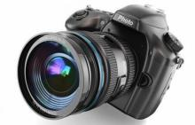
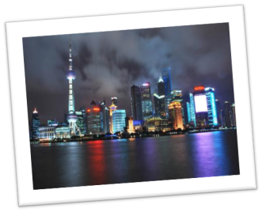
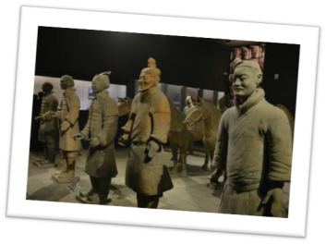
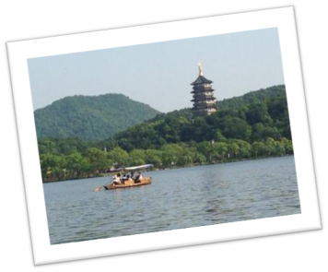
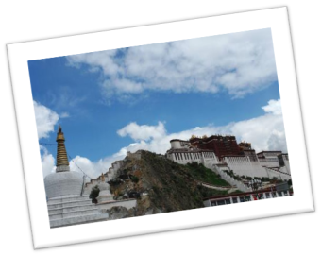
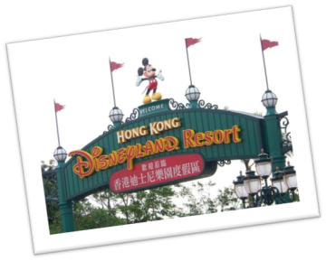
Shanghai
Xi’an
（点击照相机，出现图片）
Lhasa
Hong Kong
Hangzhou

Slide 5
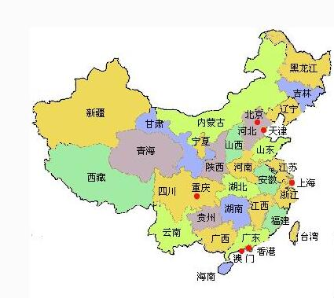
Where is Shanghai and Hong Kong in this map?

Slide 6
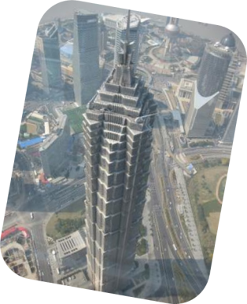
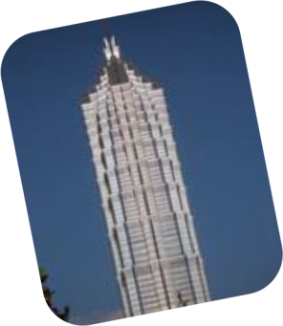
Enjoy some pictures
Jin Mao Tower, in Shanghai

Slide 7
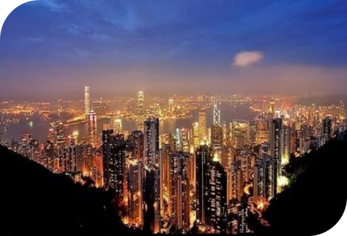
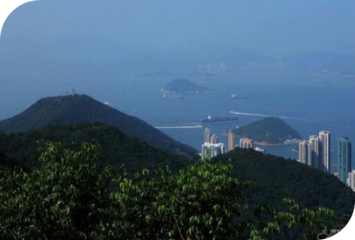
Victoria Peak , in Hong Kong

Slide 8
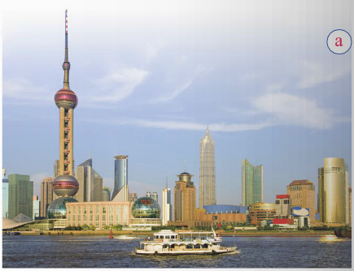
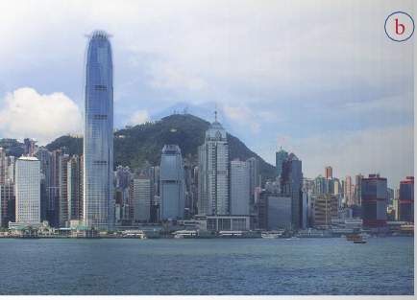
Listening
1 Look at the pictures and talk about them. Use the words in the box to help you.
high hill population river wide
Victoria Peak
Jin Mao Tower

Slide 9
Listen and complete
Place: (1)_______________
Population: (2)_______ million
Jin Mao Tower: (3) _______ metres high
Place: (4)___________
Population: (5)________ million
Victoria Peak: (6) ______ metres high
Shanghai
23.5
420.5
Hong Kong
seven
552

Slide 10
2
Task1: Listen and answer.
1) Which city are they talking about?
They’re talking about Shenzhen.
2) What famous building does it have?
It has a famous building—Diwang Tower.

Slide 11
Task2: Listen again and complete.
Thirty years ago | It was a _______________.
Now | It is a _______________.It’s getting ________and _________.The ___________ of Shenzhen is ______ten million. That’s larger than _____________________________ in China. Its streets are______________ __________________________
Some day | It will become ____________ Hong Kong.
a small village
a very new city
bigger
busier
population
over
the population of many other cities
much wider and
cleaner too.
as busy as

Slide 12
Task2: Find out the sentences of comparative degree.
1. It’s a newer city than Hong Kong.
2. It’s getting bigger and busier.
3. That’s larger than the population of many other cities in China.
4. Its streets are much wider and cleaner too.
5. It’s taller than many other buildings in Shenzhen.
1.规则形容词比较级的变化规则是什么?
2. 比较级的句型结构?

Slide 13
探索与发现
1.规则形容词比较级的变化规则：
new
wide
big
busy
newer
比较级，要变化，一般词尾加er。
wider
词尾若有不发音的e, 直接加r就可以。
bigger
重读闭音节，单辅音字母要双写。
busier
辅音字母若加y, 记得把y变为i。

Slide 14
2.比较级的句型结构：
A + be +形容词比较级 + than + B.
意为“A比B更……”。
例：
1.姚明比成龙高。
2.青岛比深圳大。
Yao Ming is taller than Jackie Chan.
Qingdao is bigger than Shenzhen.

Slide 15
Role-play
两人一组，表演课文对话。

Slide 16
Practice
Now complete the passage about Shenzhen.
地理位置
Shenzhen is on the coast near Hong Kong. It became important in the (1) . Before that it was a (2) ____________. Today the population of Shenzhen is more than (3) ____million. There are many tall buildings in Shenzhen. A famous one is the (4) _____________. It is (5) ______than many other buildings in Shenzhen.
人口规模
1980s
small village
ten
Diwang Tower
taller
标志性建筑

Slide 17
Complete the sentences with the correct form of the words in the box.
3
big busy clean large new small wide
1. About thirty years ago, Shenzhen was a_____ village, but
today it is a very city.
2. It is a ______ city than Hong Kong.
3. It is getting _____ and _____. The streets are _____
and ______.
4. It will become as _______ as Hong Kong.
5. The population is ______ than that of many other cities in China.
small
big/large
newer
bigger
busier
wider
cleaner
busy
larger

Slide 18
4
Listen to the underlined word.
1－Shenzhen is bigger in population than Beijing.
－No, it isn’t. It’s smaller.
2－Hong Kong is newer than Shenzhen.
－No, it isn’t. It’s older.
3－Shenzhen is as old as Hong Kong.
－No, it isn’t. It’s newer.
4－Hong Kong is as busy as Shenzhen.
－No, it isn’t. It’s busier.
In English, sentence stress is very important. We stress key words, which give the main information and the main ideas.

Slide 19
Group work
Work in groups. Talk about the differences between Shenzhen and your home town.
 | Shenzhen | Your home town
location
old/new/hot/cold /big/small/wide/narrow
population
famous buildings
…

Slide 20
Summary
hill
population
wide
核心词汇
Unit1
million, pretty, than, get
How was your weekend?
核心句型
Pretty good!
So it’s a newer city than Hong Kong.
Some day it will become as busy as Hong Kong.
What’s the population of Shenzhen?
Its streets are much wider and cleaner too.

Slide 21
Homework
1. 完成 Unit1 随堂练习。
2.编对话，用形容词的比较级比较你的家乡和北京的不同。

