Slide 1
Christmas is coming
WWW.PPT818.COM

Slide 2
本课时目标：
1. 学生能听说读以下新词：
May, July, September, October, Mother's Day, Teachers' Day, Halloween, Spring Festival, Summer holiday, spring, summer, holiday.
2. 学习跟节日有关的动词词组，如：go on holiday, help mum do housework, give teachers cards等等。
3. 学生能使用以下句型询问别人什么节日喜欢做什么事情的问答
（1） What do you like doing for...? （+节日名称）
I / We like .... He / She likes .... （+节日有关的动词词组）
（2） What does he/she like doing for…?
He / She likes ….

Slide 3
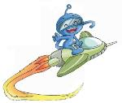
Let’s chant
Bright day, sunny day. I am happy and gay.
Mr Yates, Mr Yates, today is my birthday.
Please come to the party in my yard.
And don't forget my birthday card.

Slide 4
（Greeting时询问学生：What's the date today?引出要复习的月份，由已学的月份引出新的月份单词。）
Let’s review
January
February
December
March
November
months
April
October
May
September
June
August
July

Slide 5
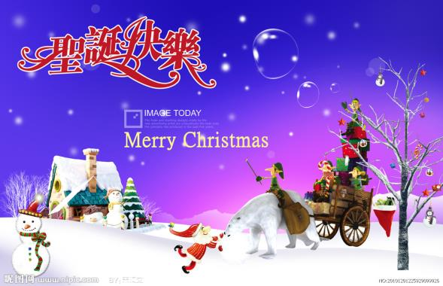
(本环节让学生看图片，回答老师的问题，为下文猜节日做铺垫。）
(1) What festival is it?
(2) When is Christmas?

Slide 6
Let’s guess!
（承接上一部分，学生猜出是圣诞节，也说出圣诞节所在月份后，老师出谜语学生猜要学的新节日,老师可以给点提示。五个不同的节日用不同的形式呈现。）
T：Can you guess which holiday is in May?
Tips: It's a holiday for our mothers.
You can give flowers to your mothers.
Mother's Day

Slide 7
Listen to the song. What holiday is it?
Spring Festival

Slide 8
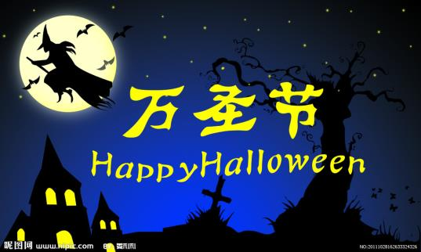
Look at the picture.
What holiday is it?
Halloween

Slide 9
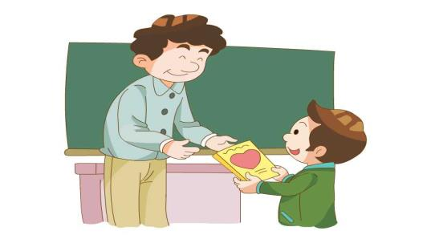
Look at the picture.
What holiday is it?
Teachers' Day

Slide 10
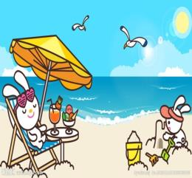
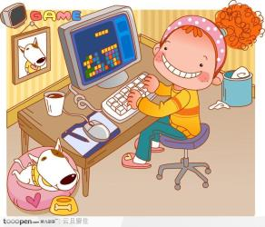
Children like this holiday very much.
They can do lots of things.
What holiday is it?
=many
summer holiday

Slide 11
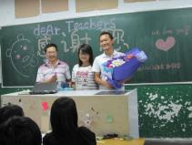
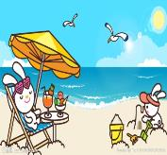
A: When is Mother’s Day?
B: It's in May.
(由这个问答句，引出每个节日所在的月份。游戏可设计为：老师说月份，学生说节日，再调换。）
December
May
January
February
October
September
July

Slide 12
Let's match!
A: When is____?
B: It's in ______.
January
February
Teachers' Day
May
Spring Festival
July
Halloween
September
Mother's Day
October
summer holiday

Slide 13
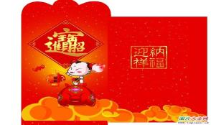
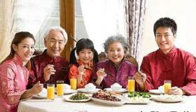
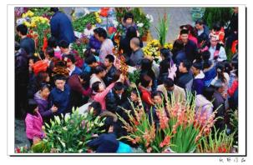
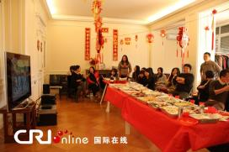
A: What do you like doing for Spring Festival?
B: I like
（这几部分的对话可分多种形式操练。）
getting lucky money
having a big family dinner
watching TV
going to the flower fair

Slide 14
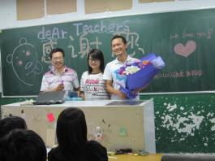
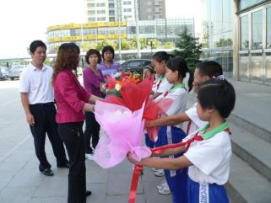
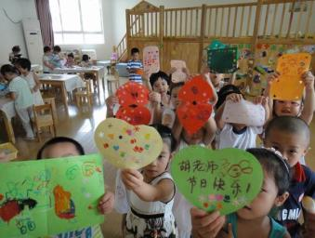
A: What do you like doing for Teachers' Day?
B: I like
having a party for the teachers
giving teachers flowers
giving teachers cards

Slide 15
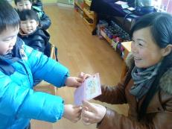
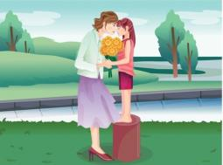
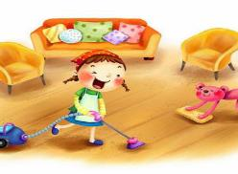
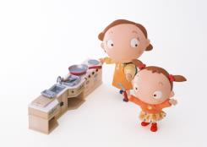
A: What do you like doing for Mother's Day?
B: I like
making a card for mum
giving mum flowers
cooking for mum
helping mum do housework

Slide 16
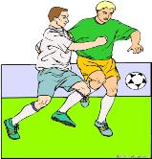
A: What do you like doing for summer holidays?
B: I like
playing computer games
going on holiday
visiting friends
reading books
playing sports
watching TV

Slide 17
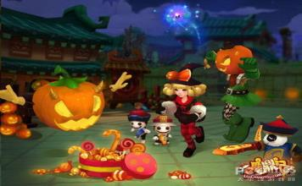
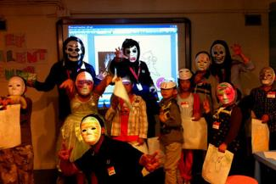
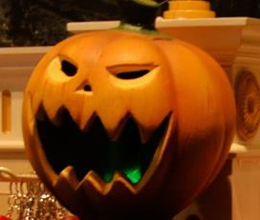
A: What do you like doing for Halloween?
B: I like
asking for sweets
wearing masks
making pumpkin lanterns

Slide 18
Do a survey.
holidays name | Mother’s Day | Teachers’ Day | Halloween | summer holiday | Spring Festival
(四人小组活动，运用所学句型完成此表格。选一个最喜欢节日，并说出该节日喜欢做什么事情。）

Slide 19
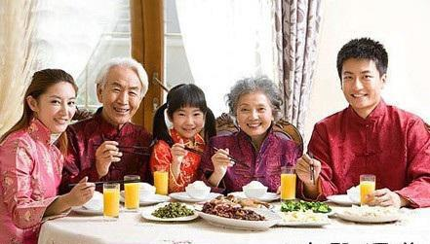
A: What do they like doing for Spring Festival?
B: They like having a big family dinner.

Slide 20
A: What do they like doing for Halloween?
B: They like asking for sweets.

Slide 21
A: What does she like doing for Mother’s Day?
B: She likes helping mum do housework.

Slide 22
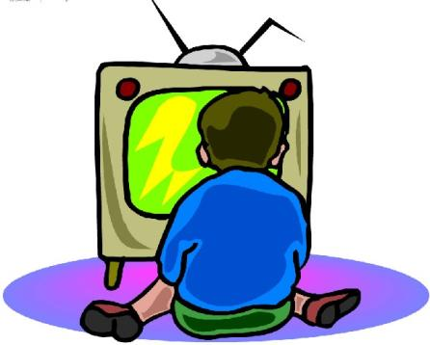
A: What does he like doing for summer holidays?
B: He likes watching TV.

Slide 23
A: What does he like doing for Mother’s Day?
B: He likes making a card for mum.

Slide 24
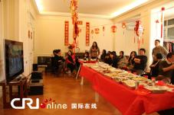
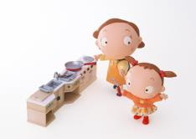
A: What does he/she like doing for_______?
B: He/She likes ________.

Slide 25
Homework:
1.仿照例子写3个句子。
如：Halloween is in October, I like asking for sweets.
2.向朋友口头描述自己喜欢的节日及节日活动。

