Slide 1
Unit 1 Friends
WWW.PPT818.COM

Slide 2
预习检测
an honest boy
1.一个诚实的男孩______________________
2. 分享我的快乐________________________
3. 使你的朋友如此特别______________________________
4. 保密____________________________
5. 干净整洁_____________________
6. 一个好看且幽默的女孩_______________________________
7. 什么样的人适合做好朋友呢？_________________________
8.关心______________
9.有更多一些食物_______________________
10.一些喝的东西______________________
11.相信他说的话（1）______________________
(2)________________________
12.撒谎____________________
13.讲滑稽的笑话_____________________
share my joy
make your friend so special
keep a secret/secrets
clean and tidy
a good-looking and humorous girl
what makes good friends
care about
have some more food
something to drink
believe what he says
believe his words
tell a lie /lies
tell funny jokes

Slide 3
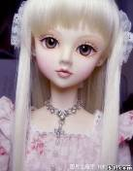
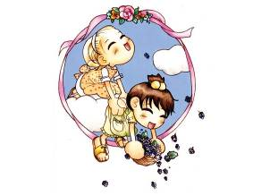
Free talk
1. Do you have a good friend?
2. What is your friend like?
3.Why do you choose him/her as your friend ?

Slide 4
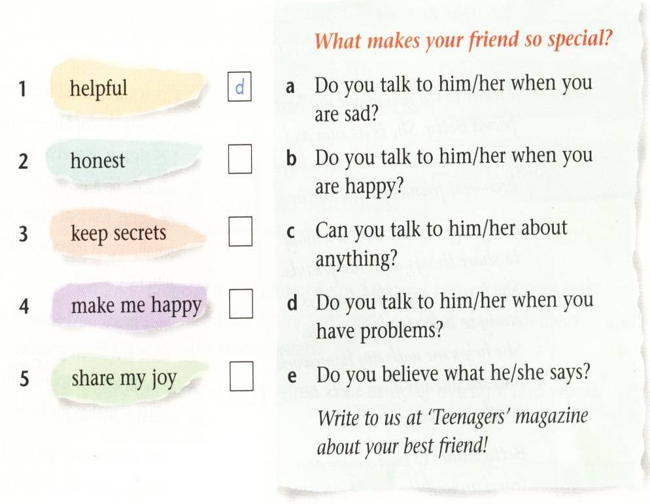
What makes your friend so special?
Does he/she care about you
when you are sad?
e
Do you talk to him/her when
you are happy?
c
Can you tell him/her
everything about yourself?
a
Is he/she ready to help when
you have problems?
Do you believe what he /she
says?
b
Write to Teenagers magazine about your best friend!

Slide 5
What qualities are important in good friends?
funny
clever
friendly
honest
helpful
kind
polite
clean
tidy
beautiful
good-looking
humorous
It is very important for my friend to be ….
It is quite important for my friend to be ….
It is not important for my friend to be ….
My good friends should be…

Slide 6
Listen and answer:
Why should good friends be honest?
Why should good friends be interesting?
What qualities do Daniel and Amy think are important in good friends?
Because we can trust them and they never tell lies.
Because they can tell funny jokes.
Honest, interesting and helpful.

Slide 7
Make a similar dialogue :
A: What makes good friends, …?
B: I think good friends should be …
You can … …
A: Yes, that’s …
I think good friends should be …,too.
They can… …
B: Yes, that’s…/ I agree.

Slide 8
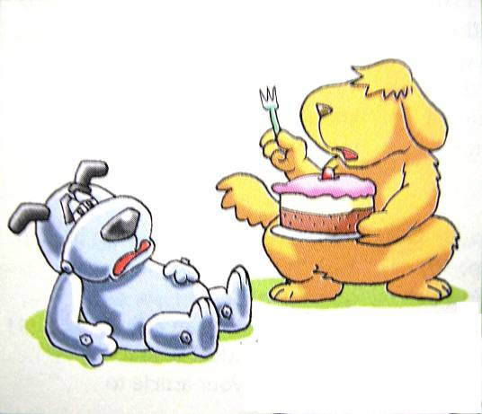
Why does Hobo choose Eddie as his friend?

Slide 9
Read and answer more questions

Slide 10
(1) Hobo is hungry.What does Eddie give him ?
(2) Does Hobo want to have something to drink? What is it?
(3) What else does Hobo want?
(4) Is there anything else in the fridge?
(5) Will Eddie share his pizza with hobo?Can you guess?
Some pieces of cake.
Yes, some milk.
He wants some more food.
No, there is nothing in the fridge.

Slide 11
Act the dialogue

Slide 12
Language points
1.Can I have something to drink?
something to eat
eg. What about __________ _____ ______?(吃的东西)
There is _________ _____ _____ (坏了) my computer.
There ____ ________ _________ in today’s newspaper.
今天报纸上没有任何有趣的内容。
something wrong with
isn’t anything interesting
类似的还有：
Something, nothing, anything ,everything
_____one,______body (动词用单数)

Slide 13
2.Can I have some more food ?
这里more为形容词，意为“另外的，超过的” 置于数词或any,some,no,a few,a little,many,much等词后面。
（1）I’m very hungry ,can I have _____ _____ /______ ______cakes?(再吃两块蛋糕)
(2) He has _____ _____ friends than I .(多得多的)
two more
another two
many more

Slide 14
能再给我三分钟吗?
=another three
Can you give me three more minutes?
请再去叫一些同学来.
Please go and call some more students.
你还有什么要说的吗?
Do you have anything more to say?

Slide 15
3. What makes your friend so special ?
“make +宾语+宾语补足语”意为“使得---怎么样”
The bad news made him ______________. (伤心)
What do you think _____ the baby _____ last night?(使---哭)
4. Is he ready to help when you have problems?
problem 意为被提出有待解决的问题，特别指疑难的、困难的。如令人困惑的问题或事。question是需要回答的、带有问号的问题。如: have problems with sth./have problems (in) doing
I _____ ______ _____ _______English .（学英语碰到困难）
He always _____ ___________ _______ his homework.
5. Do you believe what he/she says ?
sad/unhappy
made cry
have problems in learning
has problems with
(相信他们说的)
Do you believe his/her words?

Slide 16
我不相信他昨天说的话.
I don’t believe what he said yesterday
他的话总是很滑稽
What he says is always very funny.
His words are always very funny.

Slide 17
Homework:
Write a story about
yourself.

Slide 18
Thank you

