Slide 1
Unit 7 Lesson 3
They will say “Happy Spring Festival!”
WWW.PPT818.COM

Slide 2
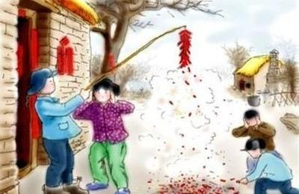
--What do you usually do at the Spring Festival?
--We…
.

Slide 3
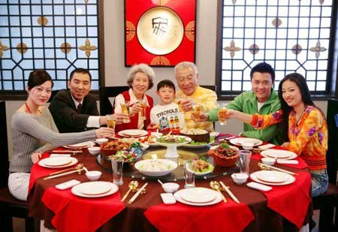

Slide 4
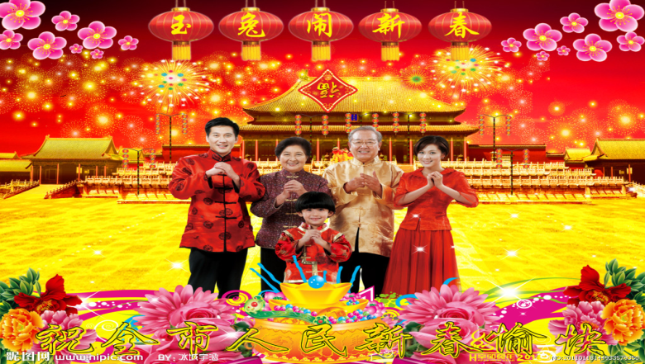

Slide 5
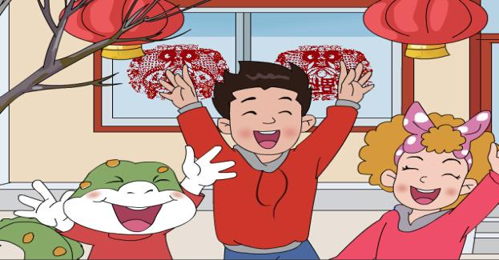
Why are Jenny and Danny excited?

Slide 6
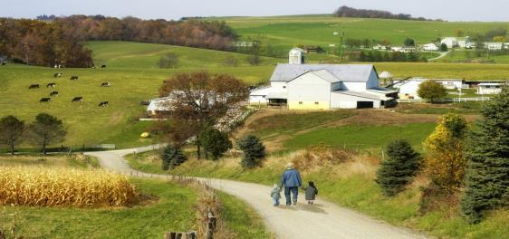
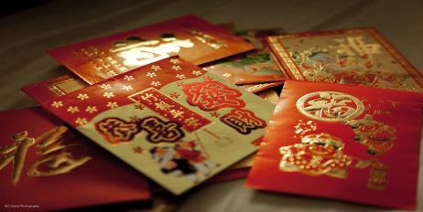
country
Lucky money

Slide 7
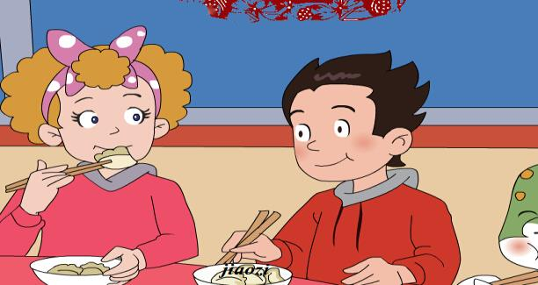
What will they do to welcome the new year?

Slide 8
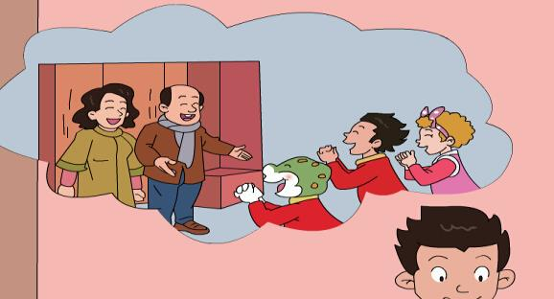
What will they do early the next morning?

Slide 9
Exercise
We’ll get _____,not from santa.
Early the next morning ,they Will _______.
They will have the _______.They are very excited.
On the eve of the Chinese New Year ,they will eat ______.
Spring Festival B. lucky money
C. eat jiaozi D. wear new clothes

Slide 10
Let’s write
eat set off get wear say
Hi, Lucy. I’m in the country with Li Ming’s family. We’ll _______ jiaozi on the eve of Chinese New Year. And then we’ll _______ fireworks. Early the next morning , we’ll _______ new clothes. And we’ll _______ “Happy Spring Festival”to relatives and friends. we’ll ______ lucky money .

Slide 11
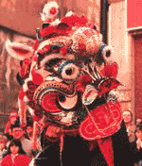
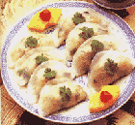
Homework:
Read the essay.
Do the workbook .

